Slide 1
Structure of sd shell Λ hypernuclei with antisymmetrized molecular dynamic
Masahiro Isaka (RIKEN)

Slide 2
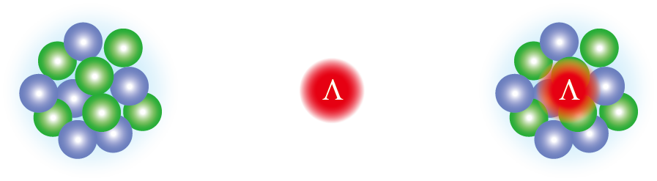
Grand challenges of hypernuclear physics
  2 body interaction between baryons (nucleon, hyperon)
    hyperon-nucleon (YN)
    hyperon-hyperon (YY)
  Addition of hyperon(s) shows us new features of nuclear structure
  Ex.) Structure change by hyperon(s)
    No Pauli exclusion between N and Y
    YN interaction is different from NN
Interaction: To understand baryon-baryon interaction
A major issue in hypernuclear physics
Structure: To understand many-body system of nucleons and hyperon
“Hyperon as an impurity in nuclei”
+
Λ hypernucleus
Normal nucleus
As an impurity
Today’s talk: “Structure change by a Λ particle”

Slide 3
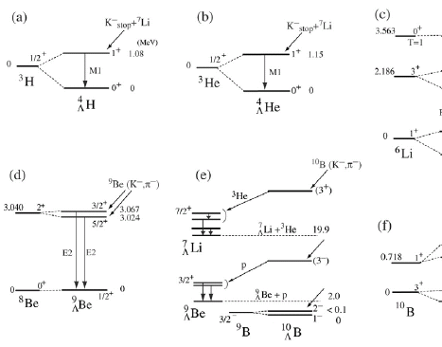
Recent achievements in (hyper)nuclear physics
Knowledge of ΛN interaction
  Study of light (s, p-shell) Λ hypernuclei
    Accurate solution of few-body problems ^{[1]}
    ΛN G-matrix effective interactions ^{[2]}
    Increases of experimental information ^{[3]}
Development of theoretical models
  Through the study of unstable nuclei
  Ex.: Antisymmetrized Molecular Dynamics (AMD)^{[4]}
      AMD can describe dynamical changes of various structure
      No assumption on clustering and deformation
Recent developments enable us to study structure of Λ hypernuclei
[1] E. Hiyama, NPA 805 (2008), 190c, [2] Y. Yamamoto, et al., PTP Suppl. 117 (1994), 361.,
[3] O. Hashimoto and H. Tamura, PPNP 57 (2006), 564., [4] Y. Kanada-En’yo et al., PTP 93 (1995), 115.

Slide 4
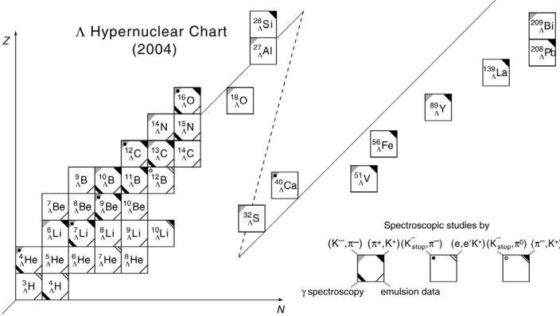
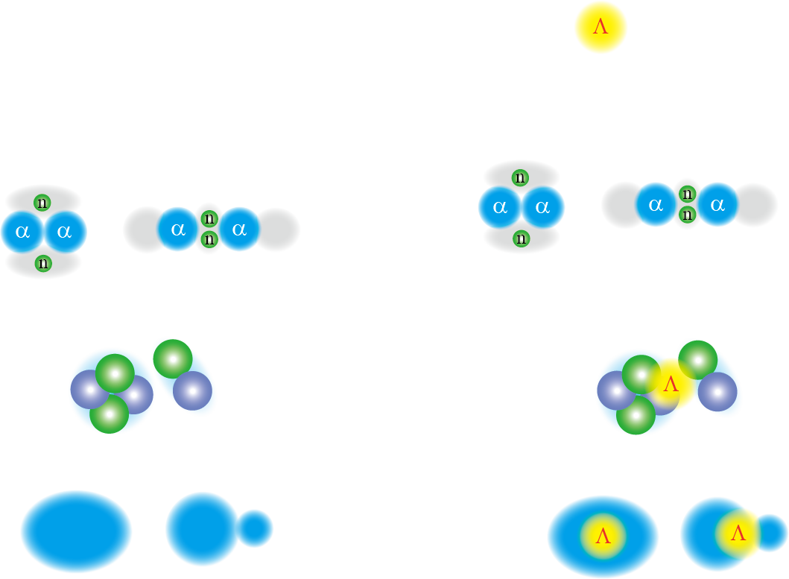
Structure of Λ hypernuclei
Λ hypernuclei observed so far
  Concentrated in light Λ hypernuclei
  Most of them have well pronounced cluster structure
Light Λ hypernuclei
Developed cluster
Taken from O. Hashimoto and H. Tamura, PPNP 57(2006),564.

Slide 5
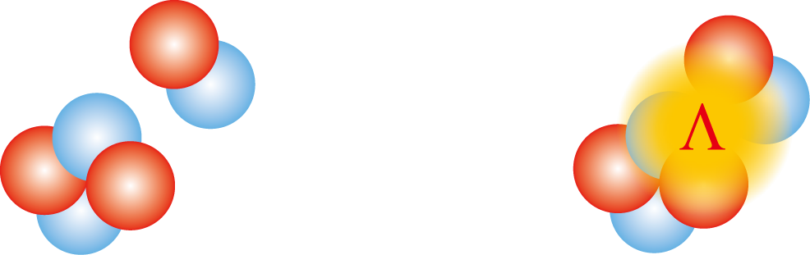
Structure of Λ hypernuclei
Λ hypernuclei observed so far
  Concentrated in light Λ hypernuclei
  Most of them have well pronounced cluster structure
Changes of cluster structure
7
Li
Example:
Λ
T. Motoba, et al., PTP 70,189 (1983)
E. Hiyama, et al., PRC 59 (1999), 2351.
K. Tanida, et al., PRL 86 (2001), 1982.
⁶Li
7
Li
Λ
Light Λ hypernuclei
Adding Λ
Developed cluster
d
α
Λ reduces inter-cluster distance between α + d
Confirmed through B(E2) reduction
Taken from O. Hashimoto and H. Tamura, PPNP 57(2006),564.

Slide 6
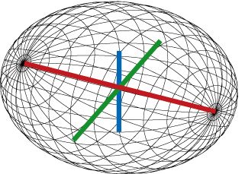
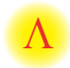
Toward heavier and exotic Λ hypernuclei
Experiments at J-PARC, JLab and Mainz etc.
  sd shell Λ hypernuclei can be produced
  Various structures will appear in hypernuclei
p-sd shell region
Coexistence of
structures
Ex.: ²¹_{Λ}Ne
sd shell region
Light Λ hypernuclei
Various deformations
Developed cluster
Ex.: ²⁵_{Λ}Mg
+
Triaxial deformation
Taken from O. Hashimoto and H. Tamura, PPNP 57(2006),564.

Slide 7
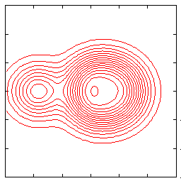
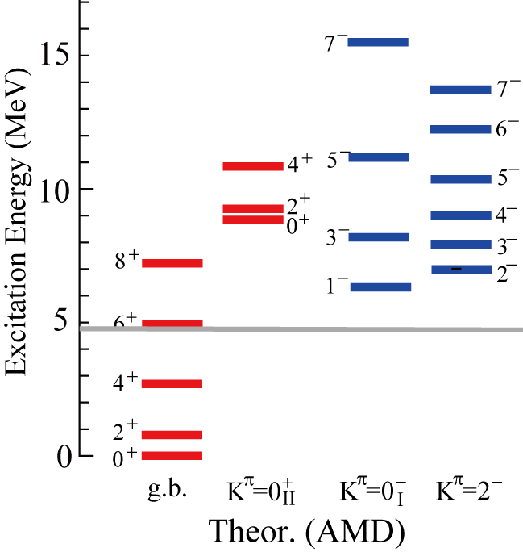
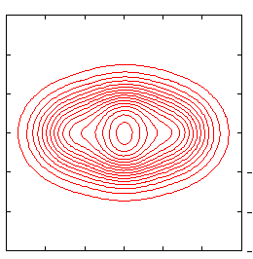
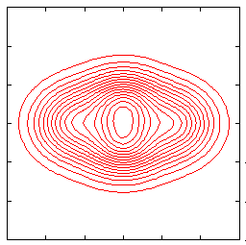
Stricture of p-sd shell nuclei
Ex.) ²⁰Ne
Mean-field like and α + ¹⁶O cluster structures coexist within the small excitation energy
²⁰Ne
α + ¹⁶O
Mean-field
1⁻
2⁻
cf. ⁷_{Λ}Li (α + d + Λ)
⁶Li
⁷_{Λ}Li
0⁺(g.s.)
Adding Λ
d
Mean-field structure also contributes
α
Λ reduces the α + d distance
What is difference in structure changes by adding a Λ particle ?

Slide 8
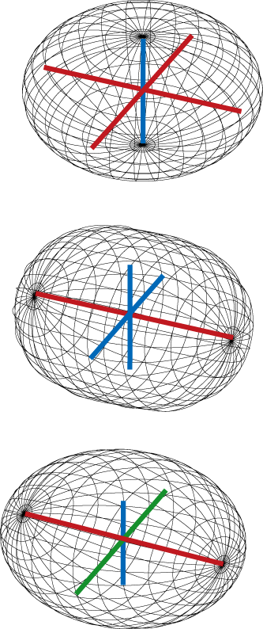
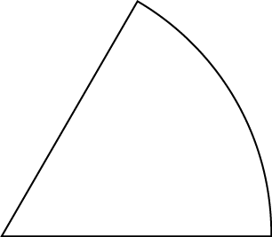
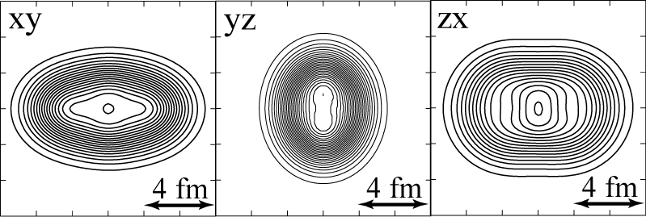
Deformation of nuclei
  Many nuclei manifests various quadrupole deformation
  Most of them are prolate or oblate deformed (axially symmetric)
(parameterized by quadrupole deformation parameters β and γ )
60◦
γ
Middle
γ = 60◦
Oblate
γ ≈ 30◦
Long
Short
Triaxial
0
0◦
Lightest candidate: Mg
β
γ = 0◦
²⁵Mg AMD calc.
Spherical
_{Λ}
Prolate

Slide 9
Toward heavier and exotic Λ hypernuclei
“Structure of Λ hypernuclei”
How does a Λ particle modify structures of p-sd shell/n-rich nuclei ?
p-sd shell region
Coexistence of
structures
Ex.: ²¹_{Λ}Ne
sd shell region
Light Λ hypernuclei
Various deformations
Developed cluster
Ex.: ²⁵_{Λ}Mg
+
Triaxial deformation
Our method: antisymmetrized molecular dynamics (AMD)
Taken from O. Hashimoto and H. Tamura, PPNP 57(2006),564.

Slide 10
Theoretical Framework: HyperAMD
M.Isaka, et al., PRC83(2011) 044323
M. Isaka, et al., PRC83(2011) 054304
  We extended the AMD to hypernuclei
  HyperAMD (Antisymmetrized Molecular Dynamics for hypernuclei)
Hamiltonian
    NN：Gogny D1S
    ΛN：YNG interactions (NF, NSC97f, ESC08c)
Wave function
Nucleon part：Slater determinant
Spatial part of single particle w.f. is
described as Gaussian packet
Single-particle w.f. of Λ hyperon:
Superposition of Gaussian packets
Total w.f.：

Slide 11
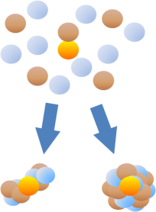
Theoretical Framework: HyperAMD
M.Isaka, et al., PRC83(2011) 044323
M. Isaka, et al., PRC83(2011) 054304
Procedure of the calculation
Variational Calculation
Imaginary time development method
Variational parameters:
Λ
Initial w.f.: randomly generated
Energy variation
Λ
Λ
Various deformations
and/or cluster structure

Slide 12
Theoretical Framework: HyperAMD
M.Isaka, et al., PRC83(2011) 044323
M. Isaka, et al., PRC83(2011) 054304
Procedure of the calculation
Variational Calculation
Imaginary time development method
Variational parameters:
Angular Momentum Projection
Generator Coordinate Method(GCM)
Superposition of the w.f. with different configuration
Diagonalization of and

Slide 13
Coexistence of shell-model like and cluster structures
What is the difference of structure changes ?
Examples: ²¹_{Λ}Ne (Theoretical prediction)
Based on
M. Isaka, M. Kimura, A. Dote, and A. Ohnishi, PRC83, 054304(2011)

Slide 14
Structure of ²⁰Ne
  Various structures coexist in the ground and low-energy states
  Example：²¹_{Λ}Ne
    K^{π}=0_{I}⁺ band ・・・ (intermediate state)⊗Λ
    K^{π}=0⁻ band ・・・ (well developed α + ¹⁶O clustering)⊗Λ
²⁰Ne(AMD)
0⁺(g.s.)
K^{π}=0_{Ι}⁺ band
(ground band)
Intermediate state
1⁻
K^{π}=0⁻ band
Well developed α + ¹⁶O clustering
Any differences in Λ binding energy and reduction of the radius ?

Slide 15
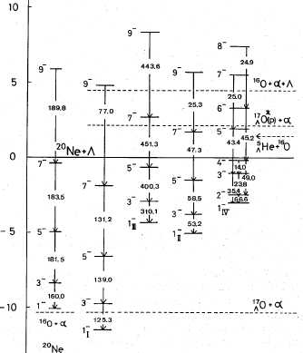
Structure of ²¹_{Λ}Ne (Preceding Study)
Structure study of ²¹_{Λ}Ne hypernucleus
  α + ¹⁶O + Λ cluster model
  “glue-like role of Λ”
      Λ hyperon stabilizes α + ¹⁶O bands
      Λ hyperon reduces the RMS radius
  “Parity Coupling (inter-shell coupling) ”
      Mixing of Λ in p orbit component in K^{π}=0⁻ ⊗Λ state,
      because K^{π}=0⁺ and K^{π}=0⁻ bands are in the same energy region
T. Yamada, K. Ikeda, H. Bandō and T. Motoba, Prog. Theor. Phys. 71 (1984), 985.
MeV
B(E2) reduction
    By comparing the K^{π} = 0⁺ and K^{π} = 0⁻ bands,
    Λ hyperon coupled to the g.s. is more deeply bound.
    B(E2) reduction is similar to each other(20 % reduction).

Slide 16
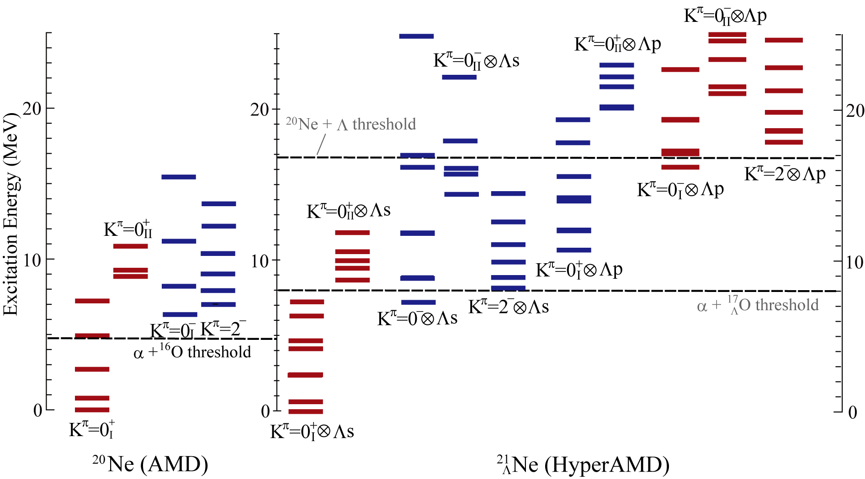
Results：energy spectra of ²¹_{Λ}Ne
K^{π}=0⁻⊗Λ(s)
K^{π}=0⁻
(developed α + O)
K^{π}=0_{I}⁺
(intermediate)
K^{π}=0_{I}⁺⊗Λ(s)

Slide 17
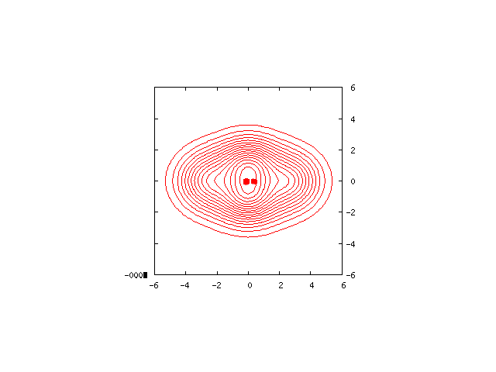
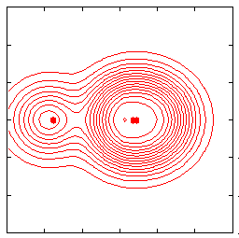
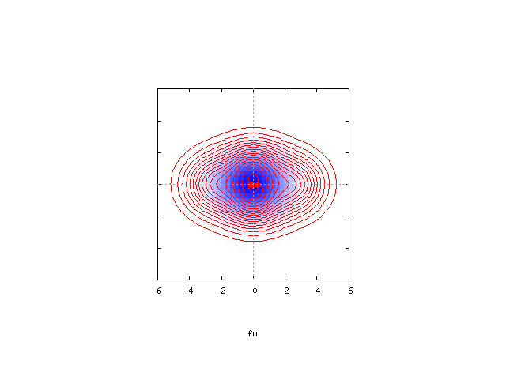
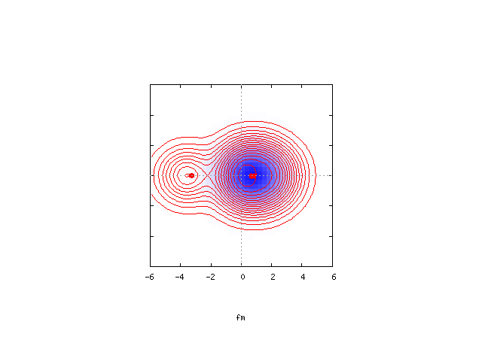
Structure dependence：Λ binding energy
  Λ particle coupled to the intermediate state is more deeply bound than that coupled to the well developed α + ¹⁶O state
  Λ is localized around ¹⁶O cluster in the α + ¹⁶O + Λ cluster state.
shallow binding in the α + ¹⁶O state
K^{π}=0_{I}⁺ band
K^{π}=0⁻ band
²⁰Ne
0⁺
1⁻
B_{Λ}=16.9 MeV
B_{Λ}=15.9 MeV
²¹_{Λ}Ne
1/2⁻
1/2⁺

Slide 18
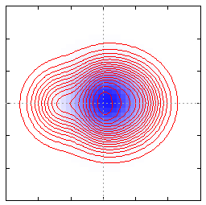

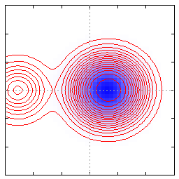
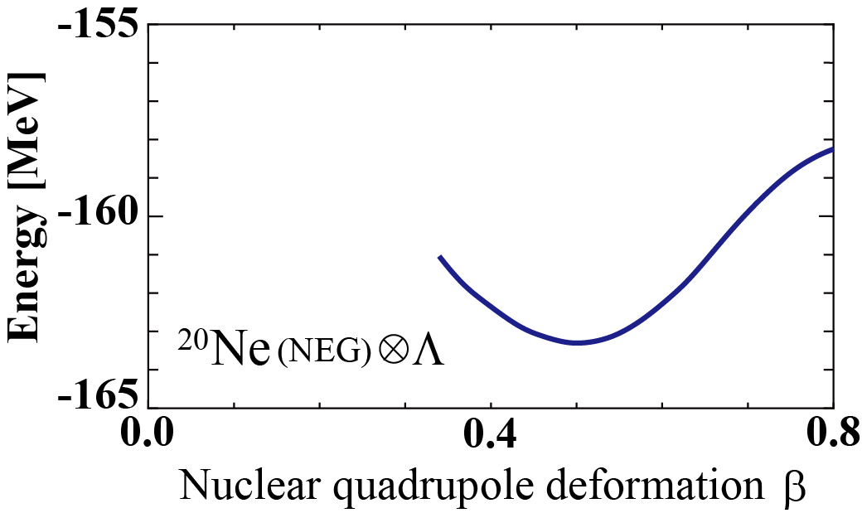
α + ¹⁶O + Λ states
  Λ prefers the ¹⁶O cluster, because B_{Λ} in ¹⁷_{Λ}O is larger than in ⁵_{Λ}He

Slide 19
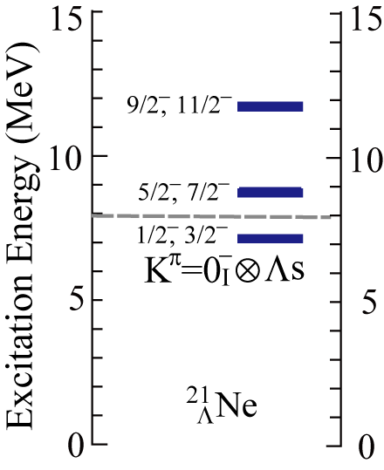
Parity Coupling: Contribution of Λ in p orbit
  Λ is localized round the ¹⁶O cluster in the cluster states
  Λ in p orbit component also mixed by the GCM calculation,
  because K^{π}=0⁺ and K^{π}=0⁻ bands are in the same energy region
it is not eigen state of parity
Λ in p orbit contribution due to asymmetry of α + ¹⁶O structure
K^{π}=0⁻⊗Λ(s)：about 90％
1/2⁻
K^{π}=0_{I}⁺⊗Λ(p)：about 10％

Slide 20
Structure dependence：nuclear radius
Nuclear RMS radii
  Reduction of RMS radii of the developed α + O states is larger
  than that of the intermediate states.
This is mainly due to the reduction of inter-cluster distance
K^{π}=0_{I}⁺ band
(intermediate)
K^{π}=0⁻ band
(α + ¹⁶O cluster)
0⁺(g.s.)
1/2⁺
1⁻
1/2⁻
²⁰Ne
²¹_{Λ}Ne
²⁰Ne
²¹_{Λ}Ne

Slide 21
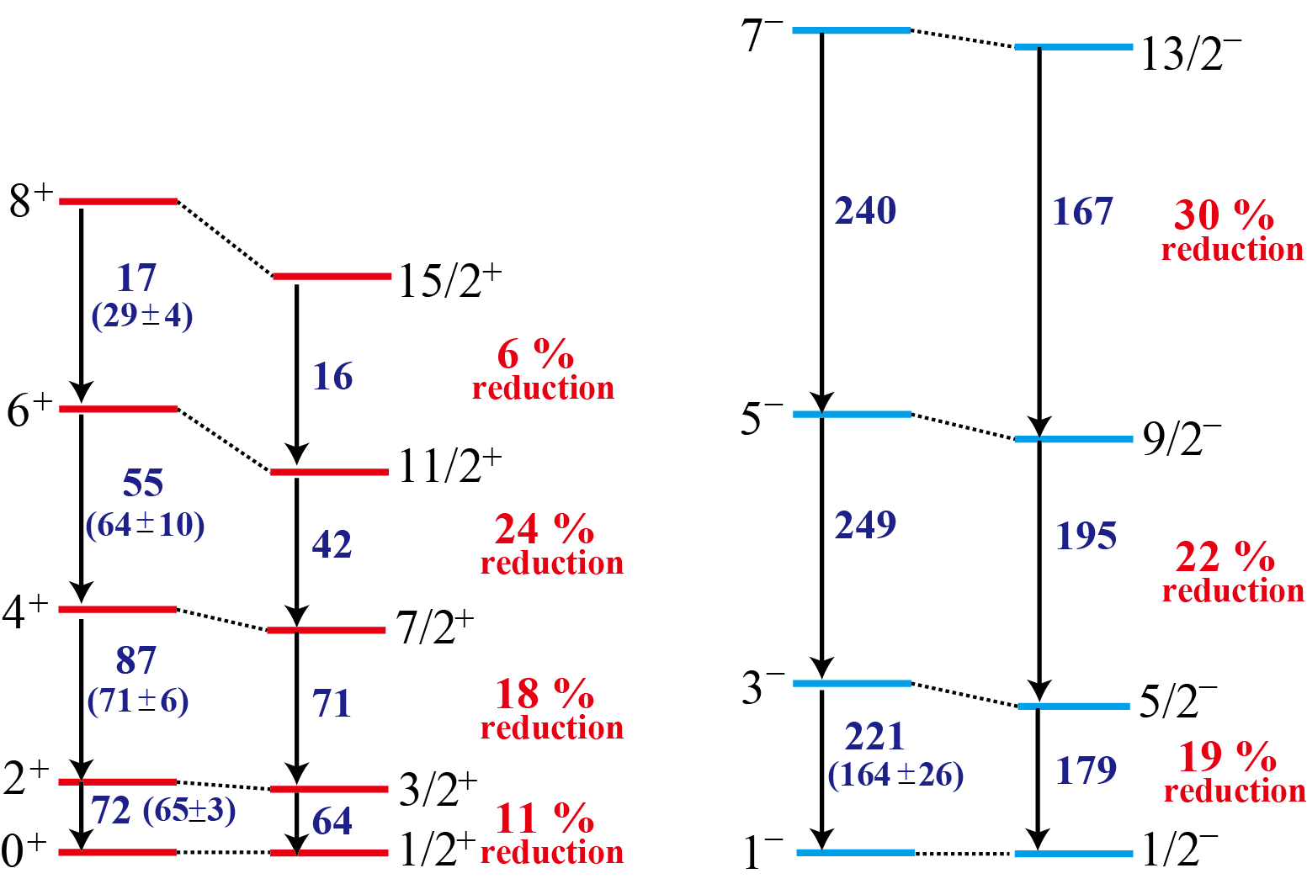
Results: B(E2) reduction
Intra-band B(E2) values
K^{π}=0_{I}⁺ band
(Intermediate)
K^{π}=0⁻ band
(Pronounced α + ¹⁶O)
Larger B(E2) reduction in the K^{π}=0⁻ band

Slide 22
Coexistence of
Various Deformation
How does a Λ particle modify triaxial deformation
and affect excitation spectra?
Examples: ²⁵_{Λ}Mg (Theoretical prediction)
Triaxial deformation
cf. Prolate deformation
M. I., M. Kimura, A. Dote and A. Ohnishi, PRC 85 (2012), 034303.

Slide 23
Deformation of nuclei
  Many nuclei manifests various quadrupole deformation
  Most of them are prolate or oblate deformed (axially symmetric)
(parameterized by quadrupole deformation parameters β and γ )
60◦
γ
Middle
γ = 60◦
Oblate
γ ≈ 30◦
Long
Short
Triaxial
0
0◦
Lightest candidate: Mg
β
γ = 0◦
Spherical
Prolate

Slide 24
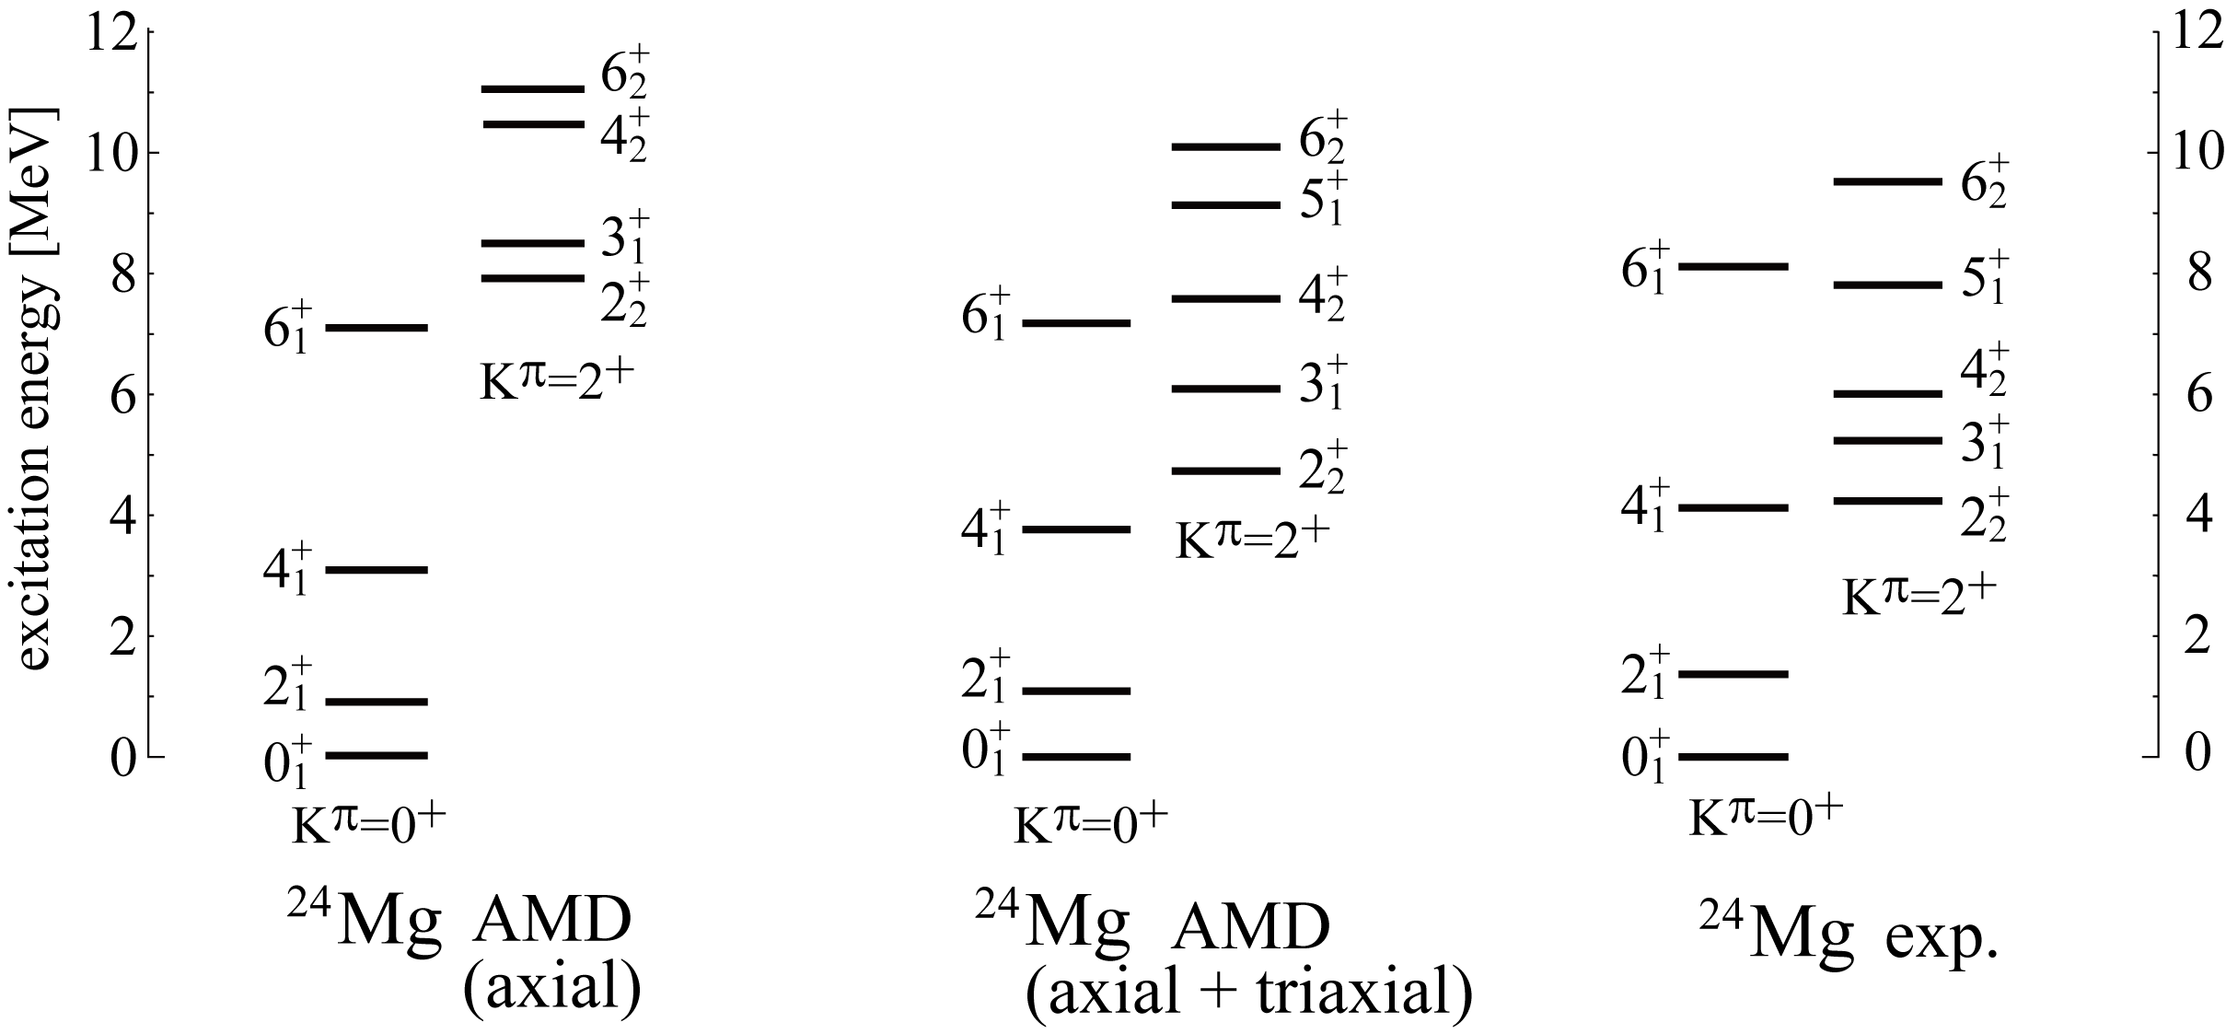
Structure of ²⁴Mg
Large deformation ・・・ Candidate of triaxial deformed nuclei
Excitation energy of K^{π}=2⁺ band depends on the triaxial deformation ^{[1,2]}
[1] M. Bender and P-H. Heenen, Phys. Rev. C78, 024309 (2008).
[2] M. Kimura, R. Yoshida and M.Isaka, Prog. Theor. Phys. 127 , 287(2011).

Slide 25
Structure of ²⁴Mg
Large deformation ・・・ Candidate of triaxial deformed nuclei
Excitation energy of K^{π}=2⁺ band depends on the triaxial deformation ^{[1,2]}
Ex
Ex
Ex
K^{π} = 2⁺ band is rigid against the exclusion of the triaxial deformation
How does Λ modify triaxial deformation of ²⁴Mg ?
[1] M. Bender and P-H. Heenen, Phys. Rev. C78, 024309 (2008).
[2] M. Kimura, R. Yoshida and M.Isaka, Prog. Theor. Phys. 127 , 287(2011).

Slide 26
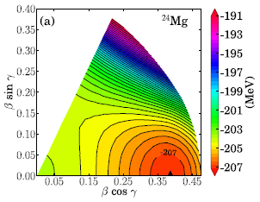
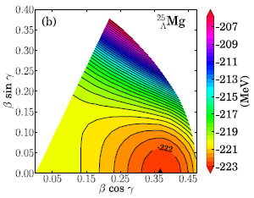
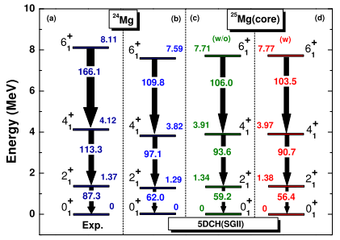
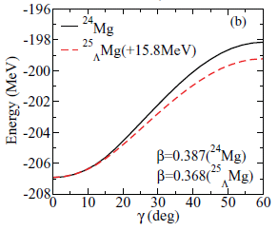
Predictions for ²⁵_{Λ}Mg
  Predicted Structure changes by Λ (in s-orbit)
  Energy surface becomes slightly soft against γ deformation
  Λ reduces the deformation and stretches the level spacing of the ground band
Myaing Thi Win, et al., Phys. Rev. C83, 014301 (2011).
J. M. Yao, et al., Nucl. Phys. A868 (2011), 12.
In triaxially deformed nuclei, responses to the Λ participation would be different from axially symmetric nuclei

Slide 27
Individual Problem (²⁵_{Λ}Mg)
Purpose of this study
  To reveal how Λ hyperon affects the triaxial deformation and observables such as excitation energies
  Example：²⁵_{Λ}Mg
    K^{π} = 0⁺⊗Λ(s) band ・・・ (ground band of ²⁴Mg) ⊗Λ(s orbit)
    K^{π} = 2⁺ ⊗Λ(s) band ・・・ (K^{π}=2⁺ band of ²⁴Mg) ⊗Λ(s orbit)

Slide 28
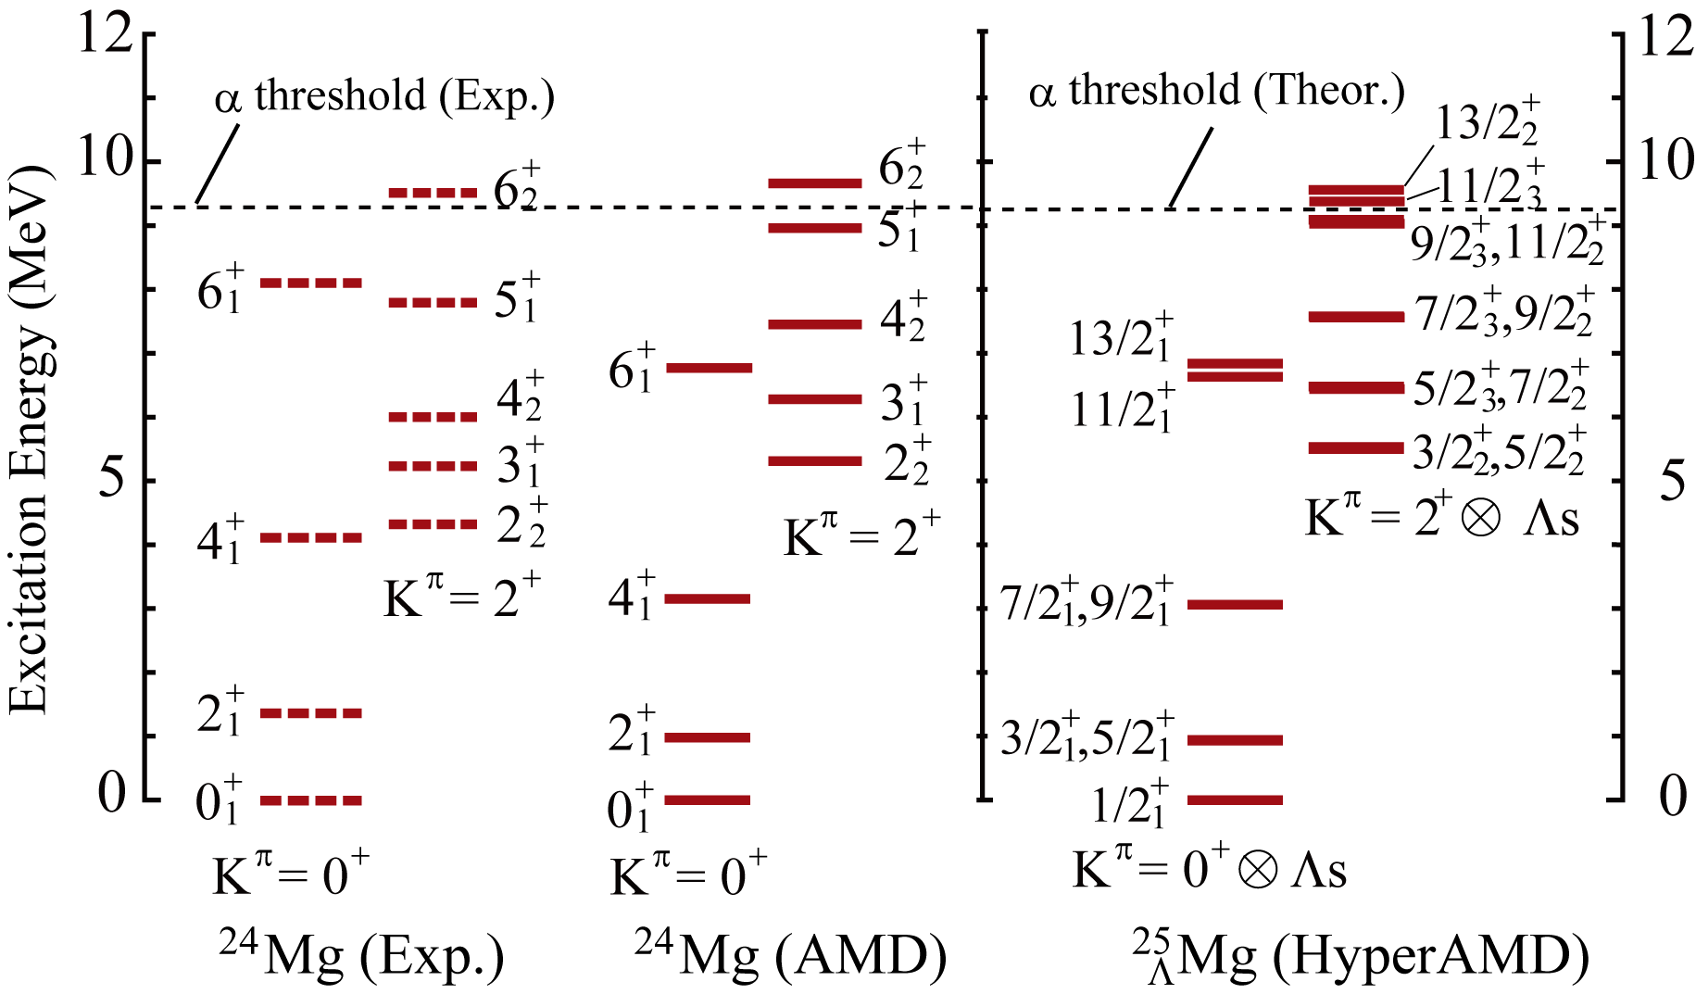
Results: Excitation spectra of ²⁵_{Λ}Mg
200keV
Excitation energy of K^{π}=2⁺⊗Λ_{s} band is shifted up by about 200 keV

Slide 29
Results: Reasons for the shift up
Difference of the Λ binding energy B_{Λ}
  B_{Λ} for the K^{π}=0⁺⊗Λ_{s} band is larger than that for the K^{π}=2⁺⊗Λ_{s} band
Energy shift of the K^{π}=2⁺⊗Λ_{s} band
²⁴Mg
+
2
2
5.31 MeV
(K^{π}=2⁺)
B_{Λ} = 15.8 MeV
+
0
1
(K^{π}=0⁺)
+
3/2
2
(K^{π}=2⁺⊗Λ_{s})
B_{Λ} = 16.0 MeV
5.53 MeV
+
1/2
1
(K^{π}=0⁺⊗Λ_{s})
25
Mg
Λ

Slide 30
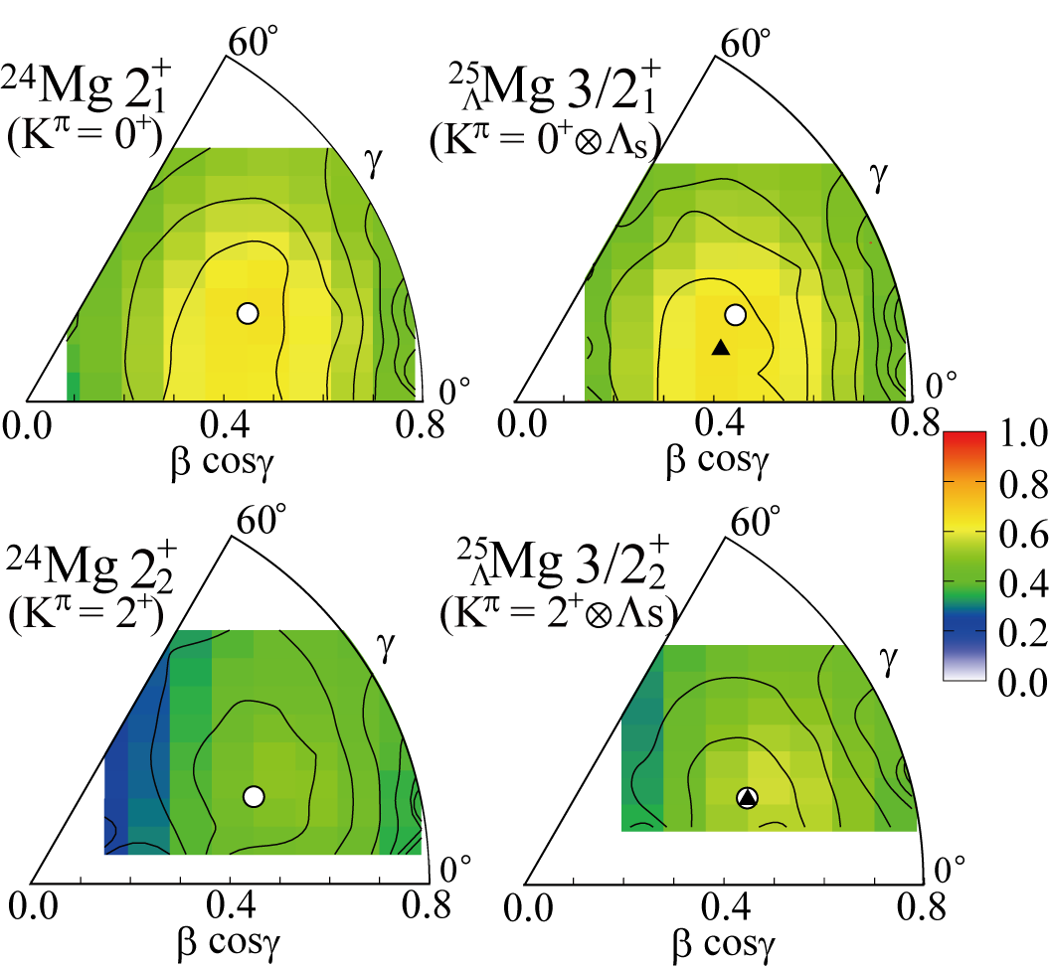
Results: Deformation change by Λ hyperon
  Large B_{Λ} of the K^{π}=0⁺⊗Λ_{s} band is due to the smaller deformation
  Λ reduces the (β, γ) deformation in the K^{π}=0⁺⊗Λ_{s} band,
  while the deformation of the K^{π}=2⁺⊗Λ_{s} band is almost unchanged
Changes of GCM overlap

Slide 31
Results: Deformation change by Λ particle
  Large B_{Λ} of the K^{π}=0⁺⊗Λ_{s} band is due to the smaller deformation
  Λ reduces the (β, γ) deformation in the K^{π}=0⁺⊗Λ_{s} band,
  while the deformation of the K^{π}=2⁺⊗Λ_{s} band is almost unchanged
Changes of GCM overlap
(β=0.48, γ=21∘) (β=0.43, γ=15∘)
By adding Λ to K^{π} = 0⁺
Unchanged:
(β=0.48, γ=21∘)
By adding Λ to K^{π} = 2⁺

Slide 32
Results: Deformation change by Λ particle
K^{π}=0⁺ band: Energy surface is soft (flat) against the (β, γ) reduction
Deformation is reduced
(slightly) larger B_{Λ}
By adding Λ to K^{π} = 0⁺
K^{π}=2⁺ band: rigid against the deformation change
Deformation is unchanged
By adding Λ to K^{π} = 2⁺

Slide 33
Results: Deformation change by Λ particle
K^{π}=0⁺ band: Energy surface is soft (flat) against the (β, γ) reduction
Reflecting the rigid feature of the K^{π} = 2⁺ band
Deformation is reduced
(slightly) larger B_{Λ}
Ex
Ex
Ex
By adding Λ to K^{π} = 0⁺
K^{π}=2⁺ band: rigid against the deformation change
Deformation is unchanged
By adding Λ to K^{π} = 2⁺

Slide 34
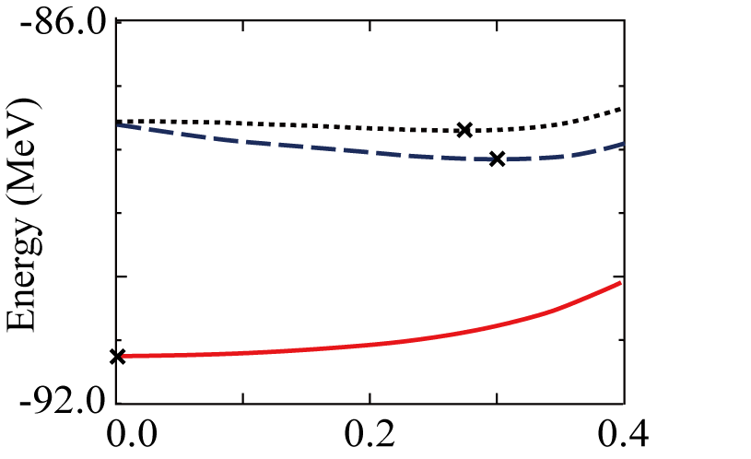
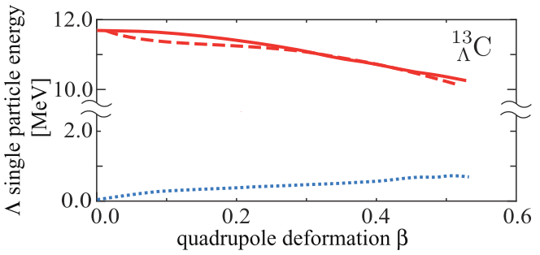
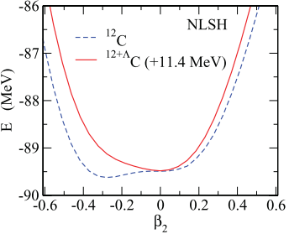
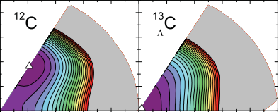
Deformation change by Λ
  Many authors predict the deformation change by Λ in s-orbit
¹³
C (AMD)
_{Λ}
¹²C(Pos.)⊗Λ(s)
¹²C(Neg)⊗Λ(s)
Λ binding energy [MeV]
adding Λ in s-orbit
¹²C(Pos)⊗Λ(p)
Ex.) Deformation change in ¹³_{Λ}C predicted by RMF calc.
Bing-Nan Lu, et al., Phys. Rev. C 84, 014328 (2011)
M. T. Win and K. Hagino, Phys. Rev. C 78, 054311(2008)

Slide 35
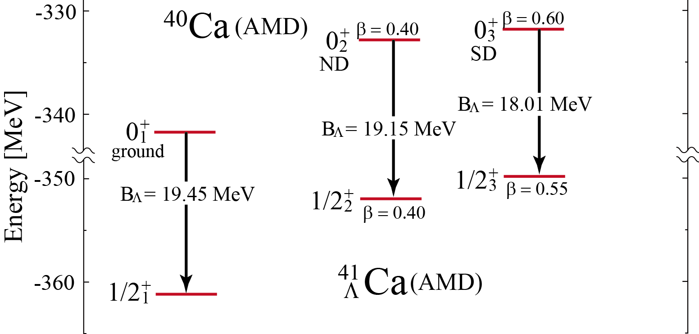
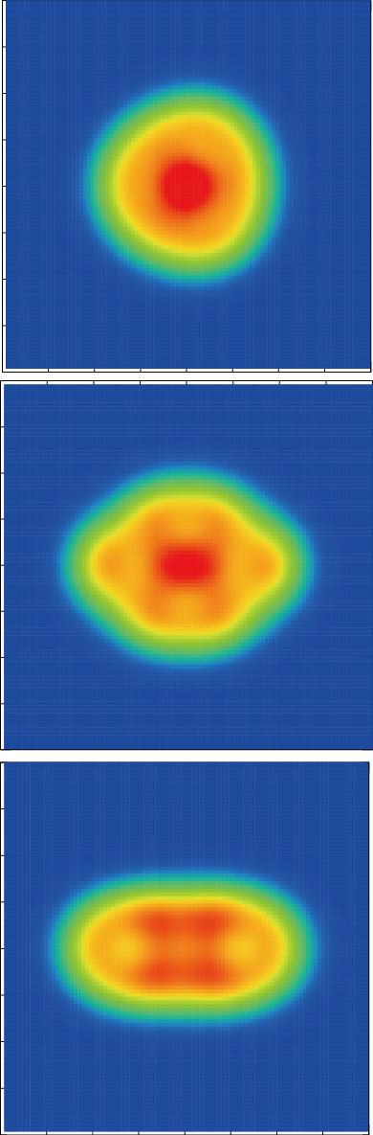
Coexistence of deformations: another example
Difference of B_{Λ} depending on deformation
  B_{Λ} is different in ground, normal deformed and superdeformed states
Smallest
largest
M. Isaka, et al., PRC89, 024310 (2014)

Slide 36
Summary
Summary
  AMD + GCM was used to study deformations of sd shell Λ hypernuclei
²¹_{Λ}Ne: Coexistence of shell and cluster structures
  Small B_{Λ} in α + ¹⁶O + Λ band related to the Parity coupling
  Shrinkage effect is larger in α + ¹⁶O + Λ band than the ground band
²⁵_{Λ}Mg: Changes of triaxial deformation
  B_{Λ} is different between the K^{π}=0⁺ and K^{π}=2⁺ bands,
  while they have almost the same (triaxial) deformation
    This is due to the difference of deformation change
Future plans
  Coexistence of structures in p-sd shell hypernuclei: ¹²_{Λ}C, ¹³_{Λ}C, ¹⁹_{Λ}F
  Difference of B_{Λ} depending on structures --> systematics of B_{Λ}
Large reduction of the B(E2) values in α + ¹⁶O + Λ band

