Slide 1
“Exotic Hadrons” at J-PARC
Strangeness WS at Tokai 2015.8.5
K.Imai

Slide 2
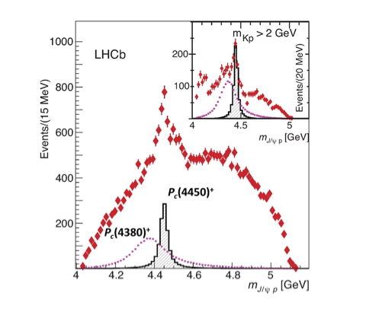
“Exotic hadrons” are no more exotic!!!
X, Y, Z (Tetra-quark or meson molecule?) were firmly established !
Now a Pentaquark
(meson-baryon molecule?) was
reported by LHCb
A dibaryon (ΔΔ) was reported
by COSY

Slide 3
Spectroscopy of “exotic hadrons”
We have to do spectroscopy of exotic hadrons.
Structure of exotic hadrons ???
4,5,6 quarks or hadron molecule?
What determine the width ???
Threshold?
.

Slide 4
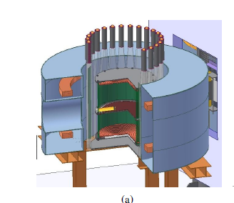
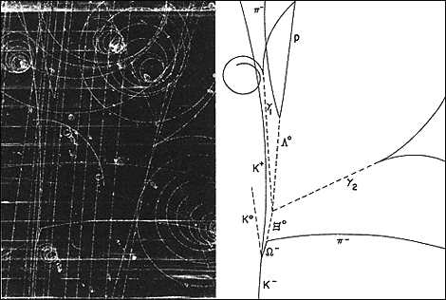
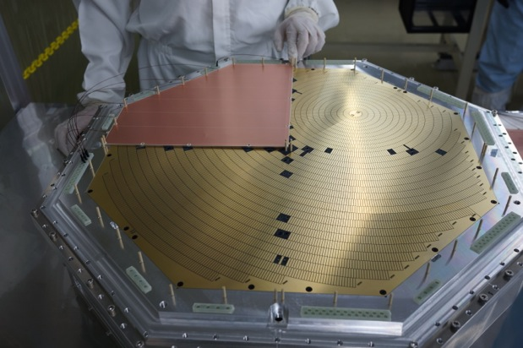
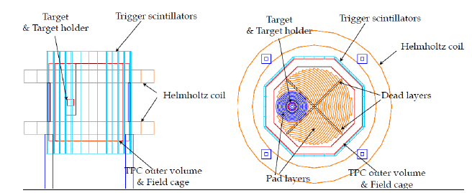
Hyperon spectrometer with TPC (for E42, E45)
Bubble chamber→TPC x10⁶ sensitivity

Slide 5
J-PARC high statistics -> partial wave analysis -> spin-parity, (two poles?) -> structure
Λ(1405) K- N threshold
π-p→ K0 Λ(1405) 10⁶ events. （K1.8)
radiative decay Sekihara S.Hwang
Ξ(1690) K-Σ threshold
K-p→ K+ Ξ(1690) 10⁵ events S.Hwang
Ω(?) Is there a state near K-Ξ threshold ?
( if there is a state below KΞ mass, it is stable against strong decay.)

Slide 6
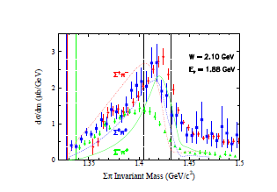
partial wave analysis is necessary on Λ(1405)
higher statistics than Jlab CLASS data

Slide 7
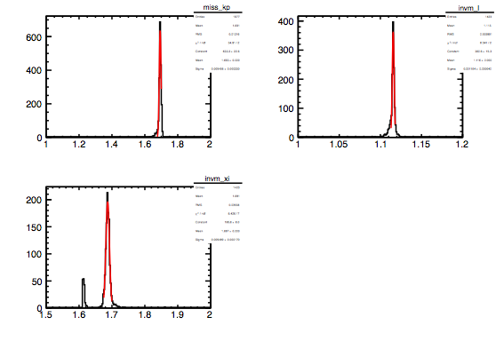
mass spectra 1) Ξ(1690) 2) Λ 3) Ξ*
1)
2
3

Slide 8
Summary
Exotics will be no more exotic
we have to understand their nature and structures.
HypTPC is near completion at JAEA and is very useful to
study “exotic hadrons” . H, L(1405), X(1690)

