Slide 1
Gluon helicity from a universality class of operators on a lattice
Yoshitaka Hatta
(Yukawa Inst., Kyoto U)
arXiv: 1310.4263 with Xiangdong Ji and Yong Zhao
（季向東） （趙勇）
TexPoint fonts used in EMF.
Read the TexPoint manual before you delete this box.: AAAAAAAAAA

Slide 2
Outline
Parton distribution function in QCD
Gluon helicity
Difficulty and strategy to measure on a lattice
Axial gauges

Slide 3
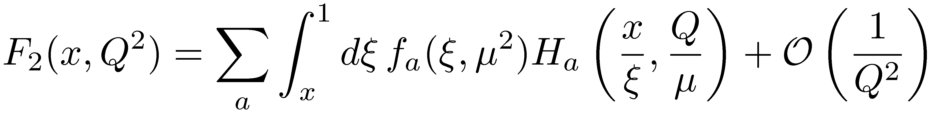
QCD factorization in DIS
parton distribution function,
nonperturbative, universal
hard scattering coefficient,
perturbative

Slide 4
Operator definition
Wilson line
Physical interpretation in the light-cone gauge
Probability to find a parton of flavor and momentum
fraction inside a fast-moving proton.

Slide 5
Measuring PDF on a lattice?
Nonlocal operator along the light-cone
→ Real-time problem
Local operator after taking the moment
For a recent calculation, see, T. Doi, et al., 1312.4816

Slide 6

Polarized gluon distribution and
Number density of right-handed gluons minus left-handed gluons
inside the longitudinally polarized nucleon.
Note that is nonlocal even though it is a x-moment.

Slide 7
Why is interesting?
Decomposition of the nucleon spin
In the naïve quark model,
Polarized quark distribution
The latest value from experiment
``Spin crisis”

Slide 8
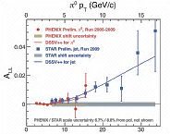
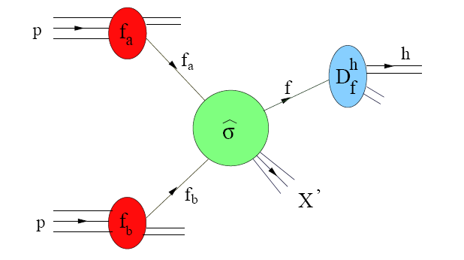
Determination of
PHENIX, STAR, COMPASS, HERMES…
Longitudinal double
spin asymmetry
Latest value
DeFlorian, Sassot
Stratmann, Vogelsang

Slide 9
Towards measuring on a lattice
The `physical part’ of the gauge field Y.H. (2011)
In the light-cone gauge,
is the (textbook) gluon spin operator
used by Jaffe and Manohar (1990).

Slide 10
infinite momentum frame,
gauge invariant, but nonlocal,
impossible to calculate on a lattice.
finite momentum frame,
gauge variant, but local
calculable on a lattice after gauge fixing.
??

Slide 11
Jaffe-Manohar in the Coulomb gauge
Ji, Zhang, Zhao (2013)
Calculate the naive gluon helicity
in the Coulomb gauge →
*
Then consider the infinite momentum frame (IMF) limit
IMF
*
For any 4-vector,

Slide 12

A subtlety
In the infinite momentum limit,
valid at the operator level
BUT
??

Slide 13
The order of limits
The limits and
do not commute due to UV divergences.

Slide 14

One-loop matching
Light-cone gauge
Coulomb gauge
logarithmic dependence!

Slide 15
Generalization
There is nothing special about the Coulomb gauge
For example, try the temporal axial gauge
In this gauge, one can identically write
IMF

Slide 16
One-loop results
Coulomb
axial
axial
covariant
axial

Slide 17

One-loop results
Matching
Coulomb
axial
axial
covariant
axial

Slide 18
A universality class
``fixed point”
IMF
IMF
IMF

Slide 19
Weiszacker-Williams interpretation
Boosted Coulomb field
boost

Slide 20
More on the temporal axial gauge
In the gauge,
Same as in the LC gauge
cf. Wakamatsu (2013)
Why? Because in the gauge is a component
of the topological current, which is a Lorentz vector.
(Forward) Matrix element of perturbatively gauge invariant.

Slide 21
All-order generalization
Gauge dependence due to anomaly can be precisely determined in axial gauges
Balitsky, Braun (1991)
OPE

Slide 22
Zoo of operators
naïve gluon spin!
They all give , and they are all measurable on a lattice

Slide 23
One-loop matching
One-loop matrix elements
in lattice perturbation theory
in MSbar scheme
One-loop matching

Slide 24
Quark matrix element
Gluon matrix element
We can work in the gauge to get this.
Use the Mandelstam-Leibbrandt prescription

Slide 25
-dependence?
Ji (2013)
A proposed factorization formula
Lin, Chen, Cohen, Ji (2014)
perturbatively calculable.
Similar formula for
Remarks
has support for all values of
Difficult to measure when x is small. (Need a large lattice.)

Slide 26
Conclusions
can be calculated on a lattice in a universality class of gauges.
Need matching and need large Pz
Axial gauges are special. The argument generalizes nonperturbatively.

