Slide 1
Productions of charmed baryons
Atsushi Hosaka, RCNP, Osaka
Mini workshop at JPARCII, 2014
With Noumi, Shirotori, Kim, Sadato, Yoshida, Oka, Hiyama
Contents
1. Introduction
2. Structure: How ρλ modes appear in the spectrum
3. Charmed baryon productions
Baryons with heavy quark(s) may
disentangle light quark dynamics

Slide 2
1. Introduction

Slide 3
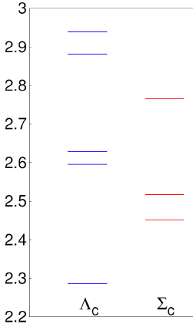
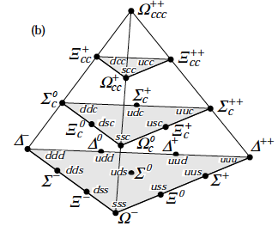
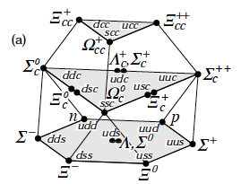
Charmed baryons
14_{c} ＋1_{cc} << 80_{uds}
(6_{excited})
More states at JPARC
[GeV]
?
?
5/2⁺
?
1/2–
3/2⁺
S=3/2
3/2⁺
Ground
states
3/2 –
1/2⁺
1/2 –
3/2⁺
Ξ’_{C}
Ω_{C}
1/2⁺
Ξ_{C}
css
1hω
Ξ_{C}
1/2⁺
csq
S=1/2
1/2⁺
1 Ξ⁺_{cc}
cqq
cqq

Slide 4
What do we expect for heavy quarks?
• Heavy quark spin symmetry
→ Heavy spin becomes irrelevant and decouples
• Flavor SU(3) symmetry is broken
→ Two orbital modes (λ and ρ) may be distinguished
➔ Diquark motions in the baryon mass spectrum
From hadrons to diquarks (spectroscopy)

Slide 5
2. Structure
How λ, ρ modes appear in the spectrum

Slide 6
2. Structure
How λ, ρ modes appear in the spectrum
CM
relative
motion of qq
HO and no ss
Degenerate

Slide 7
2. Structure
How λ, ρ modes appear in the spectrum
HO and no ss
Degenerate ← Two diquark motions → Distinguished
Isotope-shift

Slide 8
As a consequence -- Decays
λ-mode
ρ-mode

Slide 9
As a consequence -- Decays
λ-mode
ρ-mode
λ-mode: Q* decays by emitting a heavy meson
ρ-mode: (qq)* decays by emitting a pion
How they appear in excited B_{c}'s
➔ Mixing of the modes

Slide 10
qqQ systems
Quark model calculation
with spin-spin interaction:
Yoshida, Sadato, Hiyama, Oka, Hosaka
Quark model hamiltonian
Solved by the Gaussian expansion method
See how systems change as M_{Q} is varied

Slide 11
Excitation spectrum
L=1 excited states: spin-spin interaction
Hyperons
Charmed baryons
Λ
Σ
Λ_{c}
Λ_{c}
Λ
← l = 1, excited states →
Σ_{c}
Σ
Σ_{c}
Σ
Σ_{c}
Λ(1/2⁻, 3/2⁻)
Λ_{c}(1/2⁻, 3/2⁻)
Σ(3/2⁺)
Σ_{c}(3/2⁺)
← l = 0, ground states →
Σ_{c}(1/2⁺)
Σ(1/2⁺)
Λ(1/2⁺)
Λ_{c}(1/2⁺)

Slide 12
Excitation spectrum
L=1 excited states: spin-spin interaction
Hyperons
s
c
Charmed baryons
Λ
Σ
Λ_{c}
Λ_{c}
Λ
Σ_{c}
Σ
Σ_{c}
Σ
Σ_{c}
Λ(1/2⁻, 3/2⁻)
Λ_{c}(1/2⁻, 3/2⁻)
Σ(3/2⁺)
Σ_{c}(3/2⁺)
Σ(1/2⁺)
Σ_{c}(1/2⁺)
Λ(1/2⁺)
Λ_{c}(1/2⁺)

Slide 13
To understand better -- Wave functions
SU(3)
spin
u
d
s
u
,
. . .
s
d

Slide 14
To understand better -- Wave functions
SU(3)
spin
Flavor
Orbital
u
d
s
u
,
. . .
s
d

Slide 15
To understand better -- Wave functions
SU(3)

Slide 16
To understand better -- Wave functions
SU(3)
HQ

Slide 17
To understand better -- Wave functions
SU(3)
mix
HQ

Slide 18
Wave function
Mixing of
e.g. λ-mode dominant state: How much the other mode mixes?

Slide 19
Wave function
Mixing of
e.g. λ-mode dominant state: How much the other mode mixes?
Λ_{c}* is almost
pure λ mode
➔
Reflect more
diquark nature
Probability |c|²
SU(3) limit
see Talk by Shirotori
m_{Q} [GeV]
with m_{ud} = 300 MeV

Slide 20
3. Charmed baryon productions

Slide 21
Strategies:
Consider D* (Vector meson) production
At high energies: Forward peak → t-channel dominant
See the next figure
• Absolute values
Regge for the estimation of charm to strange ratio
Sangho Kim yesterday
• Relative rates of transitions to various B_{c}*
One step process in a Qd model
π
D*
Pion-induced reaction
π + p → D* + B_{c}*
V, PS, S-exchanges
p
λ
B_{c}*

Slide 22
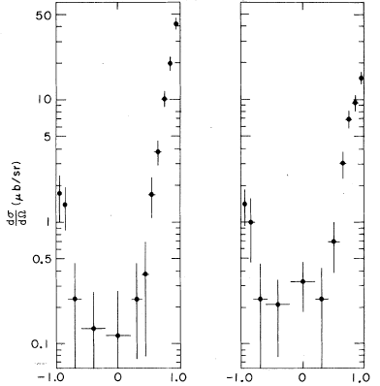
10
p_{π, Lab} = 4.5 GeV
D.J. Krennel et al
PRD6, 1220 (1972)
1
0.1
–1.0 0 +1.0
–1.0 0 +1.0
cosθ
cosθ

Slide 23
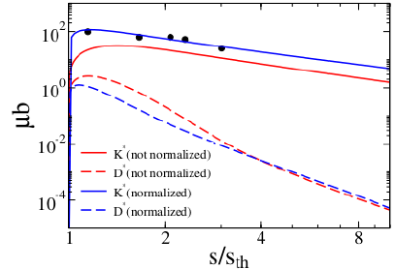
Absolute values
Regge model ~ Sang-Ho Kim on Wed evening
strangeness
10^{–2}
10^{–5}
charm
Charm/strangeness productions: 10^{–2} ~ 10^{–5}

Slide 24
Relative rates to various B_{c}
diquark model
π
d
V-exchanges
λ-mode
λ
B_{c}
Q
• Single step q → Q: λ modes are dominantly excited
• V-Reggeon dominates for D* productions
with various B's of l_{λ} = 0, 1, 2 (18 baryons)
• Estimate forward scattering amplitudes

Slide 25
Single-step qd →Qd reaction
π
V-exchanges
λ
B_{c}
= (Geometric) × (Dynamic)
CG coefficients
Transverse

Slide 26
Dynamical part ~ radial integral
GS
Excited states
d
λ-mode
q_{eff}: the momentum transfer
Q
Transitions to excited states are not suppressed

Slide 27
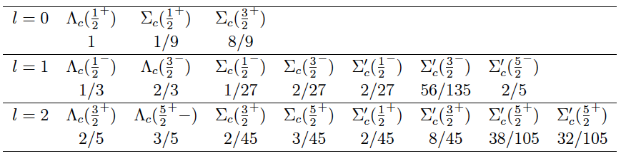
Results
Charm
k_{π}^{CM} = 2.71 [GeV] , k_{π}^{Lab} = 16 [GeV]
1.00 0.02 0.16
0.90 1.70 0.02 0.03 0.04 0.19 0.18
0.50 0.88 0.02 0.02 0.01 0.03 0.07 0.07

Slide 28
Results
Charm
k_{π}^{CM} = 2.71 [GeV] , k_{π}^{Lab} = 16 [GeV]
1.00 0.02 0.16
0.90 1.70 0.02 0.03 0.04 0.19 0.18
0.50 0.88 0.02 0.02 0.01 0.03 0.07 0.07
Strange
k_{π}^{CM} = 1.59 [GeV], k_{π}^{Lab} = 5.8 [GeV]
1.00 0.067 0.44
0.11 0.23 0.007 0.01 0.01 0.07 0.067
0.13 0.20 0.007 0.01 0.004 0.02 0.038 0.04

Slide 29
Yasui's talk, wed →
HQ doublet
HQ doublet
l = 0
l = 1
l = 2
1 : 2
3 : 2

Slide 30
Summary
• ρ and λ modes are distinct (Isotope shift)
better in Λ than in Σ → can we approach di-quark ?
• Systematic study in strangeness is important
• One step process is studied for production
• Higher excited (Λ) states may be produced
as many as the ground states
• All above are based on a quark model picture
• Can we justify, and if (not) so, how → This WS

Slide 31
Interesting systematics
bad diquark
with spin-spin
of (qq)-Q
(qq)-Q
S=1, 1/2
addition of
one more q
with good qq
[qq]-Q
S=0, 1/2
spin-spin
subtracted
q-qbar
S=1/2, 1/2

Slide 32
σσ
m_{Q} > m_{q}

Slide 33
Excitation spectrum
L=1 excited states: spin-spin interaction
Hyperons
s
c
Charmed baryons
Λ
Σ
Λ_{c}
Λ_{c}
Λ
Σ_{c}
Σ
Σ_{c}
Σ
Σ_{c}
Λ(1/2⁻, 3/2⁻)
Λ_{c}(1/2⁻, 3/2⁻)
Σ(3/2⁺)
λ
Σ_{c}(3/2⁺)
Σ(1/2⁺)
Σ_{c}(1/2⁺)
Λ(1/2⁺)
Λ_{c}(1/2⁺)

Slide 34
Wave functions
SU(3)
These two bases mix by σσ interaction
HQ

Slide 35
Wave function
Mixing of
etc
e.g. λ-mode dominant state: How much the other mode mixes?
Substantial amount of mixing in Σ
Probability |c|²
SU(3) limit
m_{Q} [GeV]
with m_{ud} = 300 MeV

