Slide 1
Polarization studies on charmed baryons
Kiyoshi Tanida
Seoul National University
@Mini workshop on “Structure and productions of charmed baryons II”
August 7-9, 2014

Slide 2
Ideas for measurements
Polarization is a powerful tool in nuclear/hadron physics
Must be so for charmed baryons – YES!
Yet few studies so far → Propose new measurements
Polarization transfer in fragmentation
Polarized quark → polarized baryon
Reflects helicity structure of baryon Polarization transfer = Δq (Augustin and Renard, 1979)
Helps to identify baryon structure – exotics?
Parity determination
Decay angle → opposite parity gives the same distribution
Yet, polarization is different

Slide 3
1. Polarization transfer in fragmentation

Slide 4
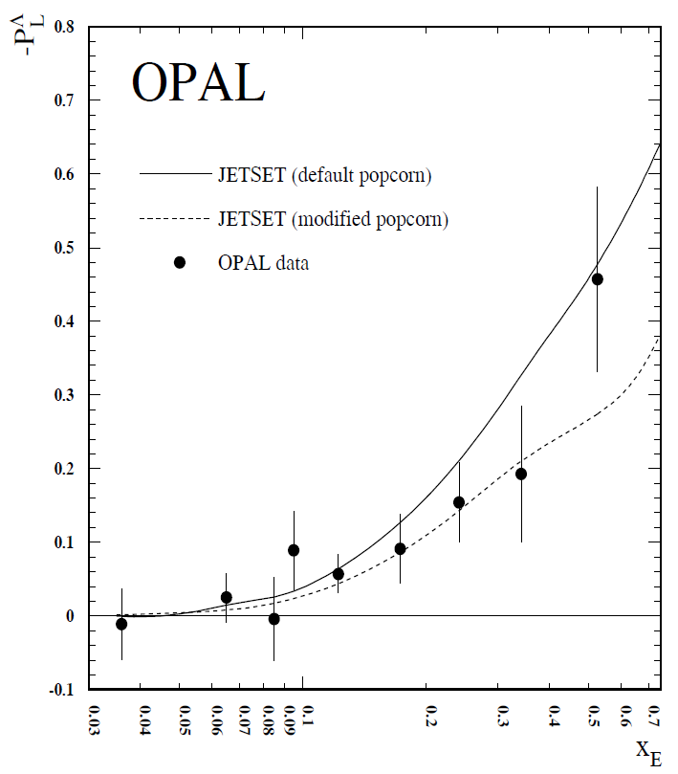
Past measurement at LEP
OPAL and ALEPH measured Λ polarization in Z⁰ decay
Z⁰ → s: polarized by -0.94
Contamination by ss-bar pair creation during fragmentation → treated in simulation, with sizable uncertainty
Consistent with quark model within the uncertainty

Slide 5
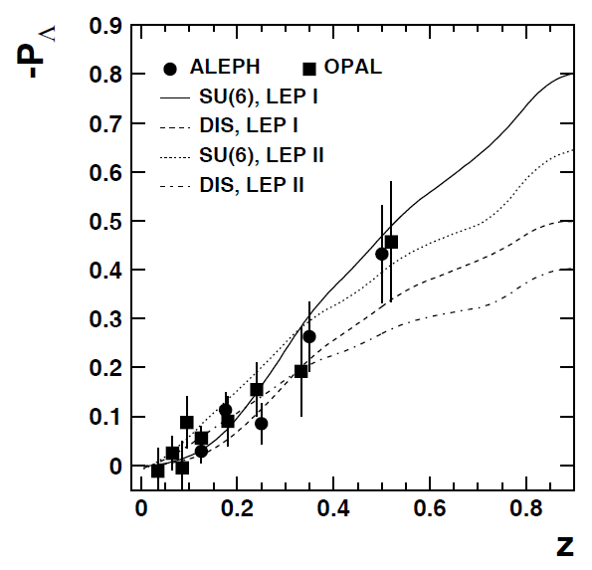
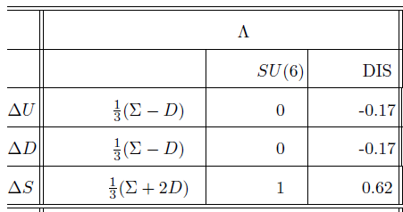
Another analysis
By Liu and Liang (arXiv:hep-ph/0005172v1)
Quark model (SU(6)) vs DIS + Hyperon-β + SU_{f}(3)
QM is favored, but uncertainty in pair creation is not taken into account

Slide 6
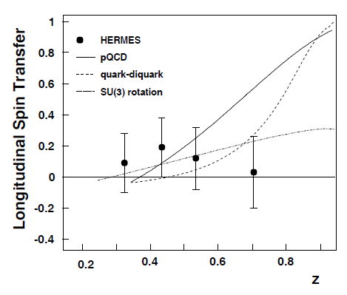
Past measurements (2) -- DIS
Example in HERMES: polarization transfer from beam positron to Λ. [PRD 74 (2006) 072004]
Initially, u&d quarks dominate, and the result is not unexpected
Interpretation is limited by fragmentation uncertainty

Slide 7
So, what can we do?
Problem: Λ can be produced from u/d quark → Uncertainty for dilution
This problem does not appear in heavier quarks
Proposed measurement: Polarization of charmed baryons, especially Λ_{c}.

Slide 8
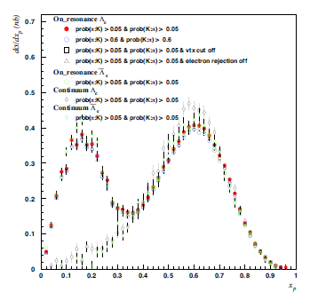
Quark polarization
Z⁰ decay → Large polarization (～0.67)
From LEP. Problem of statistics
b decay → huge statistics in B-factories
c quark is left handed
P_{c} = β_{c}～0.4
ee → cc background can be suppressed by kinematical cut $x_{p}=\frac{p}{\sqrt{s/4−M^{2}}}<0.25$
on Υ(4s) resonance
off resonance

Slide 9
Λ_{c} polarization measurement
Weak decay asymmetry: quite large
Λ_{c} → Λ + π: α = -0.91±0.15 ← can be better determined BR～1.4%
Λ_{c} → Λ + e,μ + ν: α = -0.86±0.04 BR～2.7% each
Statistics (rough estimation)
7.7x10⁸ BB pair is available
BR(B→Λ_{c}X)～5％(×2)
Acceptance & analysis efficiency ～ 20%
→ O(10⁵) counts in Λ_{c} → Λ + π mode only
Statistical uncertainty (rough estimation)
δP～0.02 with S/N=0.2

Slide 10
Comparison with model calculation
To what extent can we distinguish models?
In QM, P_{Λc}=P_{c}~0.4
δP_{Λc}~0.02 gives δΔC~0.05
Easy to distinguish ΔC~1 and ΔC~0.6
Theoretically, heavy quark symmetry supports QM
Note: contributions from higher resonances, such as Σ_{c}, should be taken into account.
Such contributions (on yields) are measurable [e.g., presentation by M. Sumihara in Hadron2013]
Polarizations of such excited baryons should be modeled, too.

Slide 11
For other baryons
Polarization can be measured for excited baryons
Can be used to study baryon structure
For example, Λ_{c}(2593) may be
A three quark state with spin-0 diquark + c with relative L=1 (QM + Heavy quark symmetry)
A bound state of DN (Hyodo et al.)
...
If 1. is the case, $P=−\frac{1}{3}P_{c}$
If 2., $P=0$, If D*N bound state mixes, $P>0$ expected.
Would be a powerful tool to identify exotic baryons

Slide 12
2. Determination of parity

Slide 13
Why is it difficult?
Let’s take an example: 3/2 → 1/2 + 0
Decay angle is the same for P and D wave → Cannot be determined from decay angle alone.
Note: for parity conserving decay, only one of them has finite amplitude

Slide 14
Example angular distribution
3/2 → 1/2 + 0
λ=1 (P-wave) J_{z}=3/2 → J_{z}’=1/2: m=ΔJ_{z}=1 $W\left(θ,φ\right)∝{\left|Y_{11}\right|}^{2}∝\sin^{2}{θ}$ J_{z}=1/2 → J_{z}’=1/2, -1/2: m=ΔJ_{z}=0,1 (weighted by CG coefficient) $W\left(θ,φ\right)∝\frac{2}{3}{\left|Y_{10}\right|}^{2}+\frac{1}{3}{\left|Y_{11}\right|}^{2}∝3\cos^{2}{θ}+1$
λ=2 (D-wave) J_{z}=3/2 → J_{z}’=±1/2: m=ΔJ_{z}=1,2 $W\left(θ,φ\right)∝\frac{1}{5}{\left|Y_{21}\right|}^{2}+\frac{4}{5}{\left|Y_{22}\right|}^{2}∝\sin^{2}{θ}$ J_{z}=1/2 → J_{z}’=±1/2: m=ΔJ_{z}=0,1 $W\left(θ,φ\right)∝\frac{2}{5}{\left|Y_{20}\right|}^{2}+\frac{3}{5}{\left|Y_{21}\right|}^{2}∝3\cos^{2}{θ}+1$
Generally, λ cannot be distinguished

Slide 15
Why is it difficult?
Let’s take an example: 3/2 → 1/2 + 0
Decay angle is the same for P and D wave → Cannot be determined from decay angle alone.
Note: for parity conserving decay, only one of them has finite amplitude
One more information is necessary E.g.,
Polarization in the final/initial state
Interference with continuum or other resonance.
Heavy quark symmetry
...

Slide 16
General method
By N. Byers and S. Fenster (PRL 11 (1963) 52)
B* → B + M (spin J → 1/2 + 0)
Assumes perfect detector, and used for bubble chamber
Take moments of (measured) decay angle distribution (c.f. Fourier transformation): $\left\langle Y_{LM}\right\rangle =\int{W\left(θ,φ\right)}Y_{LM}\left(θ,φ\right)dΩ$
for even L

Slide 17
Irreducible tensor
$\left\langle Y_{LM}\right\rangle$ can be transformed to an irreducible tensor t_{LM} as $\left\langle Y_{LM}\right\rangle =t_{LM}n_{L0}$ $n_{L0}={(−1)}^{J−1/2}\sqrt{\frac{2J+1}{4π}}\left\langle J\frac{1}{2}J\frac{−1}{2}|JJLM\right\rangle$
Meaning of t_{LM}
Expectation for spin multipole operator (of the initial baryon) $t_{10}=\frac{\left\langle S_{z}\right\rangle }{\sqrt{J(J+1)}},t_{1±1}=\frac{∓\left\langle S_{x}±iS_{y}\right\rangle }{\sqrt{2J(J+1)}}$ $t_{20}∝\left\langle 3{S_{z}}^{2}−S^{2}\right\rangle , …$
(Clebsh-Gordan coefficient)
Proof is not given in the paper: I didn’t have time to prove by myself...
I think this can be proven from Wigner-Eckert’s theorem.

Slide 18
Irreducible tensor (cont.)
For parity conserving decay, $\left\langle Y_{LM}\right\rangle$ is 0 for odd L.
In order to calculate t_{LM} for odd L, you need information on polarization of final baryon. ← measurable if final baryon undergoes weak decay.
If polarization vector of final baryon $\vec{P}$ is known, t_{LM} is given as (for odd L) $\left\langle \vec{P}∙\hat{k}Y_{LM}\right\rangle =t_{LM}n_{L0}$ Note: $\hat{k}$ is the unit vector for final baryon direction. So, $\vec{P}∙\hat{k}$ is “longitudinal polarization”.
Especially for L=1, t_{1M} gives vector polarization in the initial state

Slide 19
Transverse polarization
For transverse polarization, similar calculation can be made (though more complicated) → Relative sign gives parity.
$${γt}_{LM}n_{L1}=\sqrt{\frac{L+1}{2L+1}}\sum_{m}{\left\langle P_{m}Y_{L−1,M−m}\right\rangle }\left\langle 1,m,L−1,M−m|1,L−1,L,M\right\rangle \\ +\sqrt{\frac{L}{2L+1}}\sum_{m}{\left\langle P_{m}Y_{L+1,M−m}\right\rangle }\left\langle 1,m,L+1,M−m|1,L+1,L,M\right\rangle$$
$$n_{L1}={(−1)}^{J−1/2}\sqrt{\frac{2J+1}{4π}}\left\langle J\frac{1}{2}J\frac{1}{2}|JJLM\right\rangle \\ γ=\frac{{\left|a\right|}^{2}−{\left|b\right|}^{2}}{{\left|a\right|}^{2}+{\left|b\right|}^{2}}$$
Sign of $γ$ (=±1 for parity conserving decay) gives parity
a: amplitude for λ=J-1/2
b: amplitude for λ=J+1/2

Slide 20
Issues
Byers-Fenster method is completely model independent, and no ambiguity, but...
Assumes 4π uniform coverage, not always true for counter experiments
Control of systematic uncertainty difficult
This is because the method is integral-based
Need differential formula applicable for experiments with limited coverage.
General case is difficult, but individual formula can be derived for practical cases
Simplest example: J=1/2

Slide 21
Spin 1/2 case
Ex: Σ_{c} → Λ_{c} + π (1/2? → 1/2⁺ + 0⁻)
S-wave decay (P=－): $\vec{P_{Λ_{c}}}=\vec{P_{Σ_{c}}}$, independent of decay angle
P-wave decay (P=+): $\vec{P_{Λ_{c}}}=P_{Σ_{c}}∙\hat{n}\left(2θ\right)$, depends on decay angle (note: $\left\langle \vec{P_{Λ_{c}}}\right\rangle =0$ for this case, so feed down correction to Λ_{c} polarization is straightforward)
In case of Σ_{c}, P_{Σc} =$−\frac{1}{3}P_{c}\sim −0.13$ is expected from QM
$δP\sim 0.03$ → determination of Σ_{c} parity is possible!
Need higher statistics (Belle2) for higher excited states
Parity of Λ(1405) was determined very recently

Slide 22
K. Moriya Hyp-X

Slide 23
K. Moriya Hyp-X
Published as PRL 112 (2014) 082004

Slide 24
Extra has nothing to do with polarization...

Slide 25
Double-Cabbibo-Suppressed decay
I believe we observed a DCS decay, $Λ_{c}→pK^{+}π^{−}$ (Though I cannot show the spectrum in public)
First observation of DCS decay in baryons
Naively, $\frac{Br(Λ_{c}→pK^{+}π^{−})}{Br(Λ_{c}→pK^{−}π^{+})}=\tan^{4}{θ_{c}}=2.9×{10}^{−3}$
How much deviation possible?
What physics information can be derived?
Cf. case of D⁰ meson ($D^{0}\overline{D^{0}}$ mixing effect subtracted) $\frac{Br(D^{0}→K^{+}π^{−} via DCS)}{Br(D^{0}→K^{−}π^{+})}=(3.37±0.21)×{10}^{−3}$

Slide 26
Summary
Polarization transfer from longitudinally polarized quark to baryon ⬄ helicity contribution of quark in baryon
Past measurements on Λ at LEP (Z⁰ decay) and in DIS
Uncertainty in non-leading Λ (from ss-bar production in fragmentation) is sizable and limits the capability
Sizable polarization is expected for c quark from b decay
Λ_{c} polarization can be measured in Λ_{c} → Λ + π mode with good accuracy in B-factories
Baryon polarization can be further used for other studies
Parity of excited charmed baryons can be determined

Slide 27
Backups

Slide 28
Integrated method
Discussed by N. Byers and S. Fenster (PRL 11 (1963) 52) B* → B + M (spin J → 1/2 + 0)
Used in bubble-chamber experiments Σ∗(1385), Λ(1405), Ξ∗(1530), ...
Take moment of (measured) decay angle distribution (c.f. Fourier transformation): $\left\langle Y_{LM}\right\rangle =\int{W\left(θ,φ\right)}Y_{LM}\left(θ,φ\right)dΩ$ must be zero for L > 2J. → If $\left\langle Y_{LM}\right\rangle ≠0$ for some L, then J ≧ L/2
...to be continued

Slide 29
Irreducible tensor
$\left\langle Y_{LM}\right\rangle$ can be transformed to an irreducible tensor t_{LM} as $\left\langle Y_{LM}\right\rangle =t_{LM}n_{L0}$ $n_{L0}={(−1)}^{J−1/2}\sqrt{\frac{2J+1}{4π}}\left\langle J\frac{1}{2}J\frac{−1}{2}|JJLM\right\rangle$
Meaning of t_{LM}
Expectation for spin multipole operator (of the initial baryon) $t_{10}=\frac{\left\langle S_{z}\right\rangle }{\sqrt{J(J+1)}},t_{1±1}=\frac{∓\left\langle S_{x}±iS_{y}\right\rangle }{\sqrt{2J(J+1)}}$ $t_{20}∝\left\langle 3{S_{z}}^{2}−S^{2}\right\rangle , …$
(for even L)
(Clebsh-Gordan coefficient)
Proof is not given in the paper: I didn’t have time to prove by myself...
I think this can be proven from Wigner-Eckert’s theorem.

Slide 30
Irreducible tensor (cont.)
For parity conserving decay, $\left\langle Y_{LM}\right\rangle$ is 0 for odd L.
In order to calculate t_{LM} for odd L, you need information on polarization of final baryon. ← measurable if final baryon undergoes weak decay.
If polarization vector of final baryon $\vec{P}$ is known, t_{LM} is given as (for odd L) $\left\langle \vec{P}∙\hat{k}Y_{LM}\right\rangle =t_{LM}n_{L0}$ Note: $\hat{k}$ is the unit vector for final baryon direction. So, $\vec{P}∙\hat{k}$ is “longitudinal polarization”.
Spin of Σ(1385) and Ξ(1530) is mostly determined with these moments.

Slide 31
Ex2: polarization in final state
Byers-Fenster method in decay J → 1/2 + 0
For longitudinal polarization with odd L $\left\langle \vec{P}∙\hat{k}Y_{LM}\right\rangle =t_{LM}n_{L0}$
For transverse polarization, similar calculation can be made (though more complicated) → Relative sign gives parity.
$${γt}_{LM}n_{L1}=\sqrt{\frac{L+1}{2L+1}}\sum_{m}{\left\langle P_{m}Y_{L−1,M−m}\right\rangle }\left\langle 1,m,L−1,M−m|1,L−1,L,M\right\rangle \\ +\sqrt{\frac{L}{2L+1}}\sum_{m}{\left\langle P_{m}Y_{L+1,M−m}\right\rangle }\left\langle 1,m,L+1,M−m|1,L+1,L,M\right\rangle$$
with $γ$ (=±1 for parity conserving decay) is asymmetry for the two amplitude-squares (e.g., for P and D waves in Δ decay).

