Slide 1
Static interquark potentials from lattice QCD
Toru T. Takahashi (Gunma College of Technology)

Slide 2
CONTENTS
Introduction
Lattice QCD measurement of static quark potentials
Q-anti Q potential
3Q potential
Multi Q potential
Other representations (color excitations)
Vibrational mode (gluonic excitations)
Light quark effects
Relativistic corrections

Slide 3
Introduction

Slide 4
Quark potentials
Important for
Interquark potentials → QCD dynamics
Hadron structures
Hadronic interactions
…..
It comes from the QCD nonperturbative dynamics
Color-flux squeezing
Dual superconducting vacuum
Color electric fluxes are squeezed like a superconductor

Slide 5
Lattice QCD measurement

Slide 6

Lattice QCD measurement
VEV of the Wilson loop (closed loop) gives a Q-antiQ potential.
The line is a path-ordered product of gauge fields.
Euclidean time
$${W=Pe}^{∫A_{μ}dx^{μ}}=\prod{U_{μ}(s)}$$
Path-ordered product
Product of link variables
along the loop on the lattice.
Spatial dir.
Euclidean time
=
+
“flux” operator
Creates gauge invariant
q and anti q state
Static quark propagator
The leading term of 1/M expansion
of quark propagators.

Slide 7


Lattice QCD measurement
VEV of the Wilson loop (closed loop) gives a Q-antiQ potential.
The line is a path-ordered product of gauge fields.
Euclidean time
$${W=Pe}^{∫A_{μ}dx^{μ}}=\prod{U_{μ}(s)}$$
T
R
Path-ordered product
Product of link variables
along the loop on the lattice.
Spatial dir.
$$W=〈Q\overline{Q}\left|e^{−HT}\right|Q\overline{Q}〉=C_{0}e^{−E_{0}T}+C_{1}e^{−E_{1}T}+…\sim C_{0}e^{−E_{0}T}$$
Time evolution
g.s.
1st e.s.
$$E_{0}=σR, S=RT$$
$$W=C_{0}e^{−σRT}=C_{0}e^{−σS}$$
← Famous “area law”

Slide 8
Q-antiQ potential

Slide 9
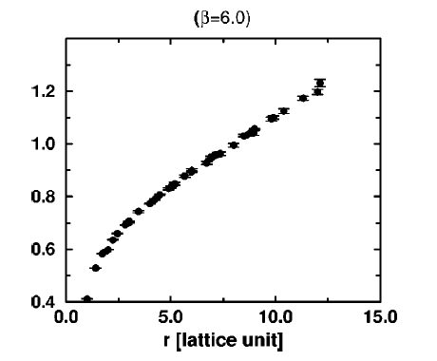




Quark potentials
Static Q-antiQ potential (it is well known)
$$r :interquark distance$$
$$V_{Q\overline{Q}}=−\frac{A}{r}+σr+C$$
Coulomb type term
Linear confinement term
Interquark distance
Perturbative gluons
Are exchanged.
Flux is squeezed.
Produces a “string”.
String tension is 1GeV/fm

Slide 10
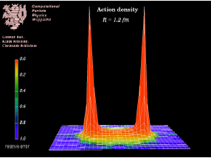
Quark potentials
Flux-tube formation in the ground-state quark-antiquark system
(by lattice QCD)
Energy density
flux
quarks
hep-ph/09809263
Nora Brambilla,
(figure provided byProf.G.S.Bali)

Slide 11
3Q potential

Slide 12
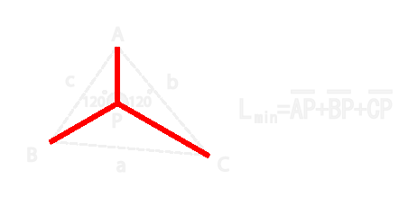
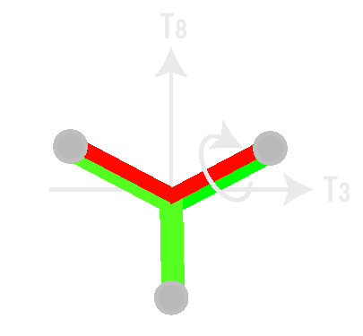

3 Quark potentials
This prescription can be easily extended to multiquark systems.
3 quark potential
$$V=−\sum{\frac{A_{3Q}}{\left|r_{i}−r_{j}\right|}}+σ_{3Q}L_{m}+C_{3Q}$$
Pertubative
2-body force
Nonperturbative
Linear confinement
Cf.) Dual superconductor picture
of the QCD vacuum
Lm is the length of
Y-shape flux tube
There appear 2 abelian charges.

Slide 13
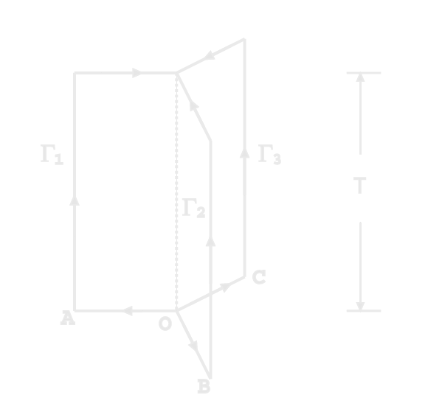


3 Quark potentials
3Q system annihilated
3Q potential is obtained from the 3Q Wilson loop
$$W_{3Q}=\frac{1}{3}ε^{abc}ε^{a^{′}b^{′}c^{′}}U_{1}^{aa^{′}}U_{2}^{bb^{′}}U_{3}^{cc^{′}}$$
$$U_{i}^{aa^{′}}→staple(product of link variables)$$
3Q system created

Slide 14
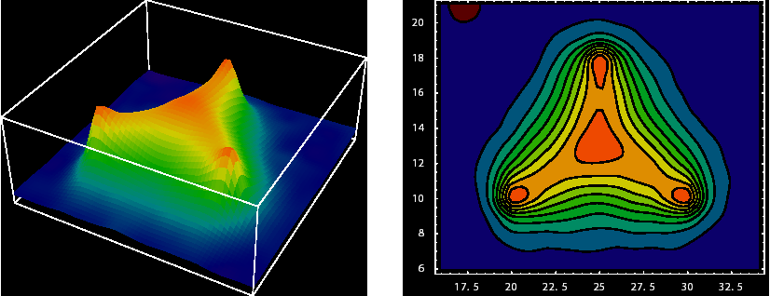
3 Quark potentials
Flux-tube formation in the ground-state 3Q System
Action density in the static 3 quark system
in the Abelian-projected QCD.
H.Ichie, V.Bornyakov, T.Streuer, G.Schierholtz
Nucl.Phys.A721:887-890,2003

Slide 15

Color fluxtube
3
3
―
3
3 flux
3
―
Q
Q
―
3
3 (fundamental)
3
3
$$3×3=\overline{3}+6$$
3-flux is terminated at the anti quark.

Slide 16
Multi Q potential

Slide 17
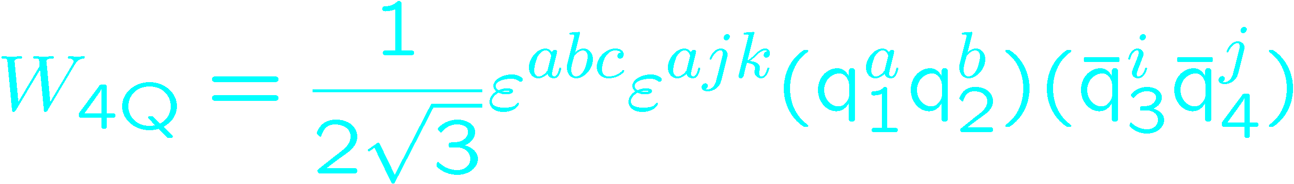
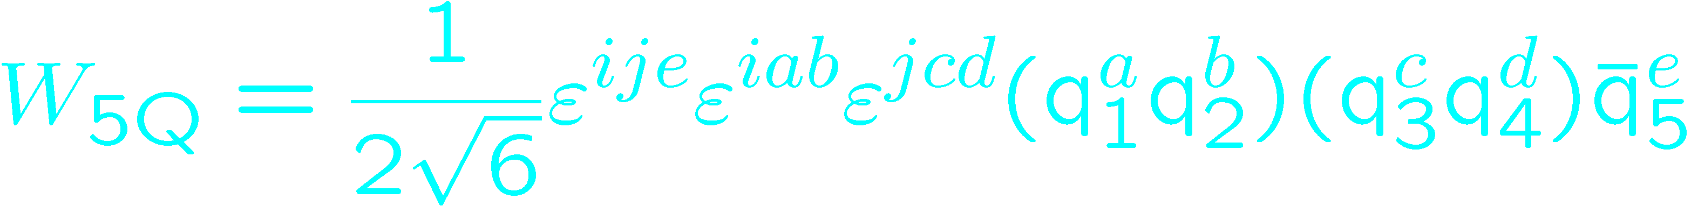


Multi Quark potentials
$$QQ\overline{Q}\overline{Q}$$
$$QQQQ\overline{Q}$$
T
T
State creation part looks like a fluxtube configuration.
BUT it cannot specify the internal color configurations.
It only specify the total quantum numbers.

Slide 18
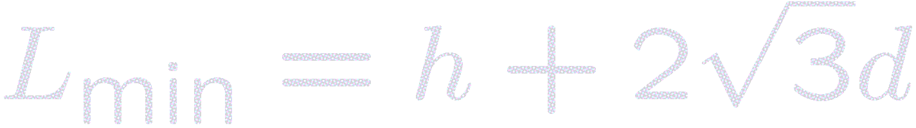
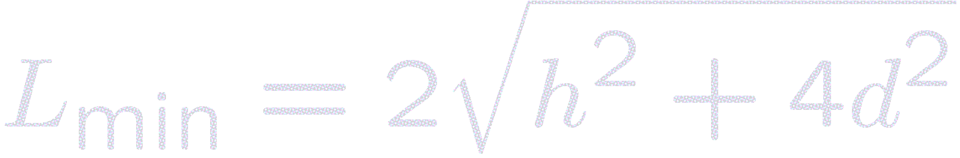
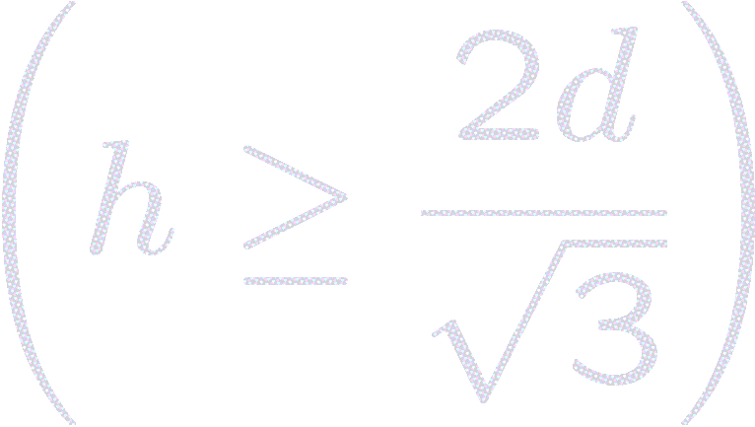
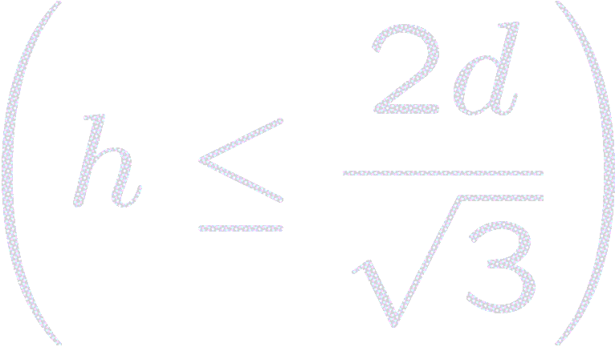
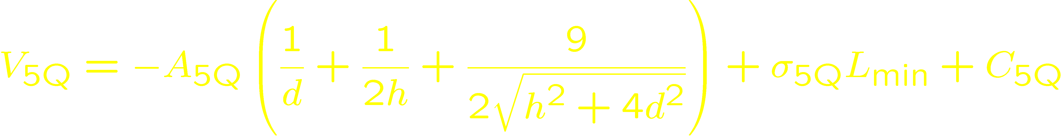
5 Quark potentials
We put 5 quarks on the same plane for simplicity.
(Actually, we investigated more and more (twisted) quark configurations.)
Anti-quark is located at middle between two junctions
・Theoretical form of the multi-Y Ansatz
ASSUMPTION
d
multi-Y type fluxtubes
Short range perturbative interaction
h
We determine these coefficients from V_{3Q} results.
A_{5Q} :: coefficient in Coulomb term (= A_{3Q} = 0.1366 )
σ_{5Q} :: string tension (= σ_{3Q} = 0.0460a⁻² ~ 0.89GeV/fm )
C_{5Q} :: constant term (= 1.57a⁻¹ ~ 5/3C_{3Q} )
There is
NO adjustable parameter

Slide 19
5 Quark potentials
Good agreement with multi-Y Ansatz,
( OGE + multi-Y linear ) potential

Slide 20
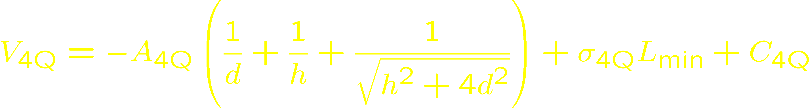
4 Quark potentials
・Theoretical form of the multi-Y Ansatz
d
ASSUMPTION
multi-Y type fluxtubes
Short range perturbative interaction
h
We determine these coefficients from V_{3Q} results.
A_{4Q} :: coefficient in Coulomb term (= A_{3Q} = 0.1366 )
σ_{4Q} :: string tension (= σ_{3Q} = 0.0460a⁻² ~ 0.89GeV/fm )
C_{4Q} :: constant term (= 1.26a⁻¹ ~ 4/3C_{3Q} )
There is again
NO adjustable parameter

Slide 21
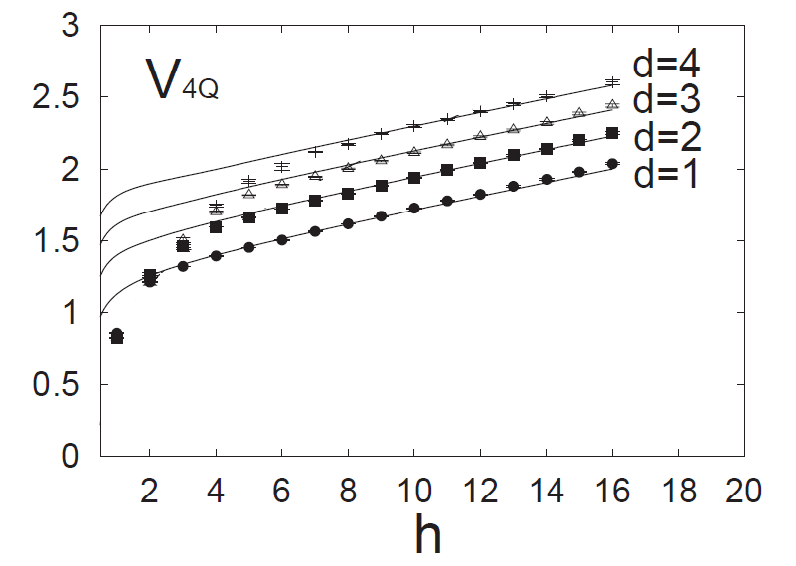
4 Quark potentials
d
h
Clearly, the data deviate form the theoretical curve!
Especially, when h << d.

Slide 22
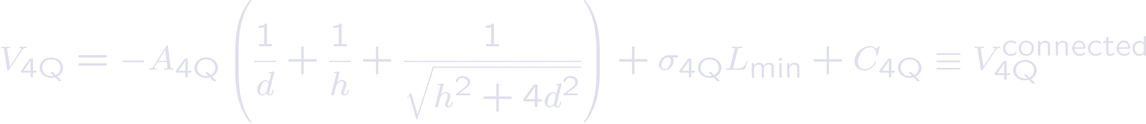
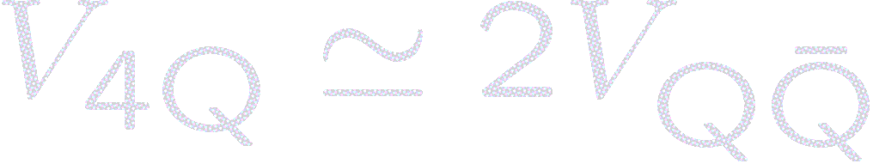
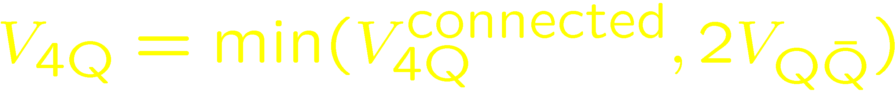
Flip-flop --recombination of the flux-tubes--
d
two mesons
h
Flip-flop occurs!
and are quark and antiquark
When d is much smaller than h,
the “two-meson” state is energetically favored!
→if connected
→if disconnected

Slide 23
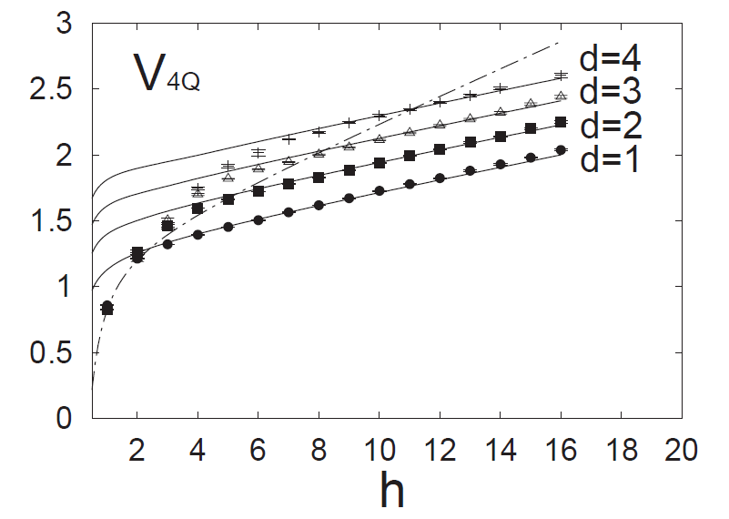
Flip-flop --recombination of the flux-tubes--
Evidence of flip-flop
Black lines
Red line

Slide 24
Flip-flop --recombination of the flux-tubes--
Confirmation of Flip-flop
Flip-flop easily occurs
2-meson state
twist
Flip-flop hardly occurs
almost works

Slide 25
Other representations
(color excitations)

Slide 26


Other representations
There are many types of fluxtubes
Depending on internal color configurations
Ground states of multiquark systems
―
3
$$3×3=\overline{3}$$
OGE→attractive
An example of Excited states of multiquark systems (color excitation)
6
But actually would be screened by gluons
May be screened and form a less heavy fluxes.
$$3×3=6$$
OGE→repulsive

Slide 27

Other representations
D flux
Casimir factor
―
Q
Q
$$tr(λ_{1}^{a}⋅λ_{2}^{a})$$
―
D -representation
D representation
Interquark potential
In different representations
V normalized by the fundamental
Q-anti Q potential
Casimir scaling of SU(3) static potentials
G.S.Bali
Phys. Rev. D62 (2000) 114503
Potentials (both OGE, Linear conf.)
Seem to be proportional to
Color Casimir factors at this range.

Slide 28
Other representations
D flux
Casimir factor
―
Q
Q
$$tr(λ_{1}^{a}⋅λ_{2}^{a})$$
―
D -representation
D representation
Violation of Casimir Scaling for Static QCD Potential at Three-loop Order
C.Anzai, Y.Kiyo, Y.Sumino, Nucl. Phys. B838 (2010) 28
Casimir scaling violation can be found at O(α^4)

Slide 29
Other representations
Energy densities of different-representation potential
Colour fields in gauge invariant quenched SU(3) Lattice QCD
P.Bicudo et al.
arXiv:1010.3870

Slide 30
Vibrational modes
(gluonic excitations)

Slide 31
Vibrational modes
Fluxtubes can vibrate carrying some quantum numbers
(Gluonic excitations, Hybrid hadrons)
―
Q
Q
Vibration=gluonic degrees of freedom
→ Excited state spectrum
Gluonic excitations of the static quark potential
And the hybrid quarkonium spectrum
K.J.Juge et al.
Nucl. Phys. Proc. Suppl. 63 (1998) 326

Slide 32
Light quark effects

Slide 33
Light quark effects
Heavy-heavy-light system e.g) doubly charmed baryons
L (fast)
0.73GeV/fm
H(slow)
L(fast)
H(slow)
H (slow)
H (slow)
3Q system
Effective 2Q system
A. Yamamoto et al.
Phys.Lett. B664 (2008) 129-13

Slide 34
Relativistic corrections

Slide 35
Relativistic corrections
We can expand interquark potential in terms of 1/Mq
→ Useful for heavy hadron spectroscopy
Relativistic corrections to the static potential at O(1/m) and O(1/m^2)
Y.Koma, M.Koma, H.Wittig; PoS LAT2007 (2007) 111
Static
1/m term
1/m^2 term

Slide 36
BEYOND
Study with static quarks
Heavy hadron-Heavy hadron potential
Diquark correlations in hadrons
…

Slide 37
Qqq Qqq potential
Replace HQ propagator
With LQ propagator
QQQ system
Qqq system
Two Wilson loop gives Qqq-Qqq potential

