Slide 1
What can we learn about
Ξ resonances at K1.8
J-PARC Hadron physics WS 2014.11.30
K.Imai (JAEA)

Slide 2
Ξ resonances in PDG

Slide 3
PDG Table of Ξ

Slide 4
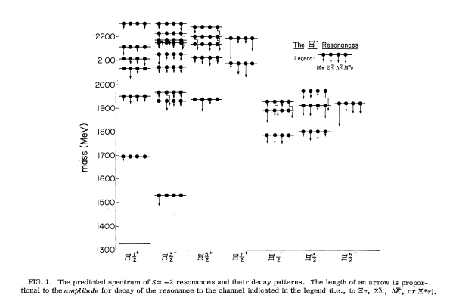
Ξ* quark model: Chao, Isgur, Karl PRD 23 (1981)
Ξ(1690)J^{P}?
Ξ(1530)3/2+
Ξ(1820)3/2-
Λ(1520)3/2-
Λ(1405)1/2-

Slide 5
Ξ* spectroscopy at K1.8
Ξ*(1530) radiative decay
Ξ*(1690) Spin-parity, Branching ratio
If ½-, it may be s=-2 analogue of Λ(1405). ΣΚ molecule?

Slide 6
Radiative decay of Ξ(1530) is not known!
Radiative decay were measured for all other 10 -> 8 baryons.
Radiative decay is the best probe to study its structure.

Slide 7
Ξ(1690) Why it is interesting?
Just below or above ΣΚ threshold
Σ⁻Κ⁰ 1695.0 MeV
Σ⁰Κ⁻ 1686.3 MeV
Σ⁰Κ⁰ 1690.2 MeV
Σ⁺Κ⁻ 1683.1 MeV
Very small branching to Ξπ
Narrow width ~10 MeV
→ candidate of exotic baryon (meson-baryon molecule)

Slide 8
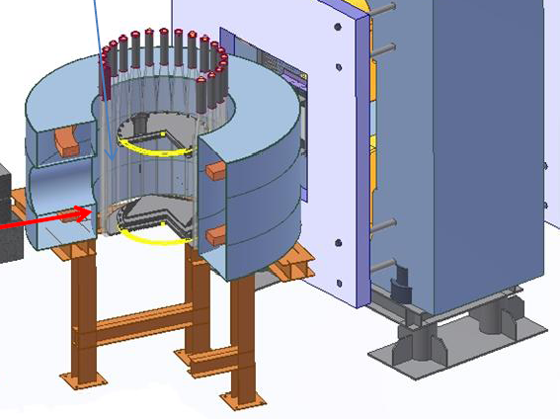
Hyperon spectrometer (HypTPC) for E42, E45 at J-PARC
TPC with GEM in Superconducting Helmholtz magnet
of 1.5 T

Slide 9
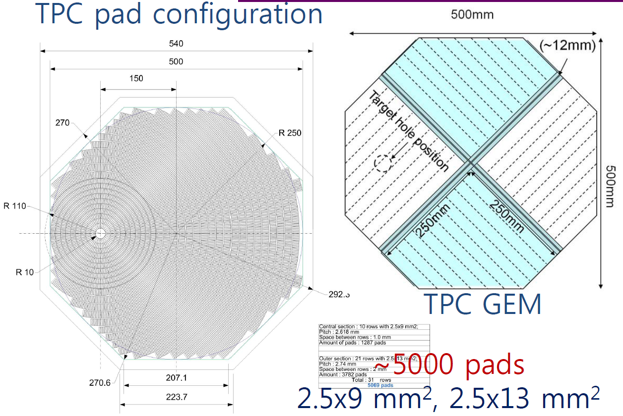

Slide 10
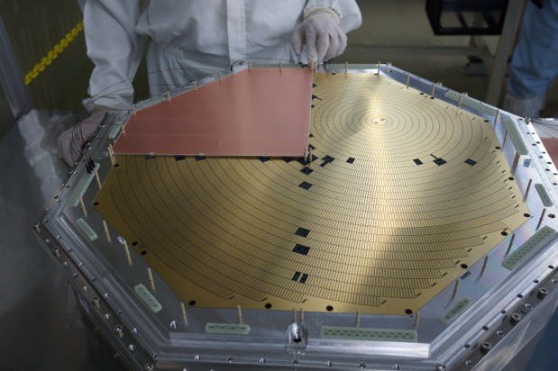
GEM sheet and the pad plane
Test of full size TPC is under progress at JAEA

Slide 11
HypTPC
Target is inside TPC
track of short life hyperons Λ, Σ±, Ξ⁻, (K⁰)
High rate operation
beam pass through up to 10⁶ Hz
(If GEM at beam path is killed, 10⁷~10⁸ Hz)
Large acceptance
almost 4π
High resolution
ΔM(ΛΛ) ~ 1 MeV

Slide 12
Ξ∗(1530) ◊ Ξ γ
K-p -> K+ Ξ⁻*(1530) dσ/dΩ ~ 40 μb/sr at p(K-) = 1.65 GeV/c
p(K+) ~ 700 MeV/c T.Iijima et al., (E176) N.P. (1992)
Yield estimation
5cm liq. H target, 10⁶ K⁻/5sec, 0.1 str. Kurama acceptance, 100 shifts,
→ 4.6x10⁵ Ξ*⁻(1530)
HypTPC acceptance for Ξ- → π−Λ, Λ→ pπ− 60%
Charged branch of Λ : 64%, branch for radiative decay: 0.5%
→ 900 (3% error)
If you require γ position to reduce background
→ 450 (5% error)

Slide 13
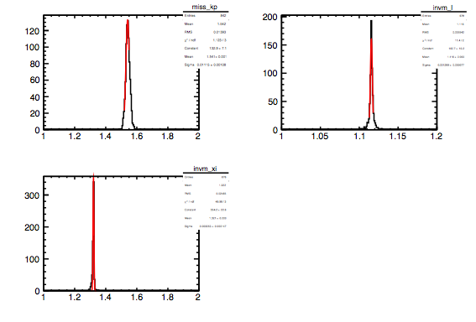
Mass spectra 1) Ξ(1530) 2) Ξ(1321) 3) Λ by S. Hwang
1)
2)
2)

Slide 14
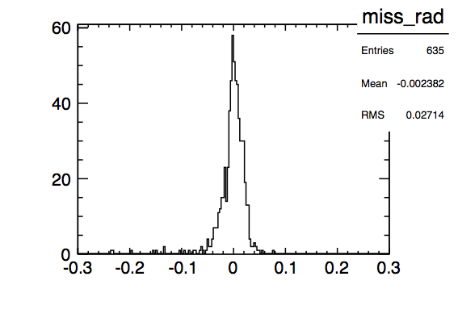
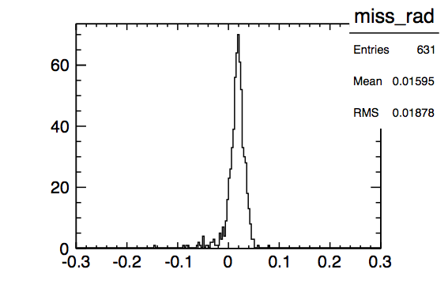
Miss mass of p(K-,K+ Ξ)
gamma
pi0

Slide 19
HBC data on Ξ(1690) P(K-)=4.2 GeV/c (CERN) cross section for Ξ(1690) ~ 7.6 μb
C. Dionisi et al., PL 80B (1978) 145.
An enhancement at the Sigma K threshold (1680 MeV) observed in K-p reactions at 4.2 GeV/c.
M(Σ+K-)
M(ΛK-)

Slide 20
S.F.Biagi et al., Z. Phys. C 34 (1987) 15.
Ξ* resonances in Ξ- Be interactions CERN 116 GeV/c Ξ- beam
Width < 8 MeV

Slide 21
M.I.Adomovich et al., WA89 EPJ C5 (1998) 621.
First observation of Ξ− π+ decay mode of the Ξ0(1690) hyperon.
345 GeV/c Σ- beam CERN
1400 events !
Width 10+-6 MeV

Slide 22
K.Abe et al., Belle PLB 524 (2002) 33.
Observation of Cabbibo-suppressed and W exchange Lambda-c baryon decays.
Λc → Ξ(1690)⁰ K+ at Belle. Width = 11+- 4 MeV

Slide 23
BarBar Λc → Λ Κ⁰ Κ⁺

Slide 24
spin of Ξ(1690)

Slide 25
B.Aubert et al., BarBar PRD 78 (2008) 34008.
Measurement of the spin of the Ξ(1530) resonance.
Λc → Ξ- π+ K+ at BarBar

Slide 26
How can we measure with HypTPC at K1.8
Spin-parity and branching ratio to ΛΚ, ΣΚ, Ξπ, Ξγ
K-p -> K+ Ξ⁻* Ξ⁻∗ −> ΛΚ⁻, Σ⁰Κ⁻, Σ⁻Κ⁰, Ξ⁻π⁰, Ξ⁰π⁻, Ξ⁻γ,
K-p -> K⁰ Ξ⁰∗, Ξ⁰∗ −> ΛΚ⁰, Σ⁰Κ⁰, Σ⁺Κ⁻, Ξ⁻π⁺,
Κ⁰−>π+π−, Ξ⁰−>Λπ⁰
Most of decay channels can be measured. (one neutral particle is allowed to reconstruct the decays )
Yield estimation: (5cm liq. H, 10⁶ K-/spill, 100shifts)
4μb → 5x10⁵ Ξ∗(1690) if 1μb for each channel
ΛΚ⁻, Σ⁰Κ⁻, Ξπ: 0.6x0.64=0.38, -> 5X10⁴ events
Σ⁻Κ⁰: 0.35x0.64x0.6=0.13 -> 1.6x10⁴
for K⁰Ξ⁰* channels, multiply 0.35x0.6=0.2

Slide 27
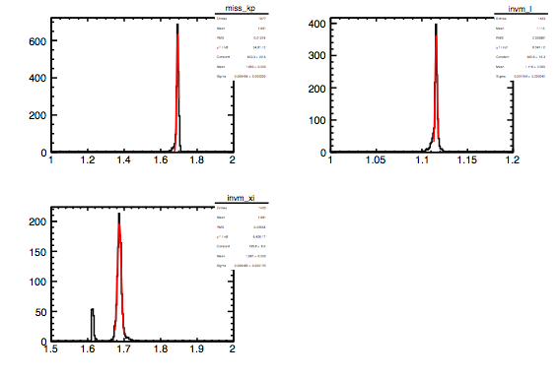
mass spectra 1) Ξ(1690) 2) Λ 3) Ξ*
1)
2
3

Slide 28
How to determine spin-parity
Angular distribution of decay particles !!
3/2 -> ½ +0 Δ−> π +N L=1 -> cosθ
But it is not so simple.
for parity determination of ½ state.
interference with background
( p(s)-wave resonance on s(p)-wave background)
polarization of daughter hyperon (Λ,Σ) if Ξ* is polarized
(Λ(1405) Moriya et al., )

Slide 29
Summary
The new hyperon spectrometer (HypTPC) is under construction at JAEA in collaboration with Korea and New Mexico U.
Following H search experiment (E42) and E45, Ξ* spectroscopy should be carried out as well as Ξ-p scattering experiment at J-PARC.

Slide 30
Back up

Slide 32
Cross sections
Xi-* Sigma0 K- (K0 pi+) 3.2+-0.8 μb
Lambda K- (K0 pi+) 1.1+-0.5
Xi0* Sigma+ K- (K+,pi-) 2.3+-0.3
Lambda K0 (K+,pi-) 1.0+-0.4
Xi pi < 1.0
Total cross section for Xi(1690) 7.6 μb

Slide 33
Ξ(1690) ½- ?

Slide 34
WA89 setup Σ⁻ 10⁵/spill Σ⁻/π⁻ =2.3
7.5 Tm 45 MWPC
29 SSD

Slide 35
E.Briefel et al., PRD 16 (1977) 2706.
Search for Xi* production in K-p interactions at 2.87 GeV/c.
sensitivity: 30 events/microbarn, BNL HB
K-p → K+ Ξ− π+
Ξ−π+ invariant mass

