Slide 1
energy spectrum of the Y-string three-body potential
Seijiro Nishi
Shigehiro Yasui, Makoto Oka
Tokyo Institute of Technology
Notes:
Hello everyone. I am Seijiro Nishi, the second year of master course in Tokyo Institute of Technology. Today, I’d like to talk about Ω_{bcc} energy spectrum of the Y-string three-body potential. The collaborators of my research are Yasui-san and Oka-san.

Slide 2
Contents
Introduction
  Y-string Three-body Potential
  Triple Heavy Baryon Ω_{bcc}
Formalism
  Hamiltonian
  Gaussian Expansion Method
Result
Summary & Perspectives
Notes:
Contents of my talk are as follows. First I’ll introduce the background of our research. Next, I’ll talk about the formalism of our calculation and the result. Finally I summarize my talk and show the perspectives.

Slide 3
1. introduction

Slide 4
Y-string Three-body Potential (1)
Characteristics of QCD
dynamical breaking of chiral symmetry
color confinement
⇒ Mass spectrum is important to understand both and
interaction.
potential
confinement V_{conf}
T. Barnes et al. Phys. Rev D 72, 054026 (2005)
potential
confinement
= Y-string potential
T. Takahashi et al, Phys. Rev. Lett, 86, 18 (2001)
Notes:
The dynamical breaking of chiral symmetry and color confinement are characteristics of the QCD. Thanks to the various researches, we have known the detail of the confinement. The mass spectrum is important to understand both qqbar and qqq interaction. In the meson system, potential is represented as the Cornell potential which is composed of the color Coulomb and confinement potential. The moson mass spectra are very clear. For example, the theoretical results about charmonium by Barnes et al are good agreement with experimental results. On the other hand, according to the Lattice QCD, in the baryon system, the confinement potential is written as the Y-string potential. which is somewhat complex. This was suggested by Takahashi-san in 2001.

Slide 5
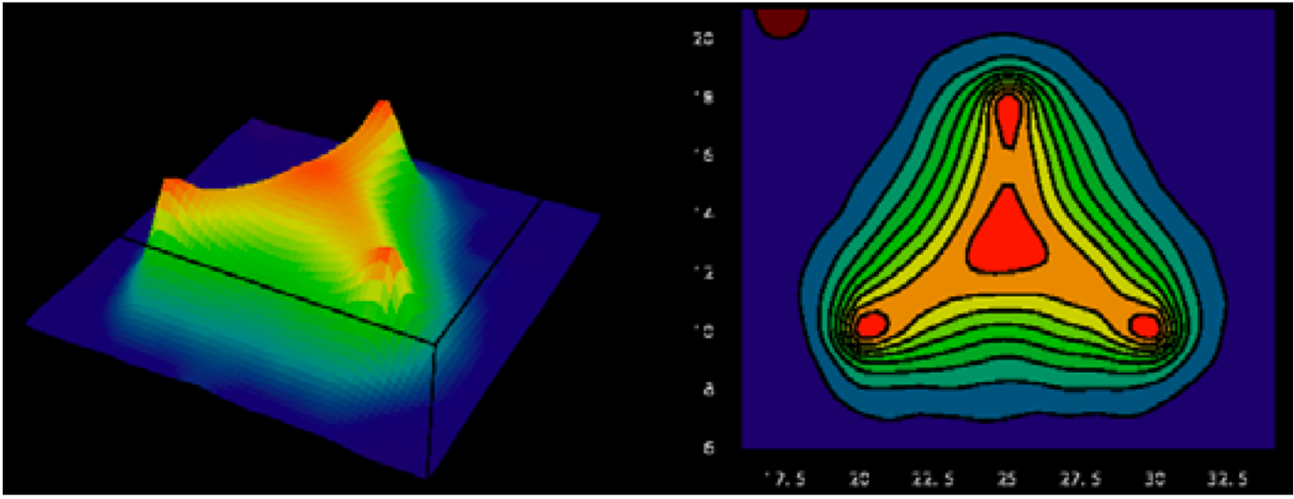
Y-string Three-body Potential (2)
pure three-body potential
energy density of three-body system
Ichie et al. Nuclear Physics A72 1 (2003) 899c-902c
Notes:
The Y-string potential takes the form like this. I’ll explain Lmin later. This potential is the pure three-body potential. That means this potential appears only when three quarks exist. This figure denotes the energy density of three-body system from Ichie-san’s Lattice QCD paper. You can see the Y-type flux tube.

Slide 6
Y-string Three-body Potential (3)
: linking point where the sum of the distances from three quarks is made minimum.
⇒ Fermat point
When we put three quarks at , and , the point is determined automatically.
equilateral triangles
This potential is reasonable because in order to minimize the potential, the sum of the distances from three quarks has to be minimum.
Fermat point
Notes:
The Y-string potential has a linking point where the sum of the distances from three quarks is made minimum. This is the characteristics of this potential. This point is mathematically called Fermat point. When we put three quarks at r₁, r₂ and r₃, the Fermat point r₀ is determined automatically. This is how you can find this potential. You draw three equilateral triangles and connect the vertices. Three lines meet at the one point. This point is the Fermat point.

Slide 7
Triple Heavy Baryon Ω_{bcc}
Ω_{bcc} is one of the triple heavy baryons, which
consists of two c quarks and one b quark.
Why Ω_{bcc} ?
Charm and Bottom hadron
  The charm and bottom hadron are now getting attention both theoretically and empirically.
Y-string potential
  The Y-string potential is the result of the Lattice QCD at the heavy quark mass limit.
  Heavy baryon is the good subject to test this potential.
  This is the almost new trial to analyze the triple heavy baryon with this potential.
⇒ Ω_{bcc} is the best system to reflect the Y-string potential.
Notes:
Next, I will talk about Ω_{bcc} baryon. Ω_{bcc} is one of the triple heavy baryons, which consists of two c quarks and one b quark.
Why we chose Ω_{bcc} as the research subject?
First, in terms of charm and bottom hadron.
The research of the strangeness sector is now finishing theoretically and empirically.
The charm hadron is now focused on.
Second, Y-string potential
The Y-string potential is the result of the Lattice QCD at the heavy quark mass limit.
⇒ Ω_{bcc} is one of the best system to reflect the Y-string potential.

Slide 8
Motivation (1)
In earlier researches, the Y-string potential has been approximated as the Δ-string potential and there has been a few result of baryon energy spectra by evaluating the Y-string potential correctly.
Simon Capstick' and Nathan Isgur, 34 9 (1986)
？
We investigate the difference in the mass spectra in the Y-string potential and in the Δ-string potential.
The heavy baryons are very useful to test!
Notes:
In earlier researches, the Y-string potential has been approximated as the Δ-string potential and there has been a few result of baryon energy spectra by evaluating the Y-string potential correctly. Is it true that Mass spectra of these two potential corresponds? We investigate the difference in the mass spectra in the Y-string potential and in the Δ-string potential. The heavy baryons are very useful to test this potential.

Slide 9
Motivation (2)
⇒V. Dmitrašinović handled the Y-string potential analytically by
using the mathematical method, “hyper spherical coordinates.”
V.Dmitrašinović , Eur. Phys. J. C (2009) 62
We use the constituent quark model and calculated the energy spectrum of a heavy baryon by using the variational method (Gaussian Expansion Method).
 | Dmitrašinović ‘s work (hyper spherical coordinates) | Our work (variational method)
method | analytical | numerical
Y-string | ✓ | ✓
color Coulomb | ✓ | ✓
Y-string + Coul | × | ✓
spin-spin | × | ✓
different mass | × | ✓
Notes:
Later in 2009, V. Dmitrašinović handled the Y-string potential by using the mathematical method. That is “hyper spherical coordinates.” This is the highly mathematical method. Dmitrašinović could not contain any other OGE potential like the color coulomb and spin-spin interaction potential because of the analytical difficulties.
We analized Ω_{bcc} particle with the constituent quark model and calculated the energy spectrum in the potential which contains Y-string, color coulomb and spin-spin interaction by using the variational method (Gaussian Expansion Method).
This table shows the advantage of our work. The advantage of our work is the numerical method. So we can handle any situation.

Slide 10
2. Formalism

Slide 11
Hamiltonian
parameters
charm mass m_{c} | 1.4794 GeV
bottom mass m_{b} | 4.67 GeV
string tensionσ | 722.152 MeV/fm
Coulomb α_{s} | 0.5461
spin-spin α_{s} | 0.5461
δ function expansion Λ | 1.0946 GeV
One Gluon
Exchange
kinetic energy
confinement
We cited the parameters, string tension , Coulomb and spin-spin interaction coefficient from the result of a charmonium spectroscopy.
T. Barnes et al. Phys. Rev D 72, 054026 (2005)
Notes:
The Hamiltonian is as follows. In the baryon system, because of the color factor, the strength of the interquark potential is half of that of the quark-antiquark potential. This is the parameter table. We cited the parameters, string tension σ, Coulomb and spin-spin interaction coefficient αs from the result of a charmonium spectroscopy.

Slide 12
Gaussian Expansion Method (1)
Using Jacobi coordinates, Schrödinger eq is written as
E.Hiyama et al, Progress in Particle and Nuclear Physics 51 (2003)
coefficient
of ρ
coefficient
ofλ
spin wave
function
range parameters
Notes:
Using Jacobi coordinates, Schrödinger equation is written like this. We expand the wave function with the Gaussian basis functions as follows. These are range parameters. We know it seems best to set the range parameters in geometric progression.

Slide 13
Gaussian Expansion Method (2)
matrix elements
The various pairs of orbital angular momenta mixed.
ex)
Solve the general eigenvalue problem
Notes:
These are the matrix elements. We solved the general eigenvalue problem. The potential term has to be integrated. The various pairs of orbital angular momenta mixed. For example, if total angular momentum is 0, the pairs l_rho, l_lambda are (0,0), (1,1), (2,2) and so on. The Y-string potential take the form like this, which depends on the angle.

Slide 14
3. result

Slide 15
Comparizon of Y with Δ
results of the potential that contains only Y or Δ in L = 0
Excitation energy | Y | Δ
5th excited | 859.4 | 863.4
4th excited | 697.5 | 666.8
3rd excited | 599.5 | 573.4
2nd excited | 394.1 | 388.6
1st excited | 312.2 | 301.2
unit [MeV]
ground : 0 MeV
There seems to be some kind of relationship between Y and Δ-string potential.
Notes:
The Delta-string potential is given as this form. Because of the color factor, the string tension of the Delta-string potential is half of that of Y-string potential. This table denotes the excitation energy of Ω_{bcc} in the Y or Δ-string potential.

Slide 16
Result of Ω_{bcc} with
Y-string + Coulomb + spin-spin
E [MeV]
preliminary
700
600
578.6
573.0
574.7
only
500
447.5
456.0
400
444.8
300
3/2⁺
0⁺
1/2⁺
200
100
7.28
19.8
ground state
0
0
Notes:
This is the result of Ω_{bcc} with J^{p} = 1/2+, 3/2+. I’m sorry we could handle the angular momentum pair only l_rho = 0, l_lambda = 0 yet.

Slide 17
4. Summary & perspectives

Slide 18
Summary & Perspectives
Summary
  We calculated Ω_{bcc} energy spectrum under the constituent quark model in the Y-string three-body confinement potential, color coulomb and spin-spin interaction.
  There is a relationship between Y and Δ-string potential in the low energy.
Perspectives
  Try the other angular momenta
  calculate something from the gotten wavefunction (E1 transition probability)

Slide 19
Backup

Slide 20
Constituent Quark Model
A baryon mass does not correspond to the sum of the current quark
masses.
ex) nucleon mass : 940 MeV, u, d quark masses : 〜 3 MeV
⇒ In the low energy region, quarks interact with virtual gluons and
sea quarks and dress them.
⇒ Considering this phenomenon, we can assume the quarks obtain
another 〜 300 MeV mass.
High energy region
current quark mass
Low energy region
constituent quark mass
〜 3 MeV
〜 300 MeV
Not only light quarks but also heavy quarks c and b quarks obtain another a few hundred MeV.
c quark : 1.2 GeV → 1.5 GeV
b quark : 4.1 GeV → 4.7 GeV
Notes:
A baryon mass does not correspond to the sum of the current quark masses. For example, the nucleon mass is about 940 MeV, but u and d quark masses are about 3 MeV. The sum of the three quark masses does not equal the nucleon mass. In the low energy region, quarks interact with virtual gluons and sea quarks and dress them. So, as we push the effect of these interactions to the quark mass, we can assume the quarks obtain another about 300 hundred MeV mass. This consideration is the basis of the constituent quark model. Not only light quarks but also heavy quarks like c and b quarks obtain another a few hundred MeV.

Slide 21
Jacobi coordinates (1)
all angles < 120°

Slide 22

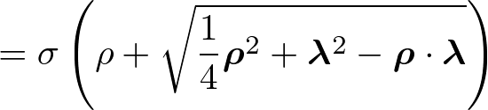

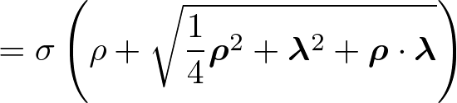

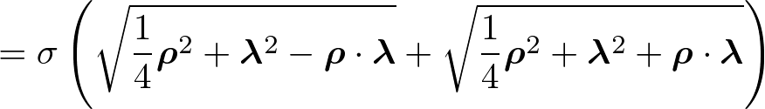
Jacobi coordinates (2)
•
⇒
•
⇒
•
⇒

Slide 23
string tension
Δ-string potential
Y-string potential
3
3
3
3
3
3
3

