Slide 1
Physics of Dense Matter in Heavy-ion Collisions at J-PARC
Masakiyo Kitazawa
J-PARC研究会、2015/8/5、J-PARC

Slide 2

Heavy Ion Collisions before 2005
relativistic heavy ion collisions
hot and dense medium

Slide 3
Heavy Ion Collisions before 2005
relativistic heavy ion collisions
hot and dense medium
The most important objective before 2005
Creation of the quark-gluon plasma (QGP)
established at RHIC

Slide 4




√s Dep. of Heavy Ion Collisions
Nuclear
liquid-gas
transition
~0.3GeV
Hadronic
DoF
Formation of
“s”QGP
AGS
SPS
top RHIC
200GeV
LHC
2.76TeV

Slide 5
√s Dep. of Heavy Ion Collisions
Nuclear
liquid-gas
transition
~0.3GeV
Directions after RHIC
② Explore the
“crossover” region
① Understand QGP
more quantitatively
Hadronic
DoF
Formation of
“s”QGP
AGS
SPS
top RHIC
200GeV
LHC
2.76TeV

Slide 6
√s Dep. of Heavy Ion Collisions
Hadronic
DoF
Formation of
“s”QGP
AGS
SPS
top RHIC
200GeV
J-PARC
RHIC-BES I 7.7 ~ 62 GeV
LHC
2.76TeV
RHIC-BES II 7.7 ~ 20 GeV
1.9 ~ 6.2 GeV
2018~
NICA
BES:
Beam
Energy
Scan
2019~??
FAIR
2021~??

Slide 7
figure by 佐甲さん
佐甲、北沢、原子核研究
High collision rate at J-PARC

Slide 8

Findings at Top-RHIC Energy
Formation of QGP
  Quark number scaling / Jet quenching
“Strongly-coupled” QGP
  strong collective flow / success of ideal hydro models
Establishment of dynamical modelling
for time evolution of the hot medium
Lack of such a picture for low E
Note: Top-RHIC energy environment
justification of Bjorken picture
high statistical data due to high multiplicity

Slide 9
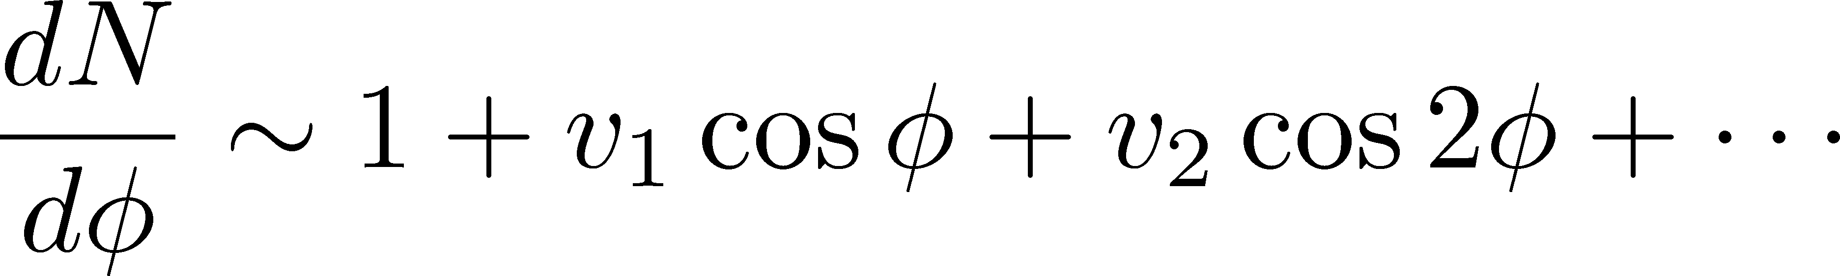
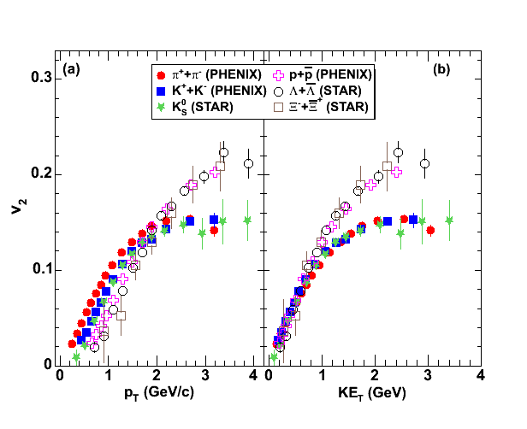
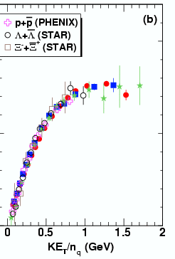
Elliptic Flow and Quark Number Scaling
non-central collision
Flow
z
beam axis
Ｙ
reaction plane
x
coordinate
space
reaction
plane
p_{T} space
v₂ >0
v₂ <0

Slide 10
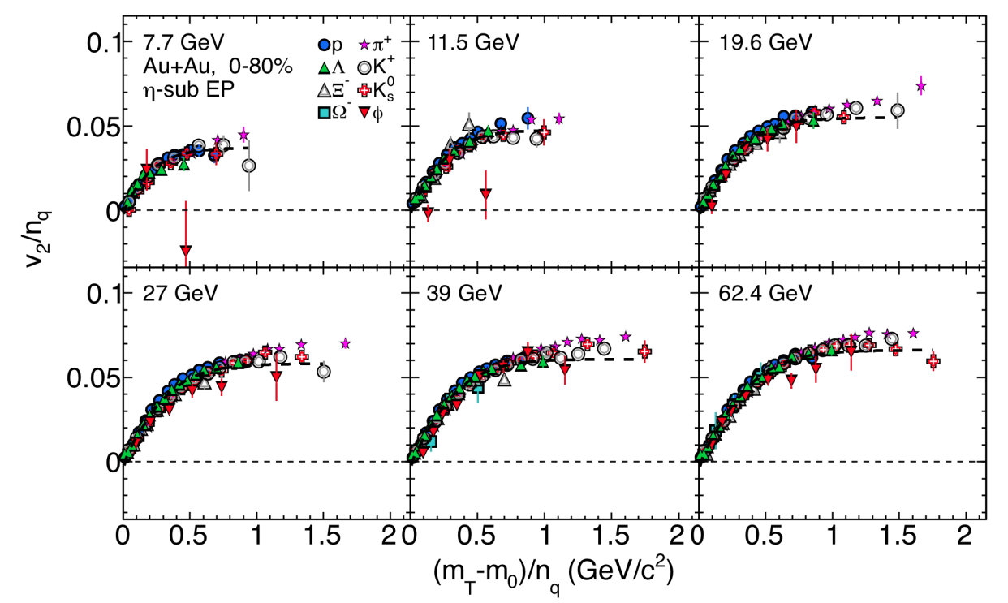
√s Dependence of QNS
STAR BES-I
QNS is well applicable even for 19.6GeV
Evidence of QGP formation for this energy??
Deviation of strangeness <11.5GeV
    Why and how??

Slide 11
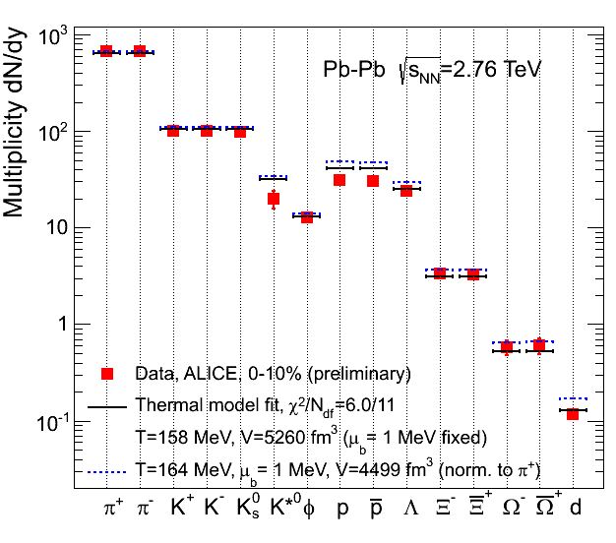
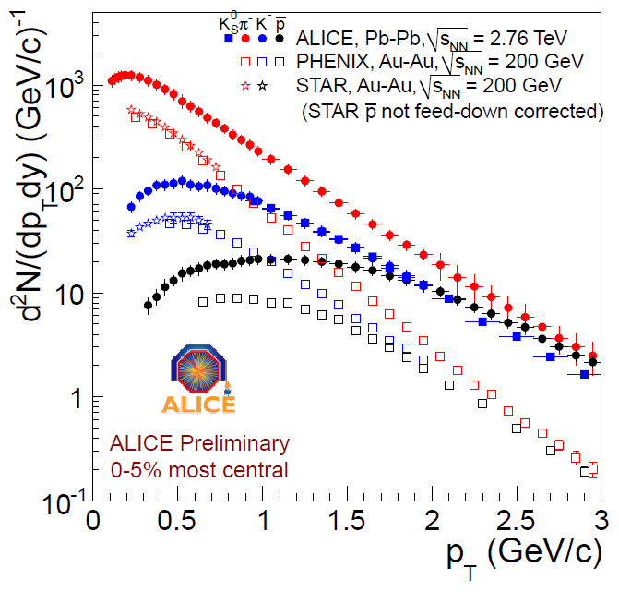
Chemical / Kinetic Freezeouts
Chemical Freezeout
Particle abundances are well described by a thermal fit.
chemical equilibration
estimate T and μ
Kinetic (Thermal) Freezeout
pT spectra is well described by thermal + blastwave model.
(radial) collective flow
estimate T

Slide 12
√s Dep. of Heavy Ion Collisions
Nuclear
liquid-gas
transition
~0.3GeV
Quark Number Scaling
?
Freezeout Pictures ~ near equil.
Hadronic
DoF
Formation of
“s”QGP
AGS
SPS
top RHIC
200GeV
J-PARC
RHIC-BES I 7.7 ~ 62 GeV
LHC
2.76TeV
RHIC-BES II 7.7 ~ 20 GeV
1.9 ~ 6.2 GeV

Slide 13
Crossover Phenomena
low T ←→ high T
weak-strong couplings
Example: BCS-BEC crossover
Leggett, 1980; Nozieres, Schmitt-Rink, 1985
Bose-Einstein
condensate
(BEC)
unitary
Fermi gas
2005~
Conventional
superconductor
(BCS state)
strong
coupling
weak
History of physics: simple limiting cases → intermediate region

Slide 14
QCD Phase Diagram
RHIC
T
Hadrons
Color SC
0
μ

Slide 15

Beam-Energy Scan
STAR 2012
high
beam energy
T
low
Hadrons
Color SC
0
μ

Slide 16
√s vs Maximum Density
Density at freezeout
Trajectory on T-ρ plane
A. Ohnishi, 2002
Maximally compressed medium would be created at J-PARC energy.
Density would exceed 5~10ρ₀
Large event-by-event fluctuations of stopping?

Slide 17
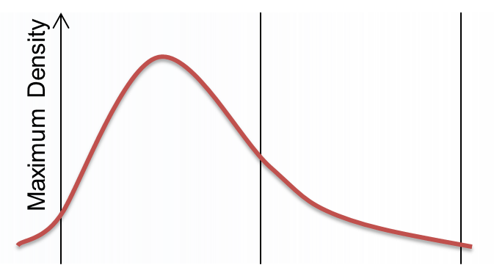
√s Dep. of Heavy Ion Collisions
Quark Number Scaling
Freezeout Pictures ~ near equil.
Hadronic
DoF
Formation of
“s”QGP
AGS
SPS
top RHIC
200GeV
J-PARC
RHIC-BES I 7.7 ~ 62 GeV
LHC
2.76TeV
RHIC-BES II 7.7 ~ 20 GeV
1.9 ~ 6.2 GeV

Slide 18
HIC@J-PARC : Motivations
Intermediate energy collisions
Fill the gap between two different pictures for low- and high-energy collisions
Onset of deconfinement phase transition
Construction of dynamical models
Medium at high baryon density
QCD phase structure
EoS of dense medium → Neutron stars

Slide 19
Toward Dynamical Picture for Time Evolution
/ Collective Flow

Slide 20
Dynamical Model for RHIC Energy
QGP
Hadronic
thermalization
~0.6fm/c
Hydrodynamic
equation
Hadronic cascade
model
Heavy ion collisions at J-PARC energy does not have this kind of dynamical picture.
Is hydro applicable? Then, how long??

Slide 21
High Intensity Beam at J-PARC
Statistics at J-PARC
more than 4 order better than previous exps. with similar energy
J-PARC will provide us with
high-precision data
detailed bin dependences (centrality, p_{T}, etc.)
various event selections

Slide 22
Directed Flow v₁
non-central collision
Flow
z
beam axis
Ｙ
reaction plane
v₁ >0
v₁ <0
x
v₁=0 at mid-rapidity
v₁ can take nonzero value at nonzero η

Slide 23
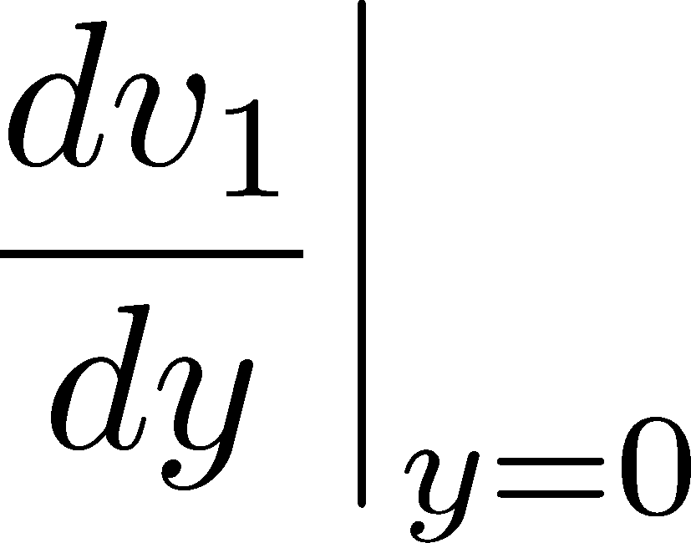
Directed Flow v₁ @ BES-I
y dependence
STAR BES I
sign change at √s ~ 9 GeV
not fully understood
recent progress: Nara-san, heavy-ion pub

Slide 24
High statistics will also provide us with
rare probes (anti-proton, strangeness, …)
higher harmonics v₃, v₄, …
event-by-event harmonics / baryon stopping
event selection

Slide 25
New Observables
(at J-PARC energy)

Slide 26
Advantages of J-PARC Detector
(that I heard from Sako-san)
Detector design
lepton and photon
4π coverage
Observables
dilepton production rate
conserved-charge fluctuations
correlation functions

Slide 27


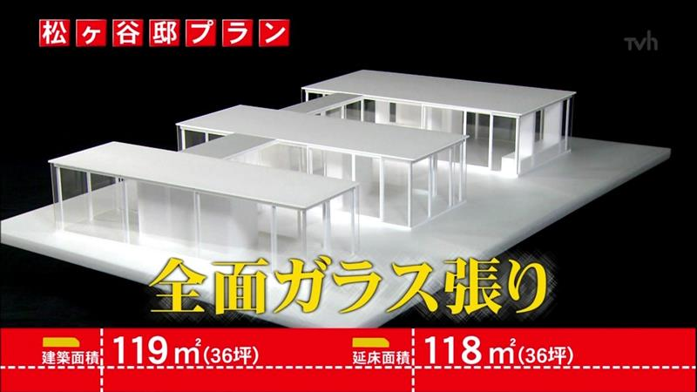

Dilepton Production Rate
Photon / lepton : no color charge
pass through hot medium without interaction
direct observables of hot medium
CAVEATES

Slide 28
Dilepton Production Rate
Result at STAR BES-I
minimum bias
large errorbar for low E

Slide 29
Dilepton Production Rate
Result at STAR BES-I
minimum bias
large errorbar for low E
at J-PARC …
high precision data
centrality / pT dependence
moment analysis

Slide 30

Event-by-event Fluctuations
STAR, PRL105 (2010)
Event-by-event
non-Gauusian fluctuation
STAR BES-I
particle numbers in each event
thermal fluctuation
thermal property of hot medium

Slide 31
Summary
Many interesting Physics in heavy ion collisions at J-PARC
  onset of deconfinement
  medium with highest baryon density
  limits of hadronic and partonic models
Experimental data with high statistics
  needed for a contruction of dynamical model
  precise understanding of the dense medium
New experimental techniques
  dilepton production rate
  fluctuations / correlaions
Understanding of the dense QCD medium will be
deepened with heavy ion collisions at J-PARC!!

Slide 32
Maximum Density

