Slide 1


New data and future plan of the gamma-ray spectroscopy of A=4 hypernuclei for study of CSB in ΛN interaction
Mifuyu Ukai
KEK/J-PARC Hadron
for the E13/E63 collaboration
Notes:
I’m Takeshi Yamamoto
from Tohoku university.
I would like to thank organizers for giving me this opportunity.
I will talk about
“Gamma-ray spectroscopy of He4L hypernuclei with Hyperball-J”
In April this year, we performed Gamma-ray spectroscopy experiment at J-PARC.
I am very happy to show you the newest result of our experiment on be half of E13 collaboration.

Slide 2

Contents
Introduction
  Charge symmetry breaking in ⁴_{Λ}H/ ⁴_{Λ}He
New data of E13 2015
  Excitation energy of ⁴_{Λ}He(1⁺)
  Future plan of E63
  Excitation energy of ⁴_{Λ}H(1⁺)
  Summary
Notes:
And, These are contents of my talk.
First,
I will talk about physics motivation:
Charge symmetry breaking in these mirror hypernuclei.
Then,
I will talk about gamma-ray spectroscopy experiment at J-PARC
,our detectors,
and new result of 4LHe excitation energy.
Finally, I will summarize my talk.

Slide 3
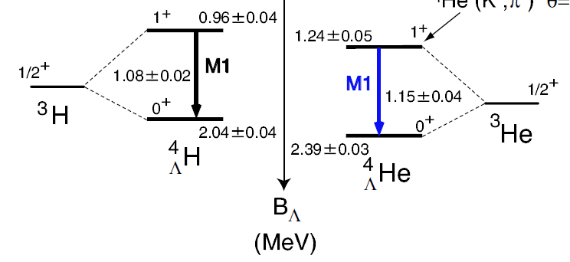
Charge symmetry breaking (CSB) in ΛN-interaction
+
Λp ≠ Λn ?
ΔΒ_{Λ} (0⁺) = 0.35 MeV , ΔΒ_{Λ} (1⁺) = 0.28 MeV
+
p
≠
n
Large CSB in ΛN-interaction ?
A. Nogga, H. Kamada, and W. Gloockle,
Phys. Rev. Lett. 88, 172501 (2002)
Eγ =
Considering
Coulomb force
2 body ΛN-ΣN coupling
( ⇒ 3 body ΛN-ΣN mixing )
1.09
Eγ =
Many theoretical studies,
but could not reproduce data
Re-examination of
existing data were long awaited
Level scheme of ⁴_{Λ}H and ⁴_{Λ}He
From emulsion data (g.s.) and
γ-measurement (Ex(1+))
Notes:
If Λ particle is bound in mirror nuclei H3 and He3,
mirror hypernuclei H4L and He4L are produced.
CSB in this A=4 hypernuclear system
is one of the hot topics in strangeness nuclear physics.
This is a level scheme of the mirror hypernuclei.
Spin doublets appear from coupling of core nuclear spin and Λ spin.
Λ Binding energies (BL) were measured with emulsion technique
And excitation energy were measured with NaI detectors back in 1970s.
Large difference exists in excitation energy and also BL
between mirror hypernuclei.
This result indicates that
charge symmetry breaking in ΛN interaction could be quite significant.
There are many theoretical studies by considering coulomb force with shrink effect of Lambda and 2-body ΛΣ coupling.
But none of them reproduces experimental data.
Therefor, there was a need for re-examination of existing data.
In fact, our experiment is dedicated to measure this He4L excitation energy
(anime)
And our new data replaced the value of 1.15 MeV by 1.4 MeV.

Slide 4
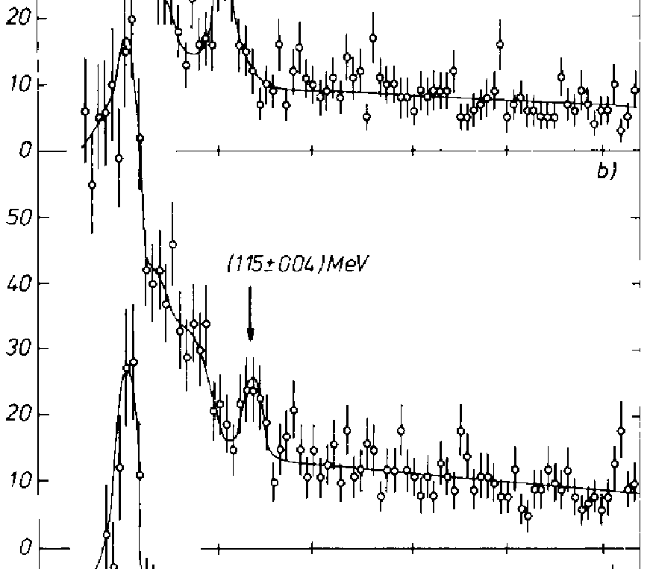
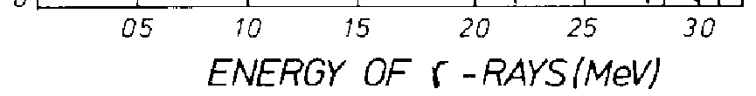
Old experiment for E_{γ}(⁴_{Λ}He)
Only one experiment
Hyperfragment production
Stopped K- reaction (Li target)
  detecting π0→γγ
  (with Pb + scinti. sandwich)
for tagging hypernuclei
  Doppler broaden γ peak
NaI detector
  Energy resolution : 120 keV(FWHM)
Limited statistics
Gamma-ray energy spectrum
with detecting π0→γγ decay
1.4 MeV (E13 data)
Direct Production
Higher sensitivity and statistics
can be achieved by
In-flight ⁴He(K-,π-)⁴_{Λ}He reaction
Ge detector (Energy resolution : 0.2%)
High intensity K beam
+ large acceptance spectrometers
M. Bedjidian et al., Phys. Lett. B 83, 252 (1979).
reported value : 1.15 (0.04) MeV
Notes:
I want to briefly discuss the past experiment.
Only one experiment was performed to measure the excitation energy of He4L.
This is an energy spectrum from this experiment
to show you the quality of data.
Reported energy value was 1.15 MeV.
But, hypernuclear tagging method has some difficulties on detecting pi0.
And they used NaI detector which has only 12% energy resolution
and Finally, this peak is statistically poor.
In comparison to this experiment,
our experiment can improve the measurement with these three features.
* First, we tagged direct production of He4L using inflight (K-,Pi-) reaction
* Second, we used Ge detector which has much better energy resolution
* In addition, we used high intensity kaon beam at J-PARC combined with large acceptance spectrometer.

Slide 5
New data
The J-PARC E13 experiment
⁴_{Λ}He(1⁺→0⁺) measurement
Notes:
Now, I will talk about our experiment: J-PARC E13

Slide 6
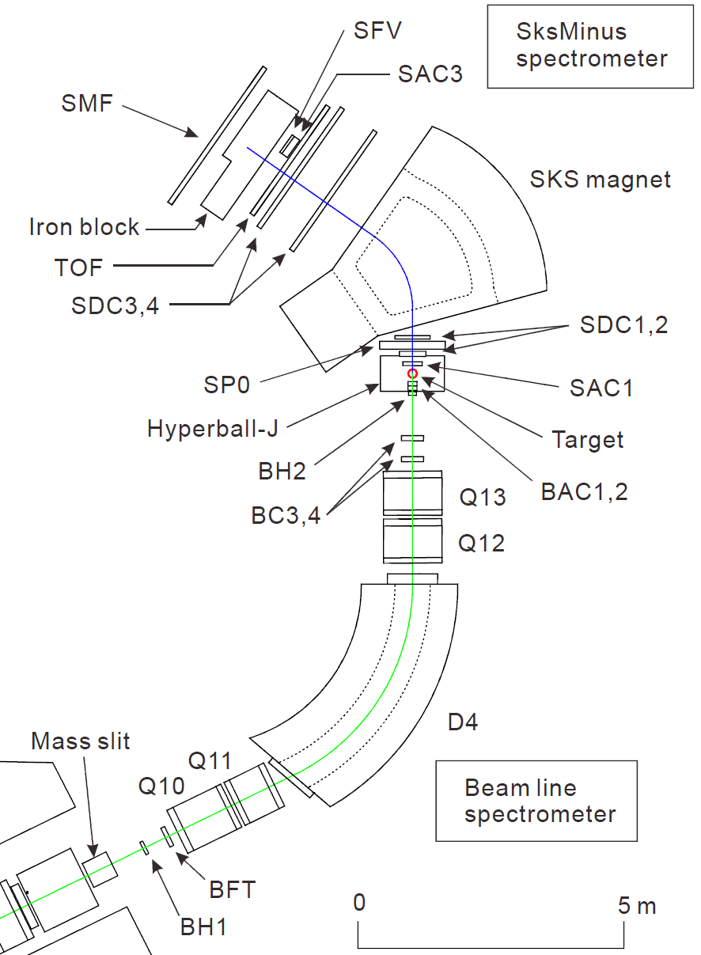
K1.8 experimental setup (E13)
Spectrometer
for scat. particle
（SksMinus）
Use high intensity K- beam delivered from J-PARC K1.8 beam line
pπ ~ 1.4 GeV/c
π⁻
⁴He(K⁻,π⁻)⁴_{Λ}He* ->⁴_{Λ}He+γ
reaction-γ coincidence experiment
Ge detector array
Hyperball-J
⁴_{Λ}He : liq.He target (2.7 g/cm²)
Total K beam : 23 G kaons
~ 5 days beam time
Just after HD hall resumption
In 2015 April.
K－
Beam line
spectrometer
pK = 1.5 GeV/c
Notes:
This is an experimental setup.
We performed reaction-gamma coincidence experiment
at the J-PARC K1.8 beam line.
Hypernuclei were produced by the (K- , pi-) reaction.
This production was tagged by two magnetic spectrometers:
the beam line spectrometer for incoming kaon
and SksMinus spectrometer for outgoing pion.
On the other hand,
gamma-rays from the hypernuclei were detected
by newly developed Ge detector array : Hyperball-J.

Slide 7
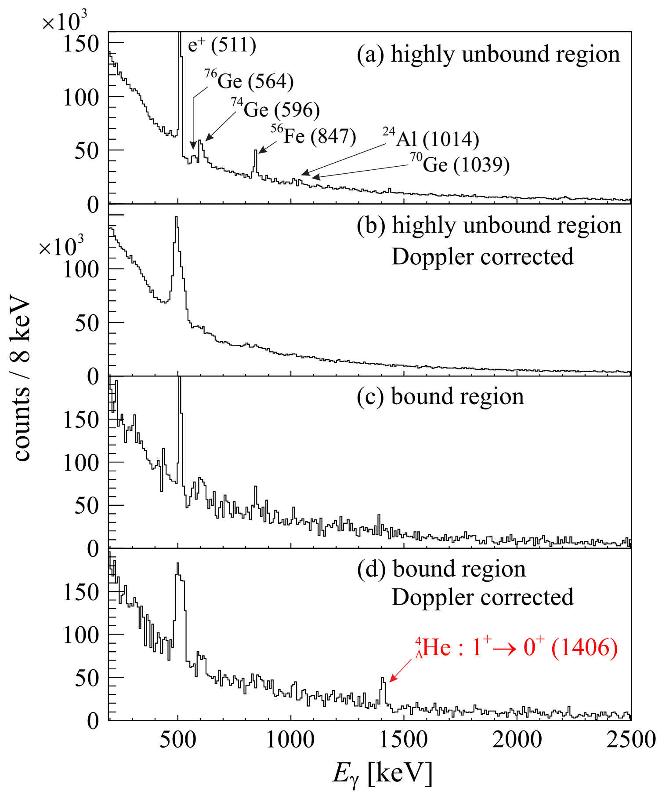
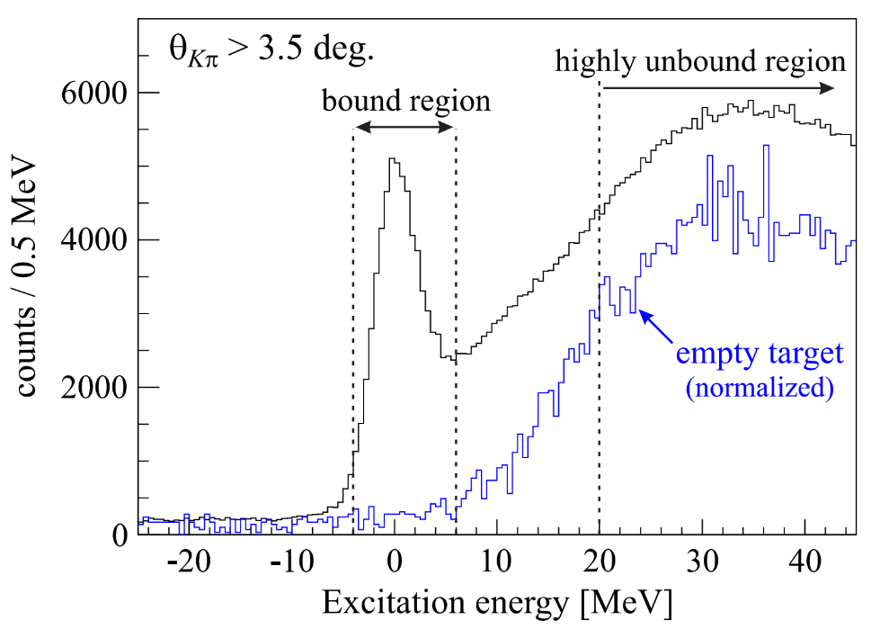
Mass gated gamma-ray spectrum
Gamma rays from only
non-strange nuclei
Doppler correction
No peak structure
Mass gate
Notes:
Ok, this is result.
This figure shows mass gated gamma-ray spectra.
In right figure, I show again missing mass spectrum.
This blue gate corresponds to highly unbound region.
With this gate, we obtained spectrum (a) and (b) to check accidental coincidence back ground.
Spectrum (b) is Doppler corrected one.
In spectrum (a), only gamma-rays from non-strange nuclei were found.
And in spectrum (b), There is no peak structure.

Slide 8
Mass gated gamma-ray spectrum
Mass gate
Doppler correction
1406 γ-ray peak was
attributed to be
⁴_{Λ}He(1⁺ →0⁺) transition
Notes:
On the other hand,
This red gate corresponds to He4L bound region.
with this gate, we obtained spectrum (c) and (d).
And spectrum (d) is Doppler corrected one.
Only in spectrum (d),
One significant peak was observed around 1.4 MeV.

Slide 9
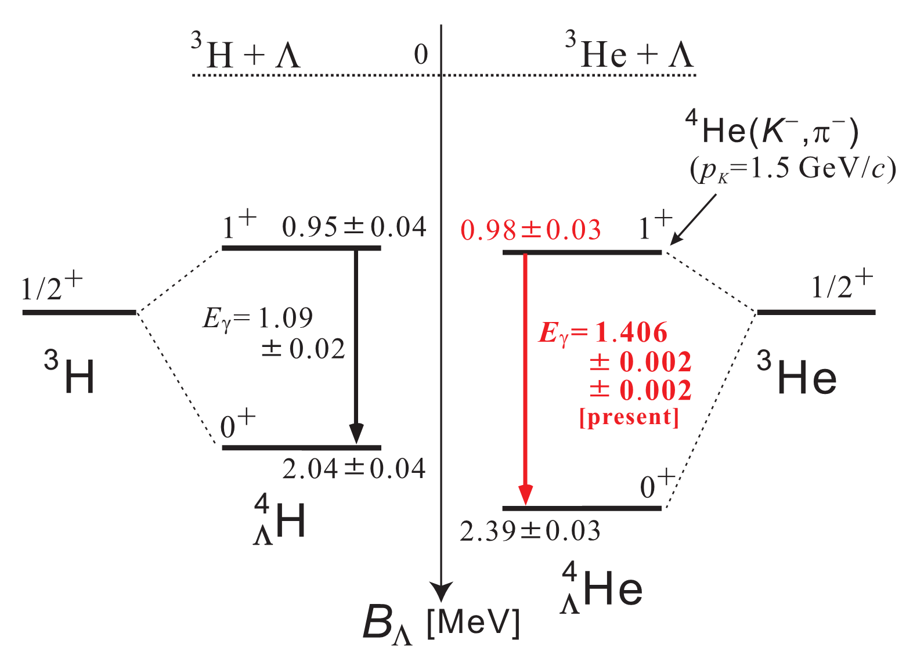
Revised level scheme and our finding
Old level scheme
Charge symmetry breaking is
Spin-dependent
1.09
Revised level scheme
ΔE_{γ} = E_{γ}(⁴_{Λ}He) - E_{γ}(⁴_{Λ}H)
= 0.32 ± 0.02 MeV
ΔB_{Λ}(1⁺) = B_{Λ}(⁴_{Λ}He(1⁺)) - B_{Λ}(⁴_{Λ}H(1⁺))
= 0.03 ± 0.05 MeV
ΔB_{Λ}(0⁺) = 0.35 ± 0.05 MeV
Notes:
This slide shows updated level scheme.
Upper is old one and Lower is revised one.
Old data of He4L excitation energy
was replace by present data of 1.4 MeV.
From this new data, we can calculate
difference in excitation energy to be about 300 keV
And also we can calculate difference in B_lambda of 1+ state
to be only 30 keV.
This difference is quite small
while more that 300 keV difference in 0+ state.

Slide 10
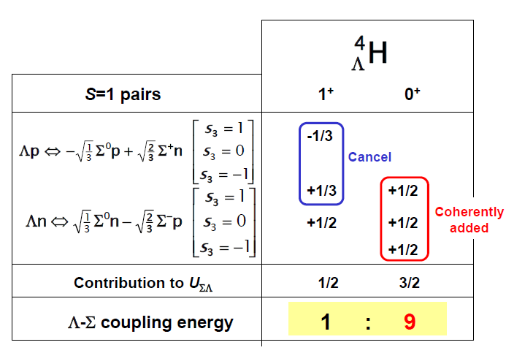
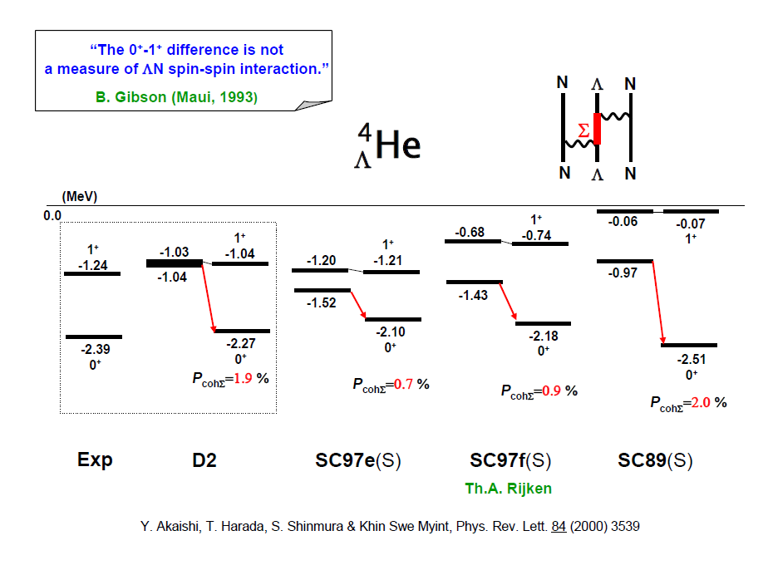
What is the origin of the large CSB effect?
-0.98
ΛN-ΣN coupling
force
Akaishi et al.,
PRL 84 (2000) 3539
D2: central only
The observed CSB effect is sensitive to
the ΛN-ΣN coupling force.
SC: tensor dominated
＊Exact calc. including Σ⁺Σ⁻ mass difference as well as CSB in BB force
(Nijmegen SC97e) gives only ΔB_{Λ}(0⁺) ~70 keV.
Nogga et al., PRL 88 (2002) 172501
＊p-shell hypernuclear levels are very well reproduced by Λ−Σ coupling
from D2 interaction. Millener (2005)
A. Gal, PLB 744 (2015) 352
＊Shell model calc. using D2 gives ΔB_{Λ}(0⁺) ~200 keV.
＊Ab-initio calc. using χ-EFT force reproduces Δ(B_{Λ}(0⁺)- ΔB_{Λ}(1⁺)) ~1.4 MeV.
= Large central force
D. Gazda and A. Gal

Slide 11
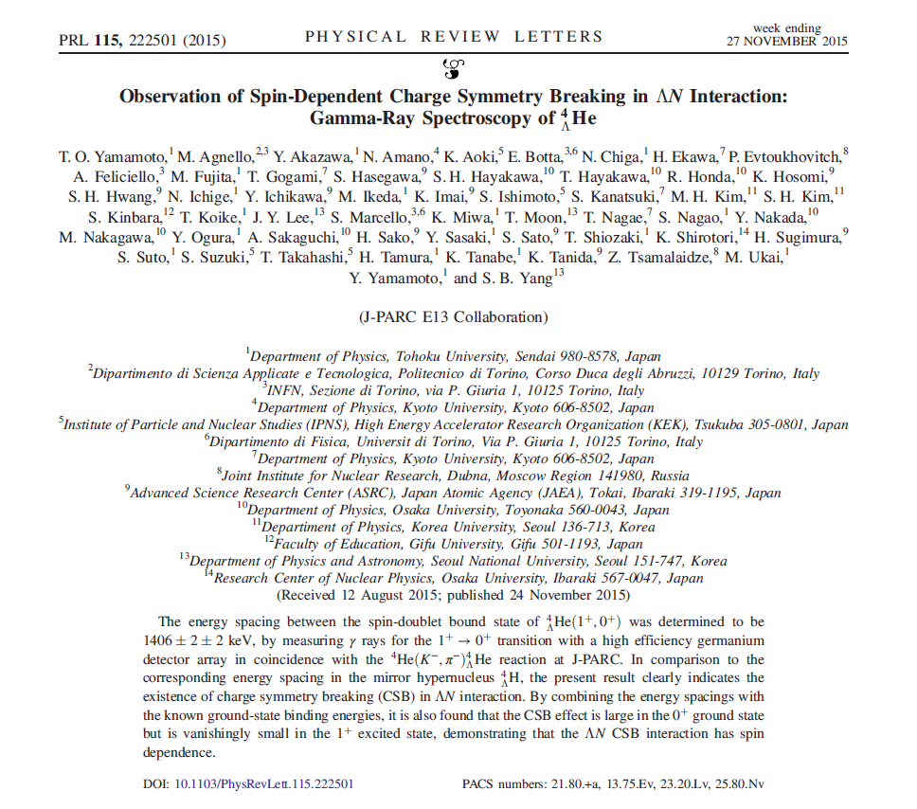
Notes:
Now, I will talk about analysis and result.

Slide 12
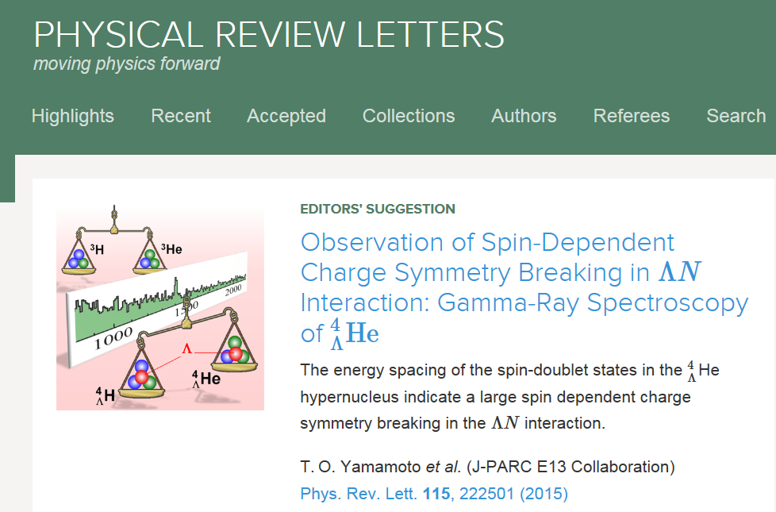
Press-released from Tohoku U., KEK, JAEA, J-PARC
Notes:
Now, I will talk about analysis and result.

Slide 13
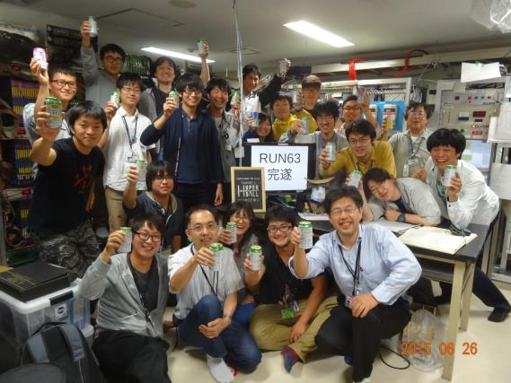

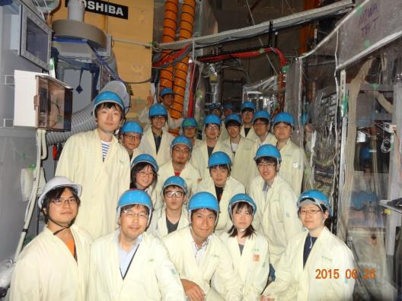
K1.8 counting room
K1.8 area
Non alcohol beer

Slide 14
Future plan
J-PARC E63
⁴_{Λ}H(1⁺→0⁺) measurement

Slide 15
Previous ⁴_{Λ}H(1⁺→0⁺) measurement
Three independent experiments
measured ⁴_{Λ}H(1⁺→0⁺) transition
average
PLB83,252(1979)
PLB62,467(1976)
A.Kawachi Doctral thesis
Notes:
This is last slide of my talk.
This is very rough image of future plan.
For this CSB puzzle,
We need four experimental data;
Two for B_lambda of 0+ state
And two for excitation energy.
Present data confirm this excitation energy of He4L.
And recently, MAMI group reported BL of H4L with new technique of decay pion spectroscopy.
Their data was consistent with old emulsion data.
In future,
we hope BL of He4L will be confirmed with modern method.
And Our next challenge is
to confirm this excitation energy of H4L by gamma-ray spectroscopy at J-PARC.

Slide 16
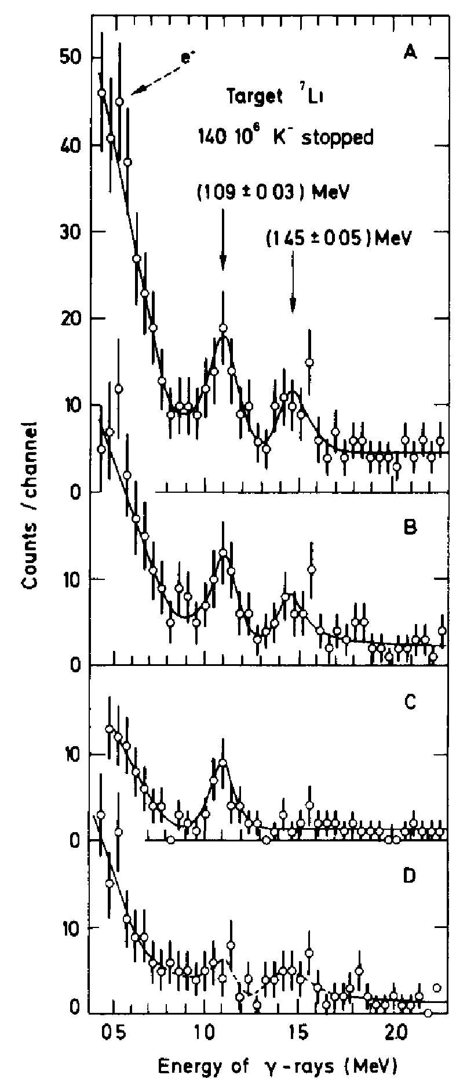
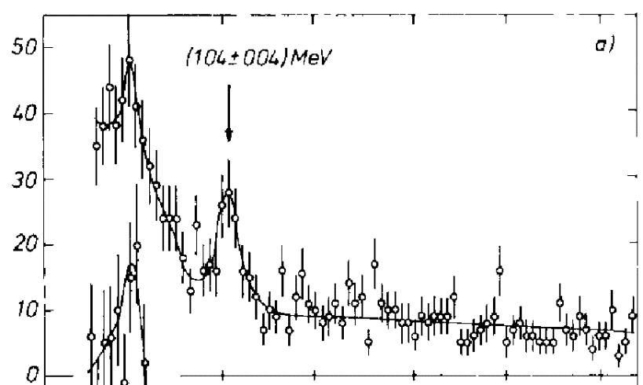
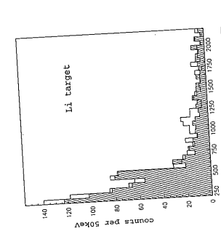
Previous ⁴_{Λ}H(1⁺→0⁺) data via stopped K⁻ on Li target
M. Bedjidian et al.
Phys. Lett. B 62,
467 (1976).
M. Bedjidian et al.
Phys. Lett. B 83,
252 (1979).
160 keV(FWHM) resolution
(~180 keV w/ Doppler broad)
Kawachi, Doctoral thesis
Univ. of Tokyo (1997)
Large Doppler-broadening of γ peak
~ 160 keV (FWHM) (with 7%NaI resolution;kawachi)

Slide 17
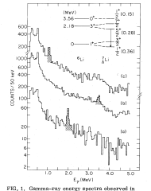
Previous ⁴_{Λ}H(1⁺→0⁺) data via inflight (K⁻,π⁻) on ⁷Li target
1.1 1.4
Gating highly unbound region of the missing mass
1.108 ± 0.010 MeV with systematic error
We will confirm this result with high sensitivity
by Hyperball-J and J-PARC K1.1 beam line
Higly unbound
Bound region
Possible reaction process; (K-,π-)reaction on α cluster
K- + α + t -> Λ + ³He + π- + t
Λ+3He -> ⁴_{Λ}He (0⁺ only non-spin-flip)
Λ+ t -> ⁴_{Λ}H (Both 0+/1+ ratio =1:3 expected)
M.May, PRL 51(1983)2085
⁷Li
NaI 74 keV(FWHM) at 1 MeV
Reasonable reaction to produce ⁴_{Λ}H(1⁺) state

Slide 18
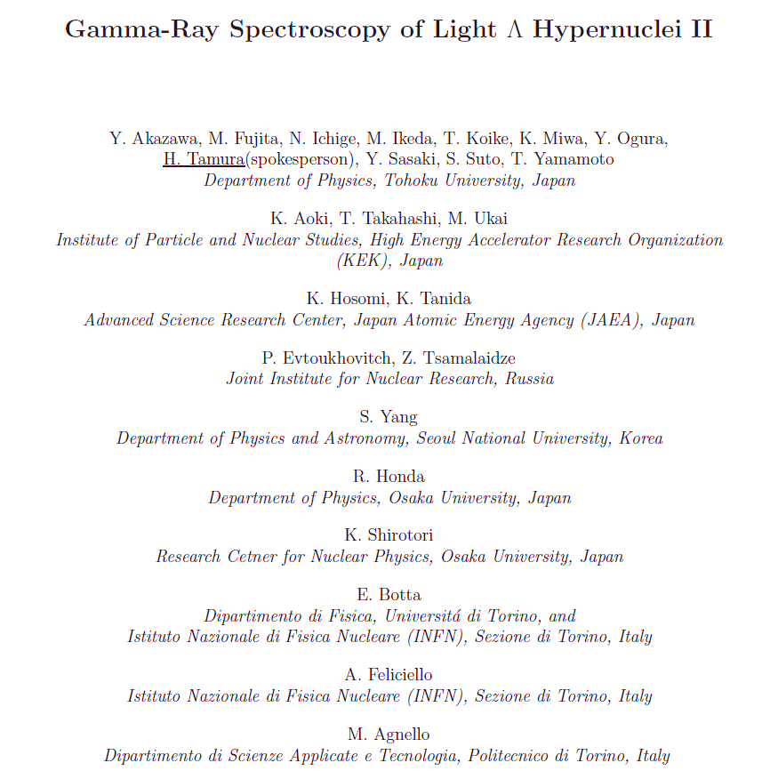
31 participants from 12 institutes
S. Nagao
S. Sato
E63 (E13-2)
Submitted in Dec. 2015
stage-1 approval
J.Y Lee, T.J. Moon
⁴_{Λ}H γ-ray spectroscopy
via ⁷Li(K-,π-) reaction
One of the movitiaons of
E63
J.K. Ahn, S.H. Kim
Korea University, Korea
T. Wang
Beihang University, China

Slide 19
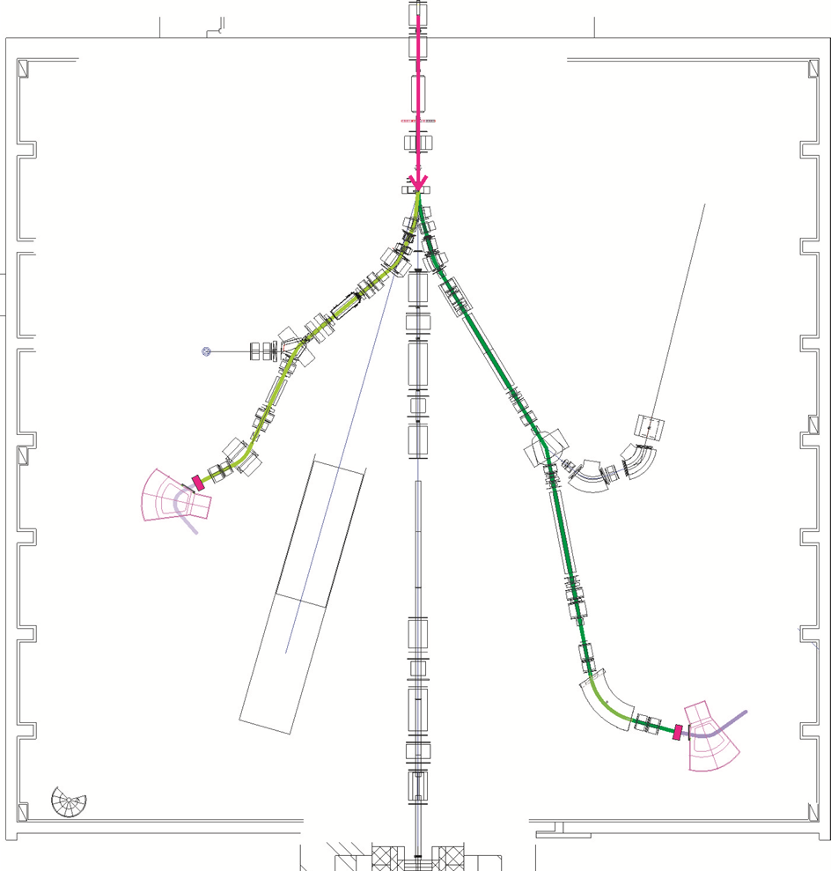
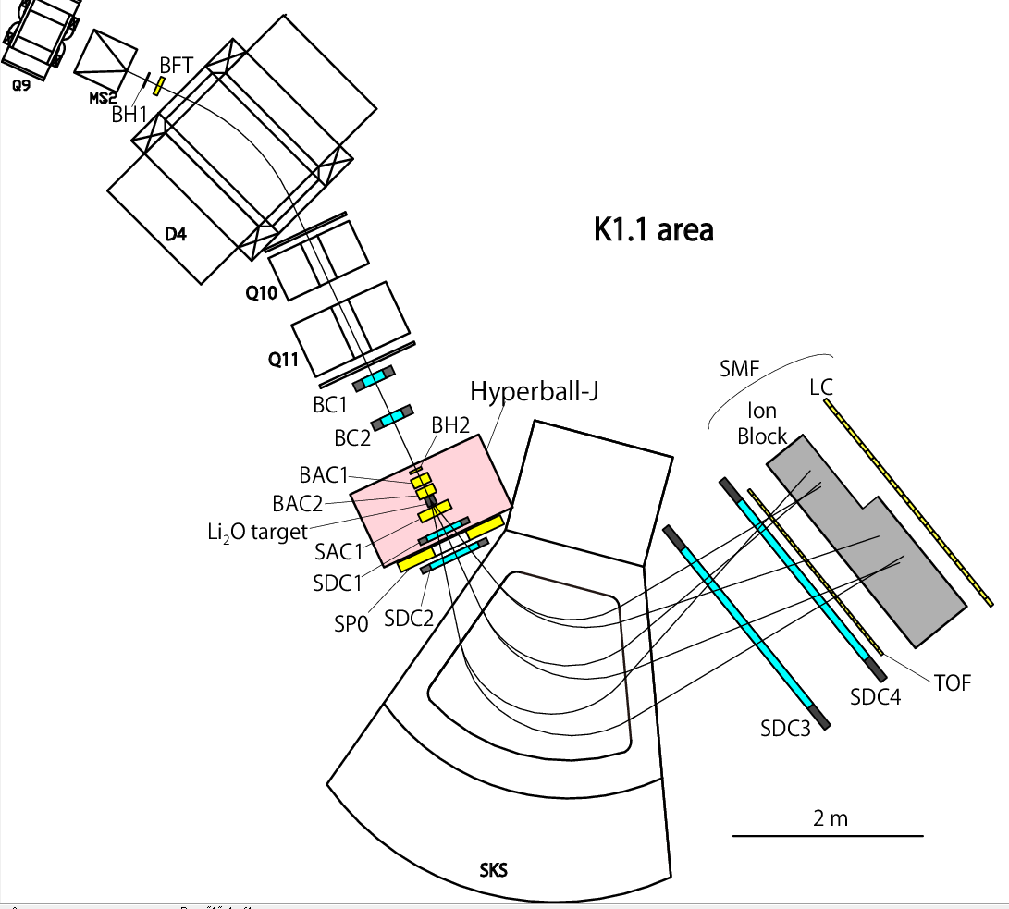

K1.1 beam line setup
K1.1 Beam line @ 50 kW
1.1 GeV/c | 180 k/spill
0.9 GeV/c | 60 k/spill
Detectors are the same as E13-1
Only minor modification
K1.1/SKS available
~FY2017
K1.1
E13 at K1.8
in 2015
K1.8
π- spectrometer SKS and
Ge array Hyperball move from K1.8 to K1.1
SKS Just now constructing at K1.1 area

Slide 20
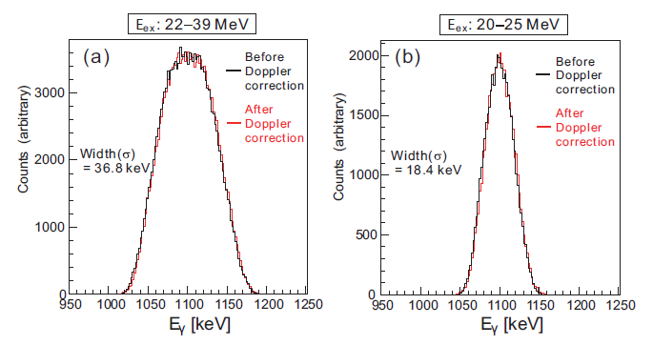
Experimental conditions for ⁴_{Λ}H(1⁺→0⁺) γ-ray
 | BNL experiment | E63 (present work)
# K beam | 10 G Kaons | 5 G Kaons (6 days)
Target thickness | 8 g/cm2 (natural) | 15 g/cm2 (enrich)
g-ray efficiency | 6% | ~ 6%
Effective π− acceptance | < 18 msr ? | ~35 msr (SKS < 6°selection)
γ peak counts | 150 counts | > 300 counts ~ 75 (Slow event)
Resolution | NaI 40 keV(σ) | Ge 2 keV(σ)
Doppler broad | 37 keV(σ) | 18 keV(σ)
Peak width | 54 keV(σ) | 18 keV(σ)
Eex = 22- 39 MeV
Eex = 20- 25 MeV
By selecting the excitation
energy, Doppler broad width
can be partly controlled.
Slow
event

Slide 21

Summary
Study of Charge Symmetry Breaking
in ΛN interaction via the ⁴_{Λ}H/ ⁴_{Λ}He
New data of E13 at K1.8,
Excitation energy ⁴_{Λ}He(1⁺) = 1.406(5) MeV
Large CSB and spin-dendence was confirmed
  E63 at K1.1 is proposed to determined
  excitation energy of ⁴_{Λ}H(1⁺) precisely
Notes:
And, These are contents of my talk.
First,
I will talk about physics motivation:
Charge symmetry breaking in these mirror hypernuclei.
Then,
I will talk about gamma-ray spectroscopy experiment at J-PARC
,our detectors,
and new result of 4LHe excitation energy.
Finally, I will summarize my talk.

