Slide 1
Few-body approach for structure of light kaonic nuclei
Shota Ohnishi (Hokkaido Univ.)
In collaboration with
Tsubasa Hoshino (Hokkaido Univ.)
Wataru Horiuchi (Hokkaido Univ.)
Kenta Miyahara (Kyoto Univ.)
Tetsuo Hyodo (YITP, Kyoto Univ.)

Slide 2



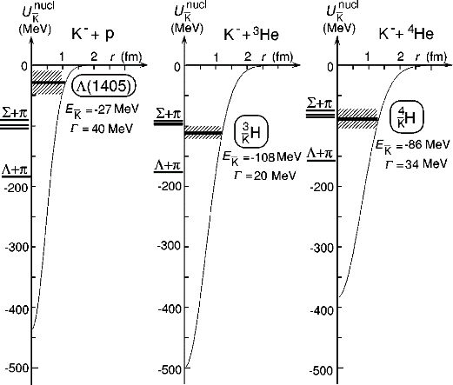
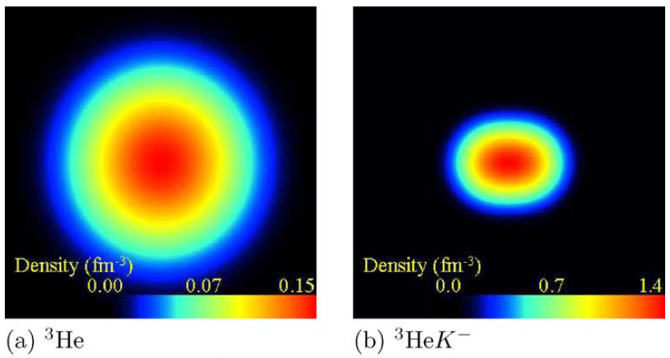
Kaonic nuclei
Λ(1405); J^{π}=1/2⁻, S= -1
  q^3(uds): P-wave excited state
    (much higher mass expected than experimental observation)
  unstable bound state
u
s
d
Isgur, Karl, PRD 18, 4187(1978).
  Dalitz, Wong, Tajasekaran, PR 153(1967)1617.
strongly attractive interaction in I=0, L=0
deeply bound and compressed systems are proposed
- phenomenological potential and optical potential/ g-matrix approach
Y. Akaishi, T. Yamazaki, PRC 65, 044005 (2002).
Dote, et. al., PLB590, 51(2004).

Slide 3
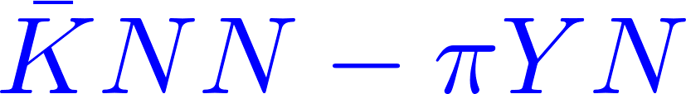
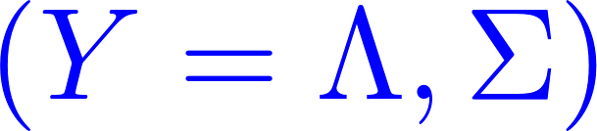
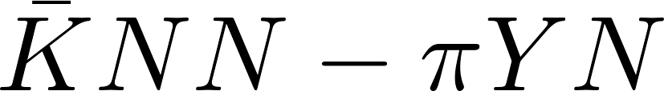



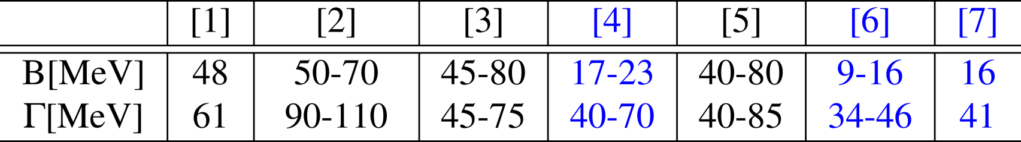
strange dibaryon
Deeply binding and compressed systems?
A test ground: three-body system (strange-dibaryon)
many particle dynamics can be examined accurately
theoretical investigations:
interactions | Phenomenological | Chiral SU(3)
Variational | Akaishi, Yamazaki[1] Wycech, Green[5] | Doté, Hyodo, Weise[4] Barnea, Gal, Liverts[7]
Faddeev eqs. | Shevchenko, Gal , Mares[2] | Ikeda, Sato[3] Ikeda, Kamano, Sato[6]
Black；E-indep.
Blue；E-dep.
[1] Akaishi, Yamazaki, PRC 65, 044005 (2002).
[2] Shevchenko, Gal, Mares, PRL. 98, 082301 (2007).
[3] Ikeda, Sato, PRC 76, 035203 (2007).
[4] Dote, Hyodo and Weise, NPA 804, 197 (2008).
[5] Wycech and A. M. Green, PRC 79, 014001 (2009).
[6] Ikeda, Kamano, Sato, PTP 124, 533 (2010).
[7] Barnea, Gal, Liverts, PLB 712, 132(2012).

Slide 4
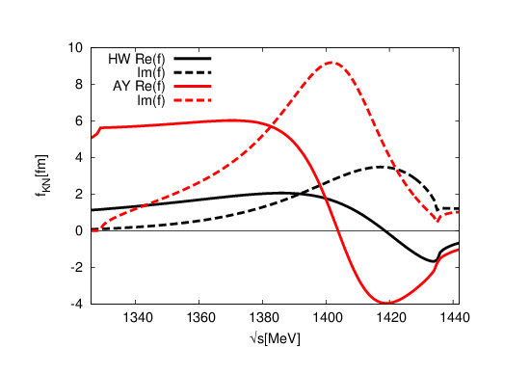
Pole position of Λ(1405) and energy dependence of the potential
Re(f)
Im(f)
HW potential
Re(f)
AY potential
Im(f)
Hyodo, Weise, PRC77, 035204 (2008).
Phenomenological potential
Chiral SU(3) dynamics
Akaishi, Yamazaki, PRC65, 04400(2002).
Shevchenko, PRC85, 034001(2012).
Kaiser, Siegel, Weise, NPA594, 325(1995).
Oset, Ramos, NPA635, 99(1998).
Hyodo, Jido, PPNP67, 55(2012).
Λ(1405), one pole
Energy independent
Λ(1420), two pole
Energy dependent
These difference are enhanced in
kaon-nucleus quasi-bound states

Slide 5
Strategy of this work
Study the structure of light kaonic nuclei w/o many-body approximation
  Perform calculation from three- to seven-body systems by using stochastic variational method with correlated Gaussian basis
Investigate how the structure of nuclei is changed by kaon
  Investigate how the structure of kaonic nuclei depends on KN interaction model
Varga, Suzuki, Comp. Pnys. Com. 106 (1997) 157.

Slide 6
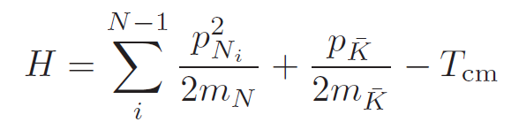
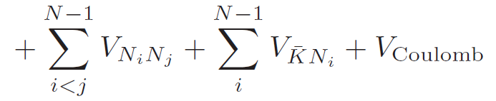
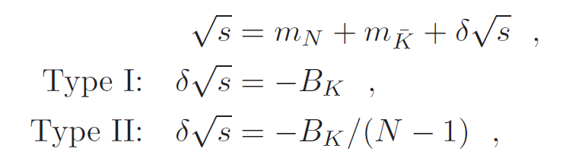
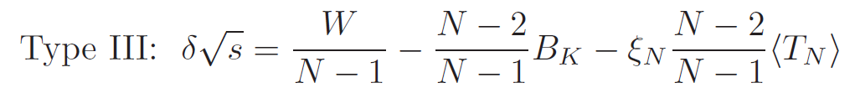
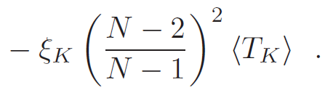


Two-body interactions
Hamiltonian for N-body systems
  V_{KN}: Miyahara-Hyodo (MH) potential [1], which reproduce the scattering amplitude by
  chiral SU(3) dynamics using driving interaction at NLO [2]
  Energy-dependent single-channel potential
  Pole energy: 1424 - 26i and 1381 – 81i MeV
  K^{bar}N two-body energy in N-body systems are determined as:
  We also use Akaishi-Yamazaki (AY) potential to investigate KN potential dependence
  V_{NN}: AV4’ potential, which reproduce binding energies of light nuclei
[1]K.Miyahara, T.Hyodo, PRC 93 (2016) 1, 015201.
[2]Y.Ikeda, T.Hyodo, W.Weise, NPA881 (2012) 98 .
A. Dote, T. Hyodo, W. Weise, NPA804, 197 (2008).
N. Barnea, A. Gal, E. Liverts, PLB712, 132 (2012).
Akaishi, Yamazaki, PRC65, 04400(2002).
R.B.Wiringa, S.C.Pieper, PRL89,182501 (2002).

Slide 7

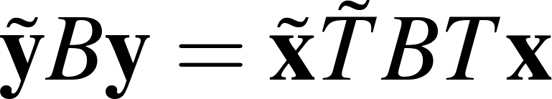
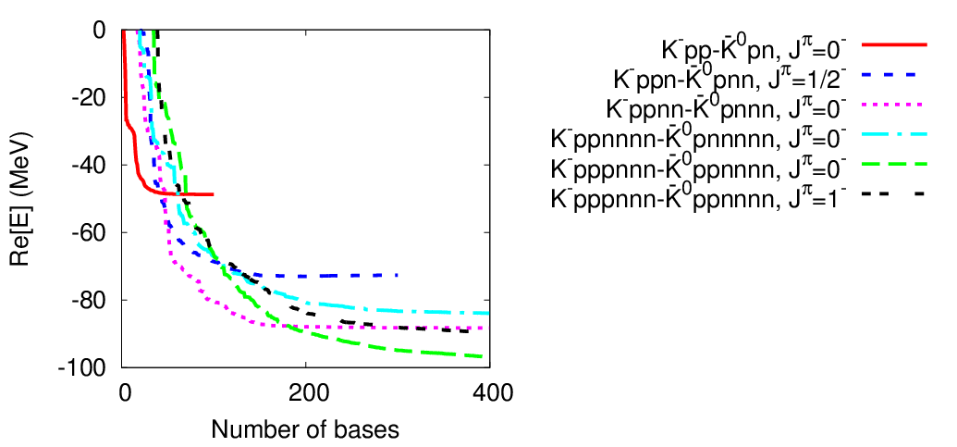
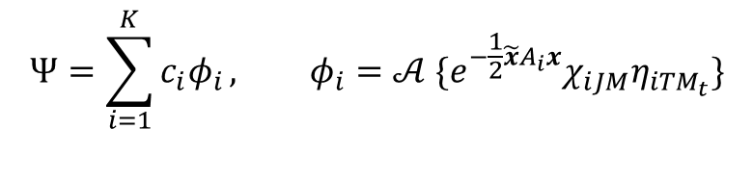
Correlated Gaussian basis
Varga, Suzuki, Comp. Pnys. Com. 106 (1997) 157.
$$Ψ=\sum_{i=1}^{K}{c_{i}φ_{i}}, φ_{i}=𝒜 \{e^{−\frac{1}{2}\tilde{x}A_{i}x}χ_{iJM}η_{iTM_{t}}\}$$
$A_{i}:\left(N−1\right)×\left(N−1\right) matrix (paramaters of coordinates )$
$x=\left\{x_{1}, x_{2},…, x_{N−1}\right\}$, $χ_{iJM}:spin function$, $η_{iTM_{t}}:isospin function$
Correlated Gaussian basis represent the total angular momentum L=0,
but higher partial wave for each x_{i} are included by off-diagonal component of A_{i}.
Matrix elements are analytically calculable for N-body systems
Functional form of the correlated Gaussian remains unchanged
under the coordinate transformation
Stochastic variational method
To obtain the well variational
basis, we increase the basis
size one-by-one by searching
for the best variational
parameter A_{i} among many
random trials
x₂
x₁
y₃
y₂
x₃
y₁
Energy convergence curve for AY-potential

Slide 8
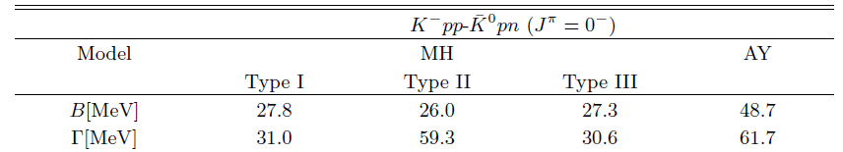
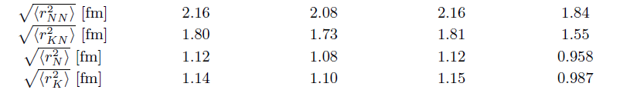
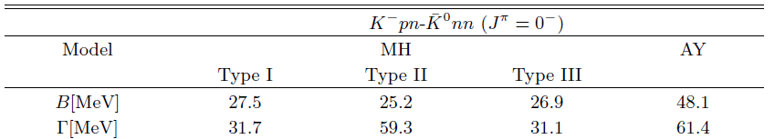
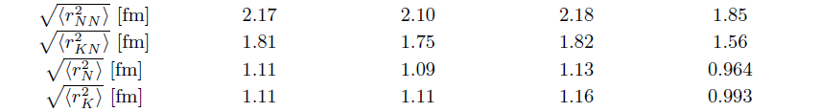
Structure of K^{bar}NN with J^{π}=0⁻
Coulomb splitting is small (~0.5MeV)
Binding energies are almost same between
Type I, II, and III, but width of Type II is twice larger than Type I and III
Binding energy for AY-potential is 48 MeV
The radii for AY-potential become smaller than MH-potential

Slide 9
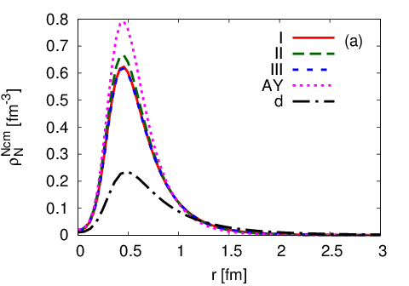
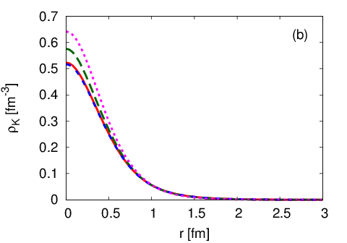
Density distribution of K⁻pp-K^{0bar}pn
Nucleon distribution from C.M. of NN
kaon distribution from C.M. of KNN
(deuteron is J=1)
Central density for MH-potential is slightly smaller than density for AY-potential

Slide 10
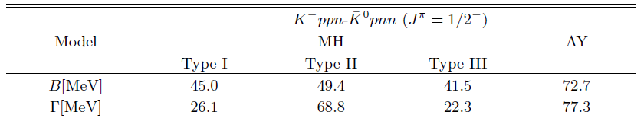
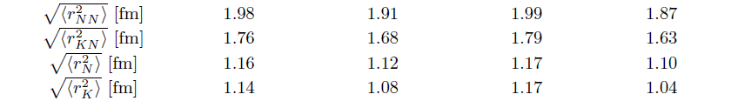
Structure of K^{bar}NNN with J^{π}=1/2⁻
Binding energies are almost same between Type I, II, and III,
but width of Type II is twice larger than Type I and II
Binding energy for AY-potential is 72 MeV, and it is smaller than 100 MeV
The radius for AY-potential is slightly smaller than MH-potential, but very close to Type II

Slide 11
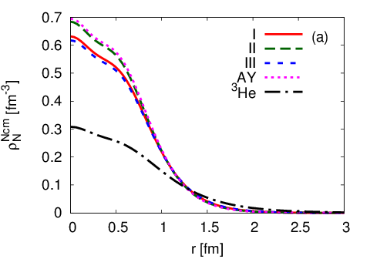
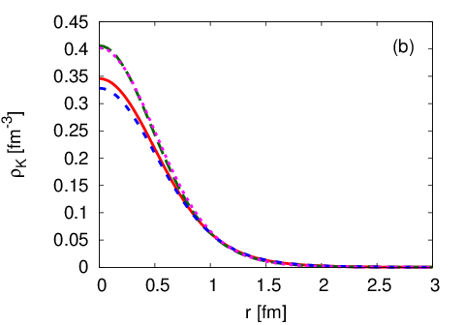
Density distribution of K⁻ppn-K^{0bar}pnn
Nucleon distribution from C.M. of NNN
kaon distribution from C.M. of KNNN
Central nucleon density ρ(0)~0.6fm⁻³ is twice larger than ³He, but smaller than the density ρ(0)=1.4 fm⁻³ predicted by using AMD with g-matrix effective KN and NN interactions
Dote, et. al., PLB590, 51(2004).

Slide 12
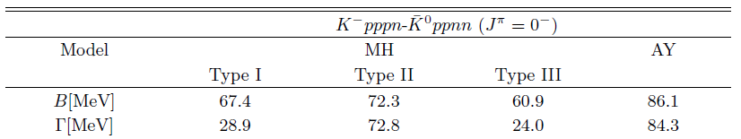
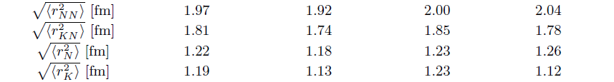
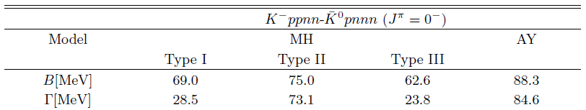
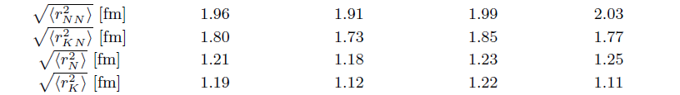
Structure of K^{bar}NNNN with J^{π}=0⁻
Coulomb splitting is large (~2 MeV), since Coulomb effect is repulsive for K⁰ppnn, but attractive for K⁻ppnn
Binding energy is about 60-70 MeV for MH-potential
width of Type II is twice larger than Type I and III
Binding energy for AY-potential is about 86 MeV
The radii of the systems for Type II are slightly smaller than Type I and III
For AY-potential the radius of kaon is slightly small, but radius of nucleon is slightly large

Slide 13
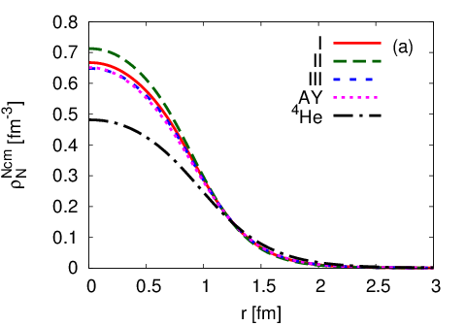
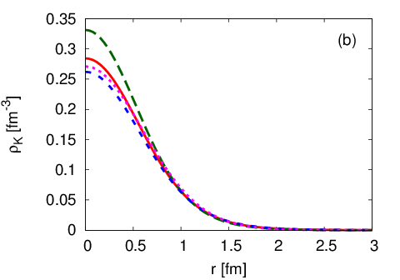
Density distribution of K⁻ppnn-K^{0bar}pnnn
Nucleon distribution from C.M. of NNNN
kaon distribution from C.M. of KNNNN
Central nucleon density ρ(0)~0.7fm⁻³ is 1.5 times larger than ⁴He

Slide 14
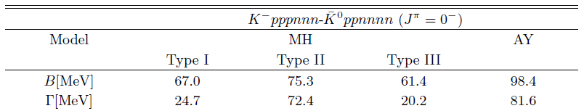
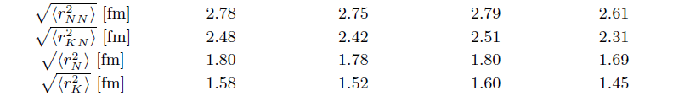
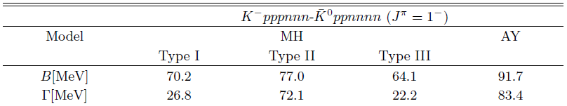
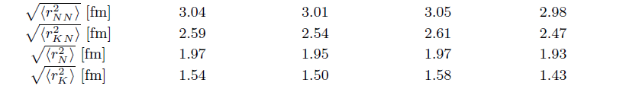

Structure of K^{bar}NNNNNN with J^{π}=0⁻ and 1⁻
Binding energy for MH-potential is 61-75 MeV for 0⁻ and 64-77 MeV for 1⁻
Width of Type II is three times larger than Type I and III
Binding energy for AY-potential is about 98 MeV (0⁻) and 92 MeV (1⁻)
The binding energy for 0⁻ state is smaller than for 1⁻ state for MH potential, but for 1⁻ state is smaller than 0⁻ state for AY potential
From the ground state quantum number for seven-body system, we may extract the information of KN interaction
Preliminary

Slide 15
Summary
We have investigated the structure of light kaonic nuclei, K^{bar}NN, K^{bar}NNN, K^{bar}NNNN and K^{bar}NNNNNN
Binding energies are 23-24, 40-48, 60-74, 61-77 MeV
Width largely depends how to deal with two-body energy in N-body systems, and it is around 20-30 MeV for Type I and III, and 60-70 MeV for Type II
Central density for K^{bar}NNN become twice larger than ³He
In the seven-body systems, J^{π}=1⁻ state is ground state for MH potential, but 0⁻ state is ground state for AY potential
Future plan
πΣ channel
Positive parity states

Slide 16
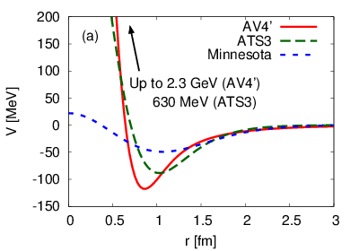
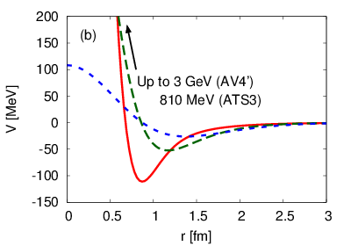
Dependence on NN interaction
³E
¹E
We investigate the NN interaction dependence by using
AV4’, ATS3, and Minnesota potential model,
which well reproduce the binding energy of s-shell nuclei

Slide 17
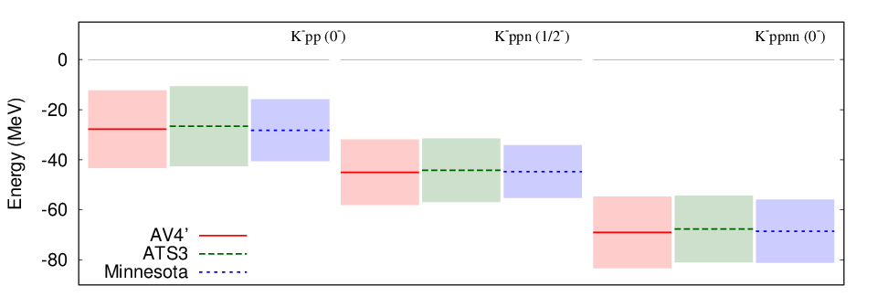
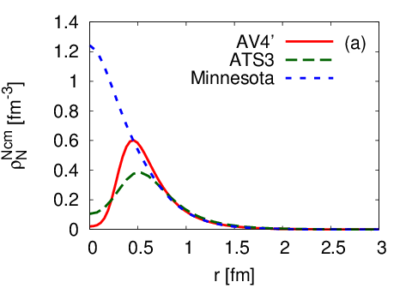
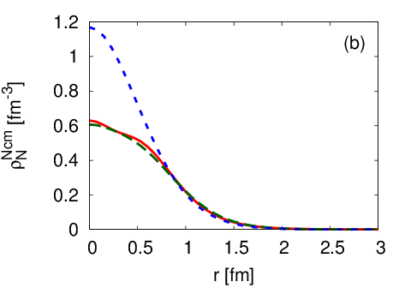
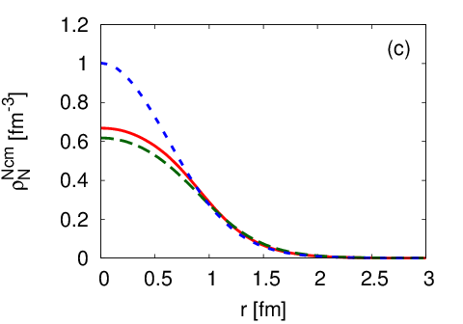
Dependence on NN interaction
Binding energy and decay width
Binding energy and
decay width are not
sensitive to NN
interaction model
Nucleon distribution
AV4’ and ATS3 potential with strong repulsive core produce similar density distribution,
but the central density for Minnesota potential with soft core become high.

Slide 18
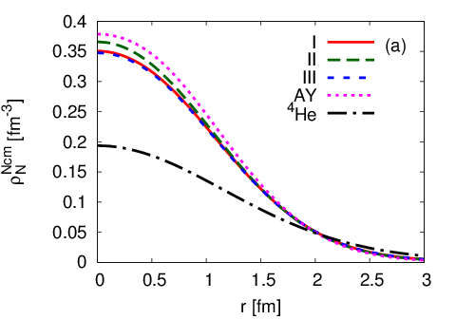
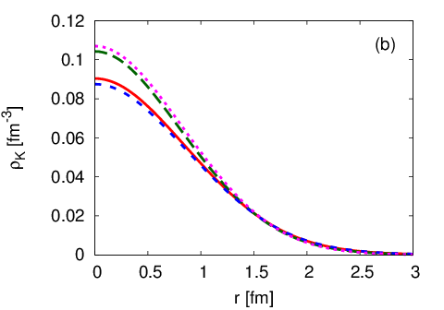
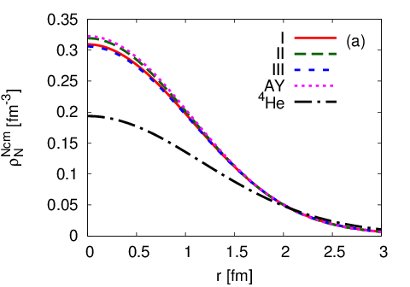
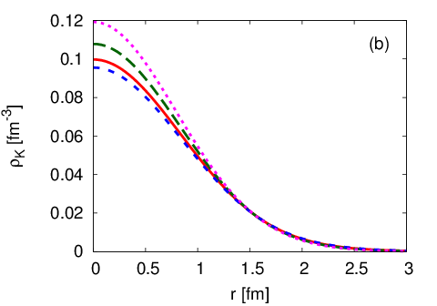
Density distribution of K⁻pppnnn-K^{0bar}ppnnnn
J^{π}=0-
J^{π}=1-

Slide 19





Gamow vector

