Slide 1

D meson in nuclear medium: a consituent quark model picture
Su Houng Lee
1. Few words on a recent sum rule result
2. A simple constituent quark model for D meson
3. Consequences
4. Summary
Acknowledgement: A. Park, W. Park, Sungtae Cho, P. Gubler, M. Harada, S. Nonaka + group members

Slide 2
I: Few words on recent QCD sum rule result
arXiv:1511.04513 By Susuki, Gubler, Oka

Slide 3
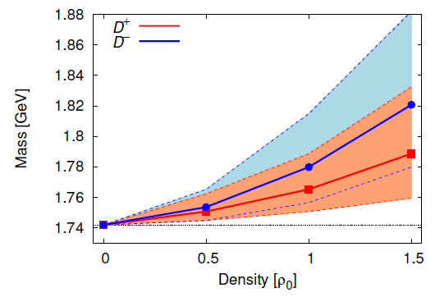
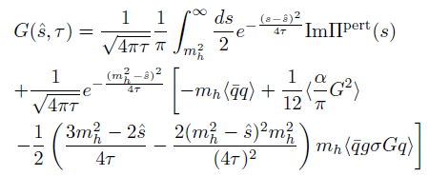
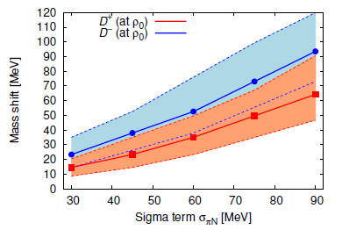
arXiv:1511.04513 : QCD sum rule +Maximal entropy method

Slide 4
Understanding the mass of a composite object
electron
quark
gluon
Nucleus
quark
quark
proton
neutron
Mass of an Atom
Nucleon: 99.95 %
electron: 0.05 %
EM binding< 0.00001 %
Nucleus
Nucleons: 99%
Nuclear binding < 1 %
Nucleon
Quark < 5 %
The rest ??
QCD
4

Slide 5
Chiral symmetry breaking for quarks
Broken phase
Vector symmetry , Massive quark
Symmetric phase
L, R symmetry, Massless quark
Spontaneous symmetry breaking: Y. Nambu (2008 NP)
NJL model → gap equation → quark mass +

Slide 6
Constituent quark mass m_{q}= 350 MeV
Nucleon 938 MeV : M_{N} =3 m_{q} + something
Charmed meson (D meson) 1870 MeV :
M_{D}= charm quark (1500MeV)+ m_{q} + something
q
c
If decreases → m_{q} will decrease → M_{D} will decrease

Slide 7
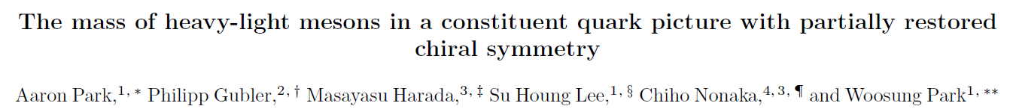
II: A simple constituent quark model for D meson
arXiv:1601.01250

Slide 8
Constituent quark model
- Applying it to D meson: a simple example including QCD effect

Slide 9
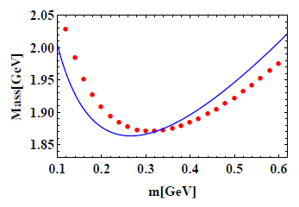
Simple quantum mechanical method – D meson
- Start from
- Use and minimize
- Minimum energy
Full Constituent quark model calculation

Slide 10
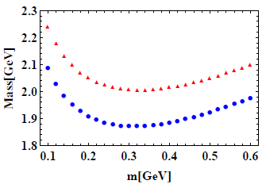
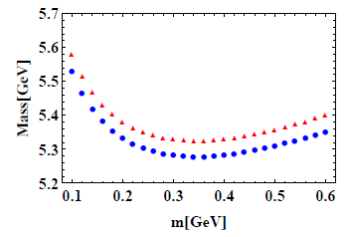
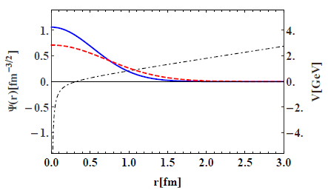
- D meson - B meson
- Wave function
M=350 MeV
M=200 MeV

Slide 11
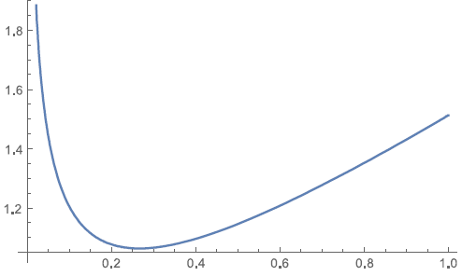
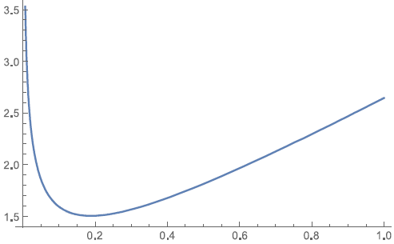
Light quark system
- H-q system
- q-q system

Slide 12
III: Consequences

Slide 13
Consequences of change in D meson mass
D Dbar production on a nuclei ?
D meson flow in heavy ion collision
Charmonium production in nuclei through anti proton reaction

Slide 14

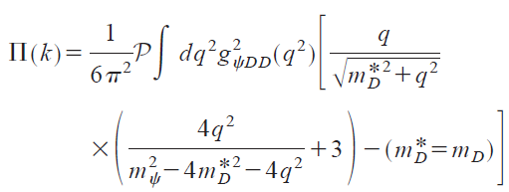
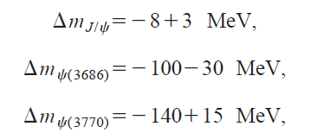
Changes in 1– system SHLee, C.M.Ko PRC67(2003)038202
2nd order Stark Effect
D Dbar loop effect
14

Slide 15
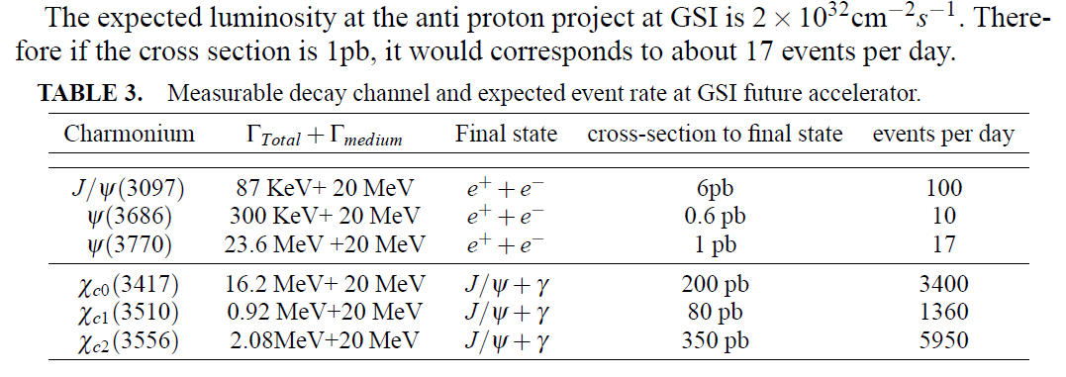
Observation of Δm through p-A reaction
Anti proton
Heavy nuclei
Can be done at J-PARC

Slide 16
Summary
1. D meson mass encodes important information on chiral symmetry breaking and confinement in QCD
D meson mass will increase in nuclear medium as shown by constituent quark model calculation and QCD sum rules
3. D meson production in nuclei
4. Charmonium production using anti proton on a nuclei

